Slide 1
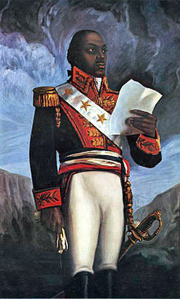
Checking Out Me History
By John Agard

Slide 2
Before we read the poem...
Discuss on your table:
Why do you think children are taught history at school?
Why do you think British history is taught across the world?
What reasons might there be to teach British children about the history of other cultures as well as British history? N.B. The new GCSE specifications will not contain literature from other cultures from 2015. Is this a good thing or a bad thing?

Slide 3
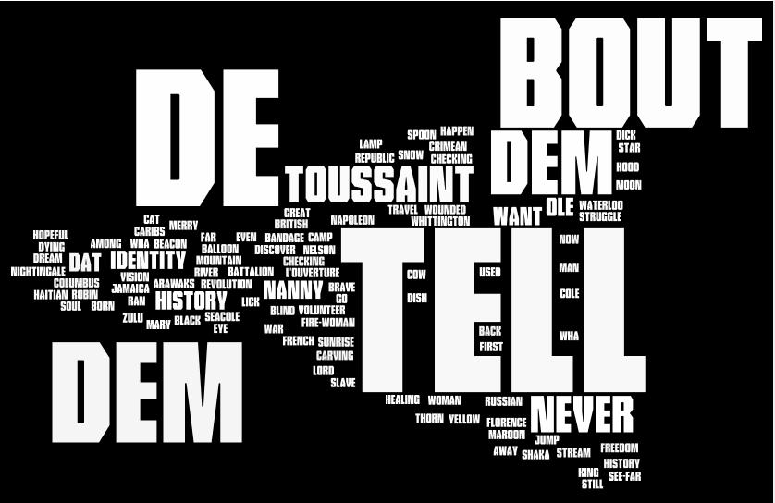
www.wordle.net
What expectations do you have of this poem?

Slide 4
Dem tell me
Dem tell me
Wha dem want to tell me
Bandage up me eye with me own history
Blind me to me own identity
Dem tell me bout 1066 and all dat
dem tell me bout Dick Whittington and he cat
But Toussaint L’Ouverture
no dem never tell me bout dat
Toussaint
a slave
with vision
lick back
Napoleon
battalion
and first Black
Republic born
Toussaint de thorn
to de French
Toussaint de beacon
of de Haitian Revolution
Dem tell me bout de man who discover de balloon
and de cow who jump over de moon
Dem tell me bout de dish ran away with de spoon
but dem never tell me bout Nanny de maroon
Nanny
see-far woman
of mountain dream
ﬁre-woman struggle
hopeful stream
to freedom river
Dem tell me bout Lord Nelson and Waterloo
but dem never tell me bout Shaka de great Zulu
Dem tell me bout Columbus and 1492
but what happen to de Caribs and de Arawaks too
Dem tell me bout Florence Nightingale and she lamp
and how Robin Hood used to camp
Dem tell me bout ole King Cole was a merry ole soul
but dem never tell me bout Mary Seacole
From Jamaica
she travel far
to the Crimean War
she volunteer to go
and even when de British said no
she still brave the Russian snow
a healing star
among the wounded
a yellow sunrise
to the dying
Dem tell me
Dem tell me wha dem want to tell me
But now I checking out me own history
I carving out me identity.
Notes:
First impressions? Tone/meaning

Slide 5
This poem is a dramatic monologue. A dramatic monologue is a piece of verse that gives the speaker a voice to EXPRESS his / her feelings to a silent audience.
In the case of ‘Checking Out Me History’, Agard’s speaker expresses a desire to learn more about his / her own country of origin, not just the British history s/he has been taught in school. Agard himself was born in Guyana in South America in 1949 (a British colony until 1966) and moved to England in 1977.
The three separate italicised stanzas in the poem tell of the achievements of West Indian heroes.
The rhythm and pace of the poem give a light-hearted feel despite the serious subject. This is typical of John Agard’s poems.

Slide 6
Checking out the ‘other’ history
In the poem, John Agard mentions several significant figures (or peoples) whom he feels have been overlooked in History:
Toussaint L’Ouverture
Nanny de maroon
Shaka ‘de great Zulu’ warrior
Arawaks and Caribs
Mary Seacole.
Use the prompt cards on each topic to begin your research. Each card has some questions and activities to get you started, but you can add to this as your research progresses.
Your presentation is due next lesson.

Slide 7
Toussaint L’Ouverture
The leader of the Haitian Revolution, Toussaint L’Ouverture transformed the lives of many slaves when he turned their society into the independent black state of Haiti. This shook slavery throughout the ‘New World’ (the Americas).
L’Ouverture is the French word for ‘opening’., which might link to the fact that he opened the lives of many.

Slide 8
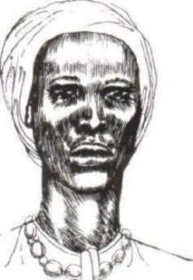
Nanny of the Maroons
A Jamaican national hero, Queen Nanny was a leader of the Jamaican Maroons in the eighteenth century, The Jamaican Maroons were black slaves who fought against their plantation work, and they formed new homes and communities in other areas.
Nanny originally fled her life as a slave and she started many of the escaped slaves’ communities.

Slide 9
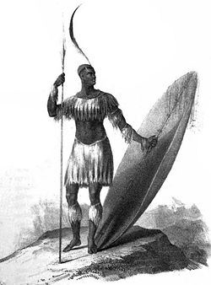
Shaka, Zulu King
Shaka was a strong leader of the Zulu Kingdom, which lived in Southern Africa.
Shaka is famous for bringing together different nations in order to grow the Zulu Kingdom, but he has also been recognised for his violence.

Slide 10
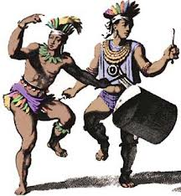
The Caribs
The people who the Caribbean is named after. They live on the Northern coast of South America.
The Caribs often made raids on other groups, which means that they grew.

Slide 11
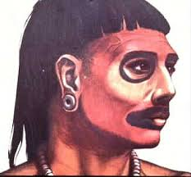
Arawak people
One of the tribes of the Caribbean. They have many different cultures. They live by growing crops, and many of the women do the craft work.

Slide 12
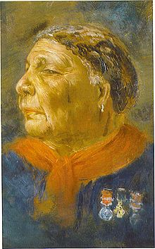
Mary Seacole
A Jamaican born woman who set up a ‘British Hotel’ behind the lines during the Crimean War. She was voted, in 2004, the greatest black Briton.
She learnt much about herbal medicine in the Caribbean, and she used this knowledge to help the wounded from the battlefield.
In 2012, reports stated that she would be removed from the National Curriculum.

Slide 13
What they don’t teach you: ‘Checking Out Me History’
Read the poem carefully and make two lists. In the first column, write down what the speaker says he learnt about. In the second column, list things he said he didn’t learn about.
1. ‘Dem tell me bout…’ | 2. ‘dem never tell me bout…’
1066 and all dat
Now look again at the list in the first column. Some of the things are (a) matters of historical fact while others are (b) fictional stories or nursery rhymes. Using two different colours, shade the boxes to show whether what the speaker learned was history or fiction.

Slide 14
If the speaker wasn’t taught about these things, how did s/he find out about them? Find a quotation to support your ideas.

Slide 15
Plosive ‘b’ sound = resentment
Who does ‘dem’ refer to?
Why do ‘dem want to tell me’ this version of history?
‘dem tell me’ is repeated throughout the poem
Dem tell me
Dem tell me
Wha dem want to tell me
Bandage up me eye with me own history
Blind me to me own identity
Dem tell me bout 1066 and all dat
dem tell me bout Dick Whittington and he cat
But Toussaint L’Ouverture
no dem never tell me bout dat
Irony: bandages should heal but here they harm/prevent a connection with the narrator’s cultural past
Set apart to emphasise the reason for the poet’s indignation
Reference to a satirical account of British history
This statement precedes the description of the heroes the narrator feels should also be celebrated

Slide 16
½ rhymes: (vision/Napoleon/battalion/de thorn/beacon/Revolution) suggest a chant/a proclamation of achievement
The layout and broken sentence structure forces the rhythm to slow down:
the reader pauses over almost every word – stresses their importance
suggests the poem is meant to be spoken aloud
as if the narrator is recounting a memory
Toussaint
a slave
with vision
lick back
Napoleon
battalion
and first Black
Republic born
Toussaint de thorn
to de French
Toussaint de beacon
of de Haitian Revolution
Repetition of ‘Toussaint’ emphasises the importance of his name
Slang term: suggests this was an ‘easy’ victory for him
Strong rhyme with powerful words contrasts with the childish cat/dat moon/spoon when referring to taught history
Difficult to remove (is the narrator just referring to the French here?)
A guiding light/inspiration/symbol of hope and courage

Slide 17
Dem tell me bout de man who discover de balloon
and de cow who jump over de moon
Dem tell me bout de dish ran away with de spoon
but dem never tell me bout Nanny de maroon
‘oon’ - incredulity
Frequent rhymes:
‘me’ ‘history’ ‘identity’ – voice of protest
When performed, these are stressed forcefully
Dialect:
Use of Caribbean Creole reflects his pride in his background; your accent and speech is part of your heritage and identity

Slide 18
Mystical images: suggest she can see the future; is a revolutionary who can look ahead and change things
Nanny
see-far woman
of mountain dream
ﬁre-woman struggle
hopeful stream
to freedom river
Dem tell me bout Lord Nelson and Waterloo
but dem never tell me bout Shaka de great Zulu
Dem tell me bout Columbus and 1492
but what happen to de Caribs and de Arawaks too
Dem tell me bout Florence Nightingale and she lamp
and how Robin Hood used to camp
Dem tell me bout ole King Cole was a merry ole soul
but dem never tell me bout Mary Seacole
Told in fragments: this story is not linear and complete – creates a sense of mystery, a puzzle
Faith and optimism
Echoes rhythm of the nursery rhyme (trivial; light hearted)

Slide 19
Why might the poet have used italics for these stanzas?
From Jamaica
she travel far
to the Crimean War
she volunteer to go
and even when de British said no
she still brave the Russian snow
a healing star
among the wounded
a yellow sunrise
to the dying
Admiration for her defiance
A shining example of light and hope
References ‘the yellow doctress’ from her autobiography; this is also her effect on the dying men she treated

Slide 20
Link to lines 1-3 of stanza 1 (lines 2/3 are combined: a sense of impatience?)
Dem tell me
Dem tell me wha dem want to tell me
But now I checking out me own history
I carving out me identity.
His new intention
Active word: he is deciding to read, question and discover; he is no longer passive
To carve is to create something enduring
Sense of triumph – he has learned
His heritage will help create his identity

Slide 21
The poet uses examples from British nursery rhymes as well as real life figures to stress the trivial nature of what he has been taught when compared to the accomplishments of his chosen figures. He is undermining British history: why? Is it relevant? To whom?
How does the speaker feel about his identity?

Slide 22
Metaphor mapping: ‘Checking Out Me History’
1. Create a metaphor map, using the metaphors below, annotating each one with any connotations or associations the word has for you.
thorn beacon healing star hopeful stream yellow sunrise
shining
A fire, warning of an enemy’s approach
2. Now match each metaphor to the characters in the poem. Explain how imagery is used to present each of these characters.
beacon
Like a lighthouse

Slide 23
1. Are all these images positive? Highlight any that seem to have potentially negative connotations. Can you explain why the poet might have included such metaphors?
2. Why do you think the poet uses metaphors to describe the figures in his ‘own history’, and not to describe what ‘dem tell’ him?

Slide 24
Complete the worksheet on this poem.

Slide 25
Agree or disagree? ‘Checking Out Me History’
Strongly agree
Agree
Don’t know
Disagree
Strongly disagree
The speaker is angry that Black culture and history has been neglected.
The speaker implies that the history he has been taught is a fiction.
The poem makes clear that cultural transmission (the passing on of knowledge about culture and history) starts at a very early age.
The poet values the qualities of independence and courage.
The poet is careful to use humour to make his point in a non-threatening way.
The poem suggests that the process of education involves passive people being bombarded with information by those who have power and/or authority.
The poem can be interpreted as encouraging self-empowerment and pride in one’s culture.
The poem equates identity with knowledge of your own cultural and racial roots.

Slide 26
It’s time to summarise! We’re going to make a note of the poem’s VITALS.

Slide 27
Poetry VITALS…
Voice: Who is speaking in the poem?
Imagery: What imagery is being created? How is it effective?
Theme: What are the main themes featured in the poem?
Address: Who is the poem addressed to? Why?
Language (Features): What type of language/ devices are used?
What is their effect?
Structure: How is the poem laid out? What is the effect of this?
Notes:
This is the acronym that we will use on each poem to look at all the different aspects

