Slide 1
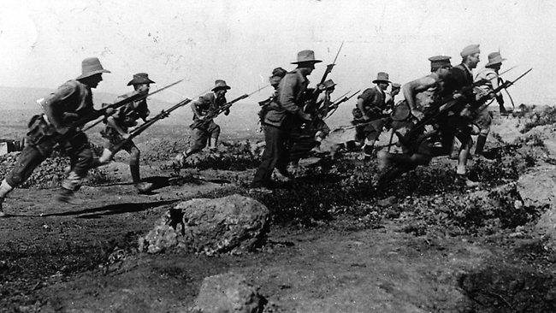
Bayonet Charge
By Ted Hughes

Slide 2
Learning Objective To understand the context and subject matter of the poem.

Slide 3
The poem focuses on a nameless soldier in the First World War (1914-18).
It describes the experience of 'going over-the-top'. This was when soldiers hiding in trenches were ordered to 'fix bayonets' (attach the long knives to the end of their rifles) and climb out of the trenches to charge an enemy position twenty or thirty metres away. The aim was to capture the enemy trench. The poem describes how this process transforms a soldier from a living thinking person into a dangerous weapon of war.

Slide 4
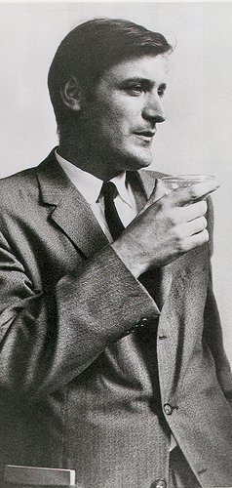
Who wrote it?
Ted Hughes (1930-1998) was born in Yorkshire, in the North of England, and grew up in the countryside. After serving in the RAF for two years, he won a scholarship to Cambridge University.
He made his name as a poet in the late 1950s and 1960s and also wrote many well-known children's books including The Iron Man (which was filmed as the Iron Giant). He was poet laureate from 1984 until his death from cancer in 1998.

Slide 6
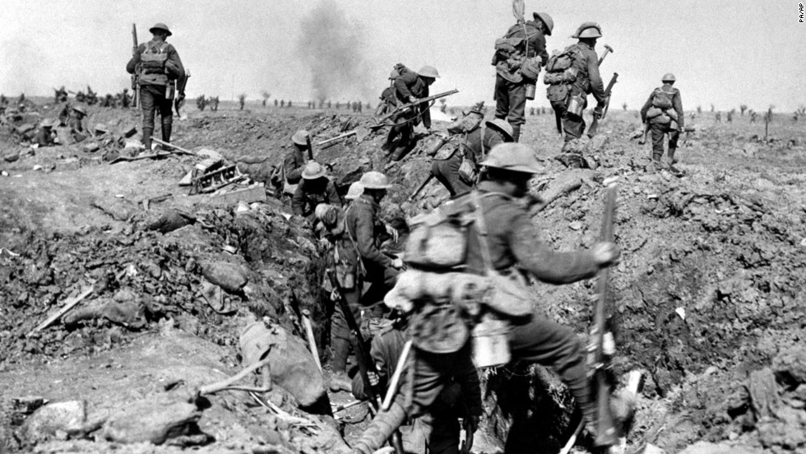
Let’s think about WWI...
What do you know?

Slide 7
For each of the following images, questions or ideas, write down your response...

Slide 8
Why serve in the Army?

Slide 9
Why do soldiers go into battle?

Slide 10
What goes through a soldier’s mind as they charge forward?

Slide 11
Consider a moment, frozen in time... What is the soldier thinking?

Slide 12
What are his reasons for fighting now?

Slide 13
Why does he keep running forward?

Slide 14
On your sheet, you have a collection of words from the poem. Sort these into as many categories as you can, e.g. colour, movement, emotion, names, violence, descriptions, abstract ideas… Try dividing your page into boxes and write the words into these.

Slide 15
air alarm arm awoke bayonet belly bewilderment blue brimmed bullets centre charge chest circle clockwork clods cold crackling crawled dark dazzled dignity dropped dynamite eye field fire flame foot footfalls furrows green hand hare hearing heavy hedge honour hot human hung iron jumped khaki king listening lugged luxuries man mid-stride molten mouth nations numb past patriotic plunged pointing raw raw-seamed reason rifle rolled running runs second shot-slashed silent smacking smashed standing stars statuary still stopped stumbling suddenly sweat sweating tear terror threshing threw touchy wide yelling yellow

Slide 16
Based on this, what emotions might you expect to find in this poem?

Slide 17
Let’s read the poem...
http://www.youtube.com/watch?v=JuCDjyCysAY

Slide 18
Put this summary in order... The soldier sees an injured hare. The soldier nearly stops running. The soldier charges at an enemy hedge. The soldier continues running because he is frightened.

Slide 19
Stanza one
How does the soldier feel as he wakes?
What physical state is he in?
How does he feel as he stumbles across the field?
What does he think as he hears the bullets?
What happened to the tear in his eye?
Stanza two
What makes him hesitate and nearly stop?
What is he thinking about at this point?
How has instinct taken over?
Stanza three
Why does he notice the hare?
What does it make him think about?
What does he think as he charges towards the green hedge?
Why does he scream?
Interpreting the poem

Slide 20
Learning Objective To explore how the writer uses theme, language and structure to present the battle.

Slide 21
What is ‘Bayonet Charge’ about?
Look at these brief descriptions. Put three of them together in a way that you think best sums up the poem. You could replace ‘he’ with ‘a soldier’ in any of the sentences.
He almost forgets why he is running.
He feels terrified but he manages to carry on.
He is bewildered and almost stops.
He is hot and sweaty.
He is running towards the enemy lines as part of an attack.
He no longer feels patriotic.
He runs across No Man’s Land towards the enemy trenches.
He rushes on, desperate to get out of the bullets.
He wonders why he is doing it.

Slide 22
Suddenly he awoke and was running – raw
In raw-seamed hot khaki, his sweat heavy,
Stumbling across a field of clods towards a green hedge
That dazzled with rifle fire, hearing
Bullets smacking the belly out of the air –
He lugged a rifle numb as a smashed arm;
The patriotic tear that had brimmed in his eye
Sweating like molten iron from the centre of his chest, –
In bewilderment then he almost stopped –
In what cold clockwork of the stars and the nations
Was he the hand pointing that second? He was running
Like a man who has jumped up in the dark and runs
Listening between his footfalls for the reason
Of his still running, and his foot hung like
Statuary in mid-stride. Then the shot-slashed furrows
Threw up a yellow hare that rolled like a flame
And crawled in a threshing circle, its mouth wide
Open silent, its eyes standing out.
He plunged past with his bayonet toward the green hedge,
King, honour, human dignity, etcetera
Dropped like luxuries in a yelling alarm
To get out of that blue crackling air
His terror’s touchy dynamite.
TED HUGHES
Bayonet Charge

Slide 23
What is the impact of the adverb ‘suddenly’ as the first word of the poem?
It says, ‘he awoke’. What does this show about the soldier?
Suddenly he awoke and was running – raw
In raw-seamed hot khaki, his sweat heavy,
This has a double meaning: discomfort but also inexperience
The alliteration here creates a repeated ‘h’ sound. What sound might this echo? [Hint: the soldier is running.]
What is the impact of the dash? Think about the pace of the line as well as the action of ‘running’...

Slide 24
Stumbling across a field of clods towards a green hedge
That dazzled with rifle fire, hearing
Bullets smacking the belly out of the air –
He lugged a rifle numb as a smashed arm;
Highlight or list any words which suggest that the soldier is struggling to run and carry his rifle.

Slide 25
Violent imagery and onomatopoeia describes the sound and impact of the shots.
Stumbling across a field of clods towards a green hedge
That dazzled with rifle fire, hearing
Bullets smacking the belly out of the air –
He lugged a rifle numb as a smashed arm;
What does Hughes personify here?
What does this simile suggest about his rifle? About what might happen to him?

Slide 26
Hughes uses the word ‘patriotic’. What does this suggest about the soldier’s reasons for enlisting?
The patriotic tear that had brimmed in his eye
Sweating like molten iron from the centre of his chest, –
Why has Hughes used this simile? What does it suggest about the soldier?

Slide 27
How does Hughes use punctuation to show the soldier’s hesitation?
In bewilderment then he almost stopped –
In what cold clockwork of the stars and the nations
Was he the hand pointing that second?
Hughes uses the metaphor of a clock. What is the soldier questioning?
Why is the clockwork ‘cold’?

Slide 28
This simile creates an image of someone blind and irrational – what does this suggest about war?
He was running
Like a man who has jumped up in the dark and runs
Listening between his footfalls for the reason
Of his still running, and his foot hung like
Statuary in mid-stride. Then the shot-slashed furrows
It’s as if the soldier is turned to stone by his bewilderment.
Caesura ends his period of thought and returns him to the action/his reality.
What other technique does Hughes use to throw the reader back into the action?

Slide 29
The yellow hare is compared to a flame. What technique is this? What it its effect?
Threw up a yellow hare that rolled like a flame
And crawled in a threshing circle, its mouth wide
Open silent, its eyes standing out.
A distressing image of out of control movement. A ‘threshing circle’ is an agricultural term, suggesting that nature too is affected by war.
Suggests pain and fear beyond expression.
Who else is silent?
a. Underline grotesque details about the hare.
b. Why has Hughes used this image of the hare? What do you think it represents?

Slide 30
Which word shows that the soldier is pushing forwards, despite his fear?
He plunged past with his bayonet toward the green hedge,
King, honour, human dignity, etcetera
Dropped like luxuries in a yelling alarm
To get out of that blue crackling air
His terror’s touchy dynamite.
What are the four reasons listed for enlisting?
What is the effect of ‘etcetera‘ at the end of the list?
Hughes uses the simile, ‘dropped like luxuries’. What does this suggest about the soldier’s original reasons for enlisting?
In the final two lines, what is the soldier’s real motivation?

Slide 31
Form, structure and tone: ‘Bayonet Charge’
Punctuation
The ways in which Hughes has used punctuation to alter the pace of the poem are interesting in that the punctuation intensifies the soldier’s experience for the reader.
Read the poem aloud around the class, with individuals stopping after each punctuation mark.
How does the punctuation affect the pace of the poem? Why is this significant?

Slide 32
Form, structure and tone: ‘Bayonet Charge’
The poem uses enjambment and caesura and has lines of uneven length. This creates an irregular rhythm, which mirrors the soldier struggling to run through the mud. The narrator uses the pronoun ‘he’, rather than naming the soldier, to keep him anonymous. It suggests he is a universal figure who could represent any young soldier.
The poem starts in media res (in the middle of the action) and covers the soldier’s movements and thoughts over a short space of time. The first stanza sees the soldier acting on instinct, but time seems to stand still in the second stanza when the soldier begins to think about his situation. In the final stanza, he gives up his thoughts and ideal and seems to have lost his humanity.

Slide 33
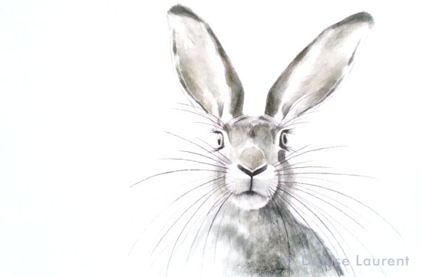
In the ‘fight or flight situation’ in which he is placed, the soldier is caught up in his own world and is torn between his obligation to fight and his need to survive. However, in stanza three, the poet moves away from the soldier’s experience into describing an injured hare.
What do you associate with hares?
What do you find interesting about the language that Hughes has used to describe the hare?
What do you think the hare represents to the soldier?
How important is the image of the hare to your understanding of the poem? Would the poem be as effective without it?
The Hare

Slide 34
Hughes has used a variety of images in the poem to convey a visual impression of the soldier and his experiences. The following examples are all similes.
He lugged a rifle numb as a smashed arm
The patriotic tear that had brimmed in his eye/ Sweating like molten iron from the centre of his chest
his foot hung like/ Statuary in mid-stride
the shot-slashed furrows/ Threw up a yellow hare that rolled like a flame
King, honour, human dignity, etcetera/ Dropped like luxuries in a yelling alarm
Imagine that a film company wants to produce a short film to accompany a reading of the poem. The film could either be an animation or a live-action film. You have been asked to design a storyboard of up to nine frames.
Re-read the poem and identify the key moments.
Think carefully about how you will present each moment visually – will the shot show the image through the soldier’s eyes? How will you convey his fear? How will you represent the imagery in the poem?
Sketch out your storyboard.
Underneath each of the frames, include the sound effects or music that you would need to accompany the reading of the poem and the type of shot used for each image. For example, Close Up (CU), Medium Shot (MS), Long Shot (LS), Extreme Close Up (ECU).

Slide 35
It’s time to summarise! We’re going to make a note of the poem’s VITALS.

Slide 36
Poetry VITALS…
Voice: Who is speaking in the poem?
Imagery: What imagery is being created? How is it effective?
Theme: What are the main themes featured in the poem?
Address: Who is the poem addressed to? Why?
Language (Features): What type of language/ devices are used?
What is their effect?
Structure: How is the poem laid out? What is the effect of this?
Notes:
This is the acronym that we will use on each poem to look at all the different aspects

Slide 37
Q
Your response should link back to the focus of the question, using key words in your topic sentences.
W
WRITER
E
Use evidence from the text to support your ideas. Your quotations should be ______________ and you should remember to use _______________ ______
R
Consider what effect the text/ events/ issues will have on the reader and what reaction the writer is trying to achieve.
T
Identify the specific choices that the writer has made to achieve his/ her purpose.
Y
Explore your own ideas and reaction to the text. Consider different ways of interpreting the text and its ideas

Slide 38
Q
How does the poet present war as dramatic in ‘Bayonet Charge’?
W
I’m going to use the question to write my first sentence…
I’m going to use the poet’s name
E
R
T
One of the ways Hughes presents war in ‘Bayonet Charge’ is by making it seem dramatic.
Y

Slide 39
Q
How does the poet present war as dramatic in ‘Bayonet Charge’?
W
One of the ways Hughes presents war in ‘Bayonet Charge’ is by making it seem dramatic.
E
I need to back up my point by using a short, precise quotation…
Hughes starts the poem by writing, ‘Suddenly he awoke’.
R
T
Y

Slide 40
Q
How does the poet present war as dramatic in ‘Bayonet Charge’?
W
One of the ways Hughes presents war in ‘Bayonet Charge’ is by making it seem dramatic. Hughes starts the poem by writing, ‘Suddenly he awoke’.
E
What choice has Hughes made? I need to identify a specific technique…
The word ‘Suddenly’ is an adverb, showing that something is happening quickly and unexpectedly.
R
T
Y

Slide 41
Q
How does the poet present war as dramatic in ‘Bayonet Charge’?
W
One of the ways Hughes presents war in ‘Bayonet Charge’ is by making it seem dramatic. Hughes starts the poem by writing, ‘Suddenly he awoke’. The word ‘Suddenly’ is an adverb, showing that something is happening quickly and unexpectedly.
E
R
This shows the reader how unpredictable war is because things happen when you don’t expect them and when you’re not prepared for them.
T
Y

Slide 42
Q
How does the poet present war as dramatic in ‘Bayonet Charge’?
W
One of the ways Hughes presents war in ‘Bayonet Charge’ is by making it seem dramatic. Hughes starts the poem by writing, ‘Suddenly he awoke’. The word ‘Suddenly’ is an adverb, showing that something is happening quickly and unexpectedly. This shows the reader how unpredictable war is because things happen when you don’t expect them and when you’re not prepared for them.
E
R
T
Hughes is showing the reader how frightening war is and makes me feel sorry for the soldiers: I can imagine their fear and panic.
Y

Slide 43
Q
How does the poet present war as dramatic in ‘Bayonet Charge’?
W
One of the ways Hughes presents war in ‘Bayonet Charge’ is by making it seem dramatic. Hughes starts the poem by writing, ‘Suddenly he awoke’. The word ‘Suddenly’ is an adverb, showing that something is happening quickly and unexpectedly. This shows the reader how unpredictable war is because things happen when you don’t expect them and when you’re not prepared for them. Hughes is showing the reader how frightening war is and makes me feel sorry for the soldiers: I can imagine their fear and panic.
E
R
T
Y

Slide 44
Q
How does the poet present war as dramatic in ‘Bayonet Charge’?
W
One of the ways Hughes _____________________
________________________________________. Hughes makes it seem as though war is tiring and the soldier is out of breath. He does this using the punctuation mark _____ in the line, “___________
________________________________________”
The ________ makes the reader think __________
_________________________________________________________________________________.
It also suggests to me _______________________
__________________________________________________________________________________
E
R
T
Y

Slide 45
Q
How does the poet present war as dramatic in ‘Bayonet Charge’?
W
One of the ways Hughes makes war seem dramatic is by using the word, “raw”.
This word has connotations of ________________
__________________________________________________________________________________
It suggests to the reader that _________________
__________________________________________________________________________________It also makes me think ______________________
__________________________________________________________________________________
E
R
T
Y

