Slide 1
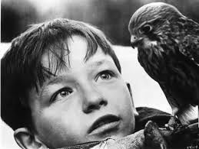
‘A Kestrel for a Knave’

Slide 2
What do the covers suggest to you about the themes and content of this classic novel?

Slide 3
‘A Kestrel for a Knave’ Barry Hines
‘A Kestrel for a Knave’ tells the story of a day in the life of Billy Casper. The story is written in the third person, but there is little doubt that we are encouraged to look through Billy’s eyes. The setting is South Yorkshire in the 1960s – probably Barnsley – though Hines never names places. We know the town is in a mining area: Billy’s brother Jud works down the pit, a fate that Billy wants to avoid, but the reader feels that inevitably he will not succeed. For boys like Billy, there was little else available.
The novel has several flashbacks that move away from the action of the day and fill in gaps from the past, such as how Billy came by Kes and trained her.
Billy lives with his feckless mother, Mrs Casper, and his brutal brother, Jud. It is not a loving home and Billy is not well provided for. He does, however, have his kestrel, Kes; she is the centre of his life and he dedicates all his time and efforts to her.

Slide 4
This is the first GCSE English Language Paper you will complete

Slide 5
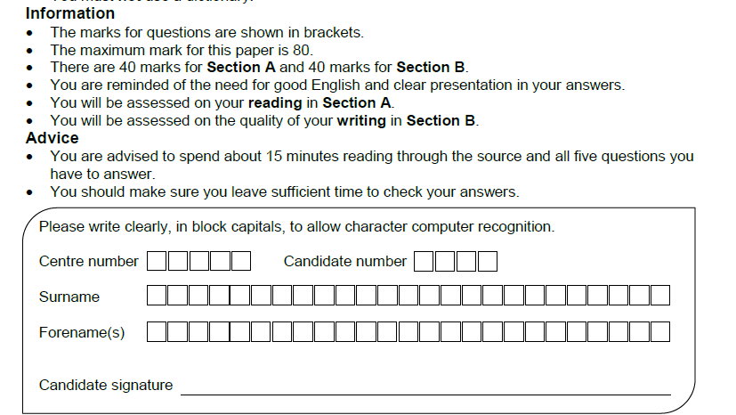

Slide 6
SECTION A: READING
4 marks
Read the text
Q1
Q2
Q3
Q4
20 marks
8 marks
8 marks

Slide 7
AO1: Identify and interpret explicit and implicit information and ideas.
Select and synthesise evidence from different texts.
AO2: Explain, comment on and analyse how writers use language to achieve effects and influence readers, using relevant subject terminology to support their views

Slide 8
What do you think you should read first in the exam?
The extract?
The questions?

Slide 9
Q3: You now need to think about the whole of the source. The text is from the opening of a novel. How has the writer structured the text to interest you as a reader?
You could write about:
• what the writer focuses your attention on at the beginning
• how and why the writer changes this focus as the extract develops
• any other structural features that interest you. (8 marks)
Q2: Look in detail at the extract from line 17 to line 50. How does the writer use language here to present the relationship between the two brothers, Billy and Jud? You could include the writer’s choice of:
• Words and phrases
• Language features and techniques
• Sentence forms
• The use of direct speech (8 marks)
Q1 Read again the first part of the source, lines 1- 17
List four things you learn about Billy (4 marks)

Slide 10
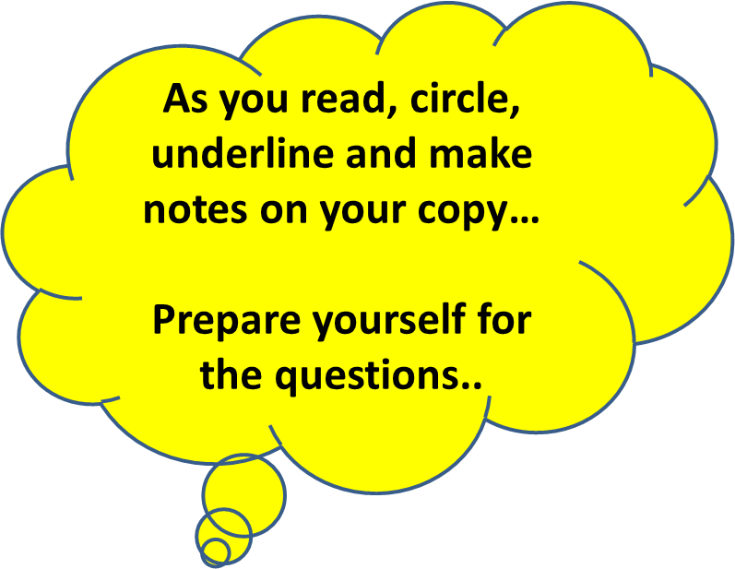
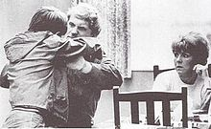
Let’s read…

Slide 11
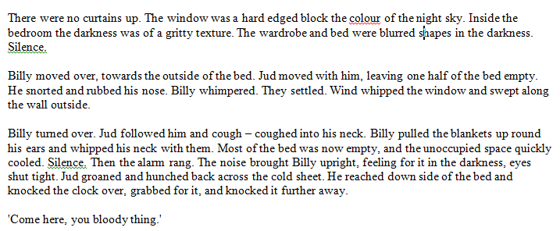
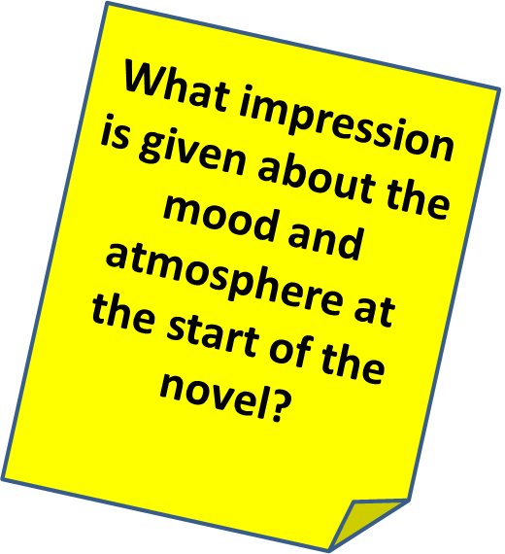
Q1 Read again the first part of the source, lines 1- 17
List four things you learn about Billy (4 marks)

Slide 12
Bonus Question!
Read the extract from Great Expectations…
Q1 Read again the first part of the source, lines 1- 13
List four things you learn about Pip (4 marks)

Slide 13
What is this passage about?
What do we learn about the characters and their family life?

Slide 14
Q2: Look in detail at the extract from line 17 to line 50
How does the writer use language here to present the relationship between the two brothers, Billy and Jud? (8 marks)
You could include the writer’s choice of:
Words and phrases
Language features and techniques
Sentence forms
The use of direct speech

Slide 15
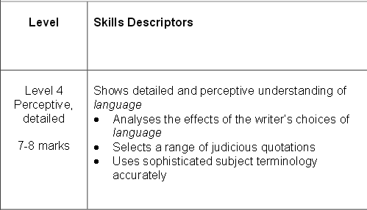
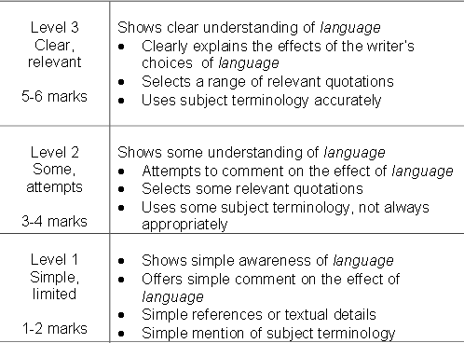
And what about the highest marks- what do you need to do?
What should you do to aim higher?
What are the key words?

Slide 16
One of the ways Hines presents the relationship is.. Another way the writer shows there relationship ... The writer suggests... The writer presents Billy as …
Q
}
W
E
This is shown when it says, “___”...
An example of this is when Hines writes, “___”...
For example, “___”
R
This makes the reader think...
This suggests to the reader... The reader will think... This implies... This suggests...
T
The use of adjectives... The use of the verbs...The repetition of... This word has strong connotations of...
Y
This suggests... This implies... This links to...

Slide 17
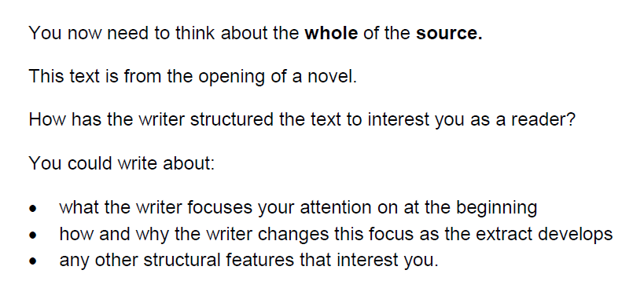
Q3: You now need to think about the whole of the source

Slide 18
What is structure?
Structure

Slide 19
Beginnings and Endings
Where are we placed?
What emotion is triggered?
What thought is offered?
What direction is set?
What do we walk away with?
What are we left to consider?
Have we journeyed somewhere or stayed in the same place?

Slide 20
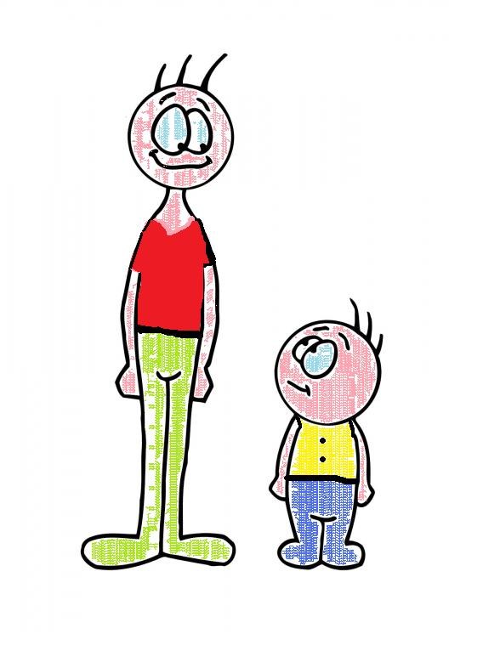
Contrast
Are there any opposites that are placed side by side for emphasis?
Is there any contrast between a character, place or idea at one point in the poem and then later? (the before/after effect)

Slide 21
Central images, ideas, settings
Is the text structured around a central image or idea?
This image may be described in great detail. Perhaps an extended metaphor or symbol.
Or perhaps the setting is the key thing that provides a structure for the writer to develop his/her ideas?

Slide 22
Distinct sections /
Pivotal moments
Is it clear that there are sections to this text that have been chosen by the writer on purpose?
What do each of these sections reveal / represent?
Is there a pivotal moment, a hinge, that seems to move the ideas in a new direction?

Slide 23
Build up of ideas, image, feeling
What is the build up?
Where is it heading?
What grows over the course of the text?
How does it grow?

Slide 24
Passages of time
How is time presented in the text?
Present tense, past tense?
Days, weeks, years?
History, present day, future?

Slide 25
Movement (sentence types / punctuation)
What about sentence types? Are there many short ones? Long ones? A ‘stand out’ short or long sentence that marks something. Simple vs complex?
Look at the punctuation. Why does it stop where it does?
Are commas used to make lists – this may speed things up.
Does it seem ‘choppy’ or more smooth? What punctuation is creating that effect?

Slide 26
Voice
Who is speaking? What perspective are we offered? Who is the voice talking to?
Is there more than one voice? Is the tone the same or different?
Why are they speaking? Can they be trusted?
Is it first, second, third person? What’s the impact?
Is there any direct speech? What is the effect of this?

Slide 27
What is structure?
The writer chose a structure and form on purpose – it has meaning.
The examiner is not interested in a list of techniques – you need to make meaningful connections. Why has the writer chosen this technique?

Slide 28
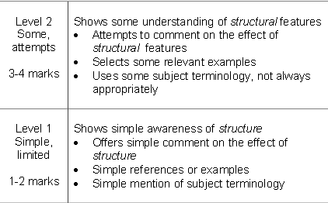
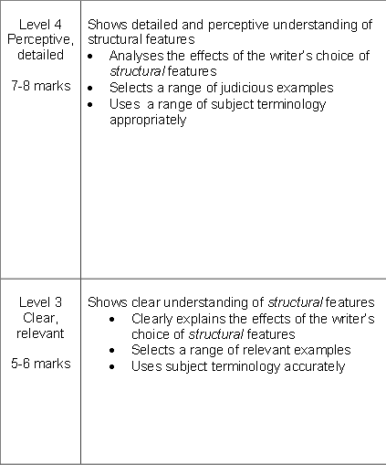
What are the key words?
What does the examiner want you to do?

Slide 29
One of the ways Hines structures the chapter is... The opening sentence/ paragraph is... The writer begins by telling us about... Another structural point is … At the start of the extract we are told..
Q
}
W
E
This is shown when it says, “___”...
An example of this is when Hineswrites, “___”...
For example, “___”
R
This makes the reader think...
This suggests to the reader... The reader will think... This implies... This suggests...
T
The opening sentence… The writer uses repetition to…The use of the paragraphs ...The repetition of... This setting… The use of time…The shift in focus from…to… The use of the direct speech...
Y
This links to ... This connects to ... This builds an atmosphere of...

