Slide 1
Learning Objective To study Chapter 6 of the novel

Slide 2
Learning Objective: To study Chapter 6 of the novel

Slide 3
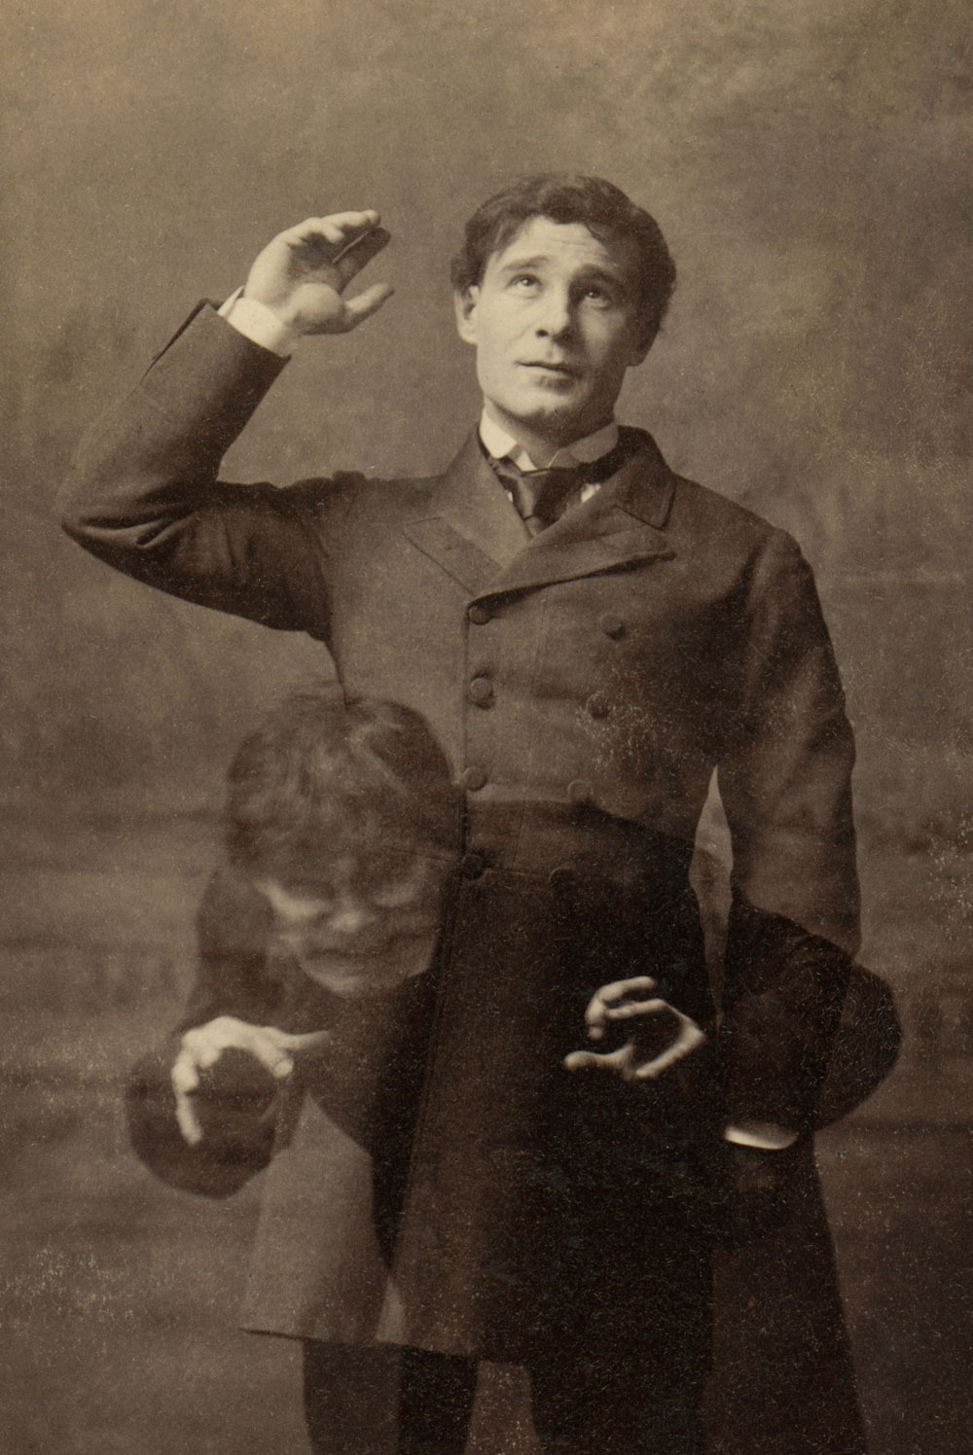
Learning Objective: To study Chapter 6 of the novel
The change in Dr Lanyon
Chapter 2:
‘This was a hearty, healthy, dapper, red-faced gentleman, with a shock of hair prematurely white, and a boisterous and decided manner. At sight of Mr. Utterson, he sprang up from his chair and welcomed him with both hands. The geniality, as was the way of the man, was somewhat theatrical to the eye; but it reposed on genuine feeling.’
Chapter 6:
‘He had his death-warrant written legibly upon his face. The rosy man had grown pale; his flesh had fallen away; he was visibly balder and older; and yet it was not so much these tokens of a swift physical decay that arrested the lawyer’s notice, as a look in the eye and quality of manner that seemed to testify to some deep-seated terror of the mind.’

Slide 4
Learning Objective: To study Chapter 6 of the novel
The change in Dr Lanyon
What contrasts does Stevenson make in these two extracts?
Consider:
adjectives describing Lanyon’s appearance
his manner in the two extracts
his feelings

Slide 5
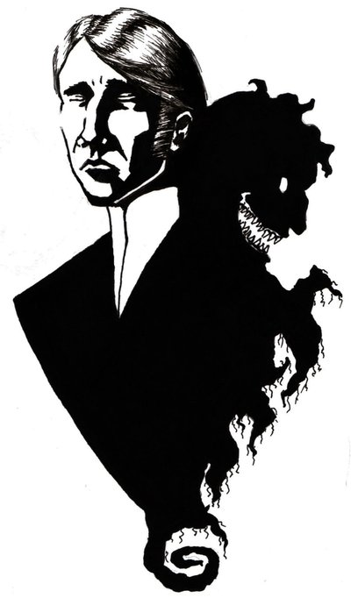
Learning Objective: To study Chapter 6 of the novel
Jekyll also changes (again!) in this chapter – he starts a new life, socialising with friends, supporting charities and practising religion… then suddenly withdraws from society and refuses to see anyone.
‘Utterson was amazed; the dark influence of Hyde had been withdrawn, the doctor had returned to his old tasks and amities; a week ago, the prospect had smiled with every promise of a cheerful and an honoured age; and now in a moment, friendship, and peace of mind, and the whole tenor of his life were wrecked. So great and unprepared a change pointed to madness; but in view of Lanyon’s manner and words, there
must lie for it some deeper ground.’

Slide 6
Learning Objective: To study Chapter 6 of the novel
‘I have brought on myself a punishment and a danger that I cannot name. If I am the chief of sinners, I am the chief of sufferers also.’
Victorian readers would have recognised these references to a ‘disgrace’ and a ‘punishment brought on myself’ as a hint at sexual misbehaviour but, of course, Stevenson is misleading his readers here.
He deliberately leaves details open to a range of interpretations to sustain a sense of mystery and tension.
AO3: In the c19^{th,} respectable people did not discuss sexuality or sexual behaviour. Homosexuality was against the law; visits to prostitutes were common; venereal disease was rampant. Syphilis was a particularly widespread problem, for which there was no cure. It badly disfigured its sufferers. Some religious people and medical professionals believed it was a punishment for immoral behaviour.

Slide 7
Learning Objective: To study Chapter 6 of the novel
Key Theme: Secrets and Sin
Look at the following information. What do these details suggest to you about the secret lives of the characters? [Hint: remember that Stevenson deliberately leaves things open to a range of interpretations.]
Respectable men such as Mr Enfield and Sir Danvers Carew are found in odd places in London at the dead of night.
Crime or involvement in illicit sexual behaviour
Sexually transmitted disease or professional misdemeanour
Actions against the Christian moral code of behaviour
A suggestion of shame or fear that he is a danger to others
Lanyon, who is a doctor, knows a dreadful secret about Jekyll.
Jekyll writes to Utterson that he has brought on himself a punishment and a danger that he cannot name. He describes himself as ‘the chief of all sinners’.
Jekyll punishes himself by cutting himself off from the outside world.

Slide 8
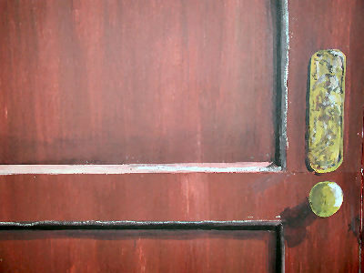
Learning Objective: To study Chapter 6 of the novel
The theme of secrets or concealment is important in all mystery stories. Stevenson uses imagery of doors, locks and safes to suggest that the characters are hiding the truth.
Homework:
1. List all the examples you can find where doors, locks and safes are mentioned in Chapters 1-5.
2. Re-read Chapter 6 and note down any references to:
Openness and confinement
Closed or locked doors
Sealed documents
Safe places
3. Finish this sentence: ‘Stevenson uses the symbolism of locked doors and sealed documents to suggest…’

