Slide 1
Learning Objective To study Chapter 2 of the novel

Slide 2
Learning Objective: To study Chapter 2 of the novel
Past Exam Question:
Part (a)
How does Steinbeck use details in this passage to present the bunkhouse and its inhabitants?
and then Part (b)
In the rest of the novel, how does Steinbeck present the lives of ranch workers at that time?
We’re going to have a go at answering part (a) of this exam question (we’ll worry about part (b) later).
Bear that in mind as we complete the study questions on it!

Slide 3
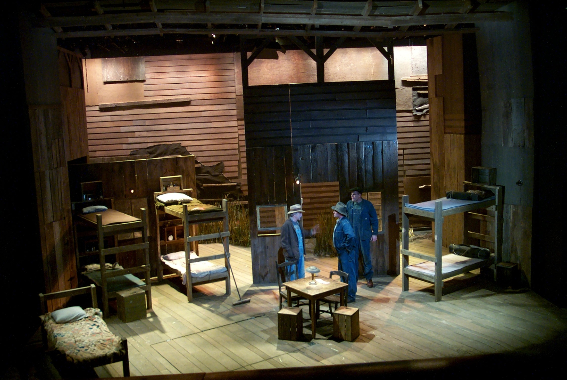
Learning Objective: To study Chapter 2 of the novel
Read the extract of the novel given on the exam paper. In it, George and Lennie have arrived at the ranch and go to the bunk house.

Slide 4
How does Steinbeck use details in this passage to present the bunkhouse and its inhabitants?
The bunk house was a long, rectangular building. Inside, the walls were whitewashed
and the floor unpainted. In three walls there were small, square windows, and in the
fourth, a solid door with a wooden latch. Against the walls were eight bunks, five of
them made up with blankets and the other three showing their burlap ticking. Over
each bunk there was nailed an apple box with the opening forward so that it made two
shelves for the personal belongings of the occupant of the bunk. And these shelves
were loaded with little articles, soap and talcum powder, razors and those Western
magazines ranch men love to read and scoff at and secretly believe. And there were
medicines on the shelves, and little vials, combs; and from nails on the box sides, a
few neckties. Near one wall there was a black cast-iron stove, its stove-pipe going
straight up through the ceiling. In the middle of the room stood a big square table
littered with playing cards, and around it were grouped boxes for the players to sit on.
At about ten o’clock in the morning the sun threw a bright dust-laden bar through one
of the side windows, and in and out of the beam flies shot like rushing stars.
The wooden latch raised. The door opened and a tall, stoop-shouldered old man
came in. He was dressed in blue jeans and he carried a big push-broom in his left
hand. Behind him came George, and behind George, Lennie.
‘The boss was expectin’ you last night,’ the old man said. ‘He was sore as hell when
you wasn’t here to go out this morning.’ He pointed with his right arm, and out of
the sleeve came a round stick-like wrist, but no hand. ‘You can have them two beds
there,’ he said, indicating two bunks near the stove.
George stepped over and threw his blankets down on the burlap sack of straw that
was a mattress. He looked into the box shelf and then picked a small yellow can from
it. ‘Say. What the hell’s this?’
‘I don’t know,’ said the old man.
‘Says “positively kills lice, roaches, and other scourges”. What the hell kind of bed
you giving us, anyways. We don’t want no pants rabbits.’

Slide 5
Setting the scene – the bunk house
Language, Structure and Form: Setting
To identify, explore and analyse the techniques Steinbeck uses in his description of the setting – the bunk house.
Using the details in the description, draw a plan of the layout of the bunk house – a bird’s eye view. Label your drawing with relevant quotes from the extract.
Highlight the quotes you use on your handout.
Write next to each quote an idea about how it presents the bunkhouse and its inhabitants.

Slide 6
The description of the ‘decoration’ in the bunk house highlights the fact that the room is plain and practical.
Furnishings, too, are provided for practical reasons only – there are no luxuries. Boxes are used both as shelves and as chairs.
Storage is unsophisticated and limited – a reflection of the fact that the men travel lightly and have very few personal possessions.
It is a basic building that meets the basic needs of the men. We get the sense that it is a dark and gloomy room, built cheaply and quickly.
The bunk house is described as a very functional place with one main purpose. It is a place for the men to sleep after long days working in the fields.
The emptiness of the bunk house reflects the emptiness of the men’s lives. There are not many things that they can do to entertain themselves in the bunk house.
The men’s belongings relate to health and, for some, small items of clothing. This highlights the sadness of the men’s’ plight as they seem, in spite of all of the hardships they suffer, desperate to maintain some form of dignity and wellbeing in hygiene, health and dress.
Find a quote from the text to go with each of these comments about the bunk house.
Copy down the quote and its matching comment in your book.

Slide 7
How does Steinbeck use details in this passage to present the bunkhouse and its inhabitants?
Which quotes could link to...?
What do these details tell us...?
The sparse nature of bunkhouse / only had necessities /sense of impermanence?
The activities of the inhabitants – Western magazines / playing cards?
How the impersonal, harsh – almost formal – nature of the bunkhouse is created, e.g. ‘rectangular’, ‘square’, ‘straight up’, ‘boxes’?
The significance of the word ‘littered’ in contrast with the ordered nature of the rest of the bunkhouse?
The ‘sameness’ of each bunk and each man’s possessions?

Slide 8
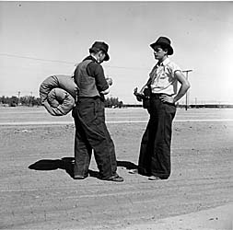
Answering the question:
The bunk house is an important setting in the novella; a number of important and dramatic events take place there.
Steinbeck’s description of the bunk house gives us many clues about ranch life and the wider issues affecting the lives of the migrant farm workers.
Using what you’ve written around the extract, try to answer the exam question:
How does Steinbeck use details in this passage to present the bunkhouse and its inhabitants?
Hints:
Try to spend around 20 minutes on this question. Pick out 3-4 key quotes and write a lot about a little. Don’t forget your QWERTY structure!
Focus on Steinbeck’s use of language and what it tells us about the bunkhouse and its inhabitants.

Slide 9
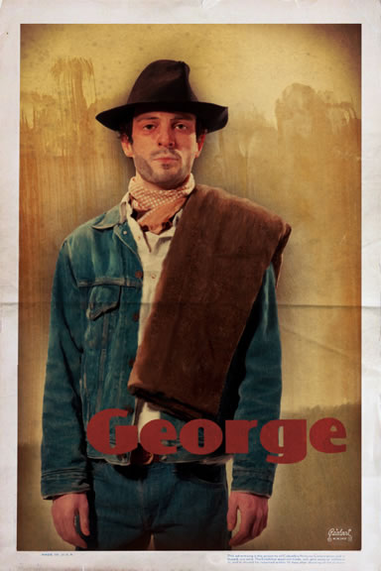
Learning Objective: To study Chapter 2 of the novel
George is horrified when he finds lice powder on the shelves next to his bed and sets about investigating the mattress. What does this say about his character?
George arranges his personal possessions on his shelves. List the items he arranges.
These objects are all he owns. What does it say about him and the lifestyle he leads in that he owns so little?

Slide 10
Learning Objective: To study Chapter 2 of the novel
Each person on your table should take a question. You can work in a pair or share questions if necessary – just make sure every question is answered! Be prepared to share your ideas with your table-mates as well as the rest of the class.
(1) Candy describes the last man’s departure – what does he suggest life is like for farmworkers?
(2) Candy describes the Stable Buck – how do we know that society is racist? What clues are there here? What kind of man is the boss?
(3) The Boss’ reaction to Lennie and George’s relationship tells us a great deal about men at the time. What is his reaction and what does it tell us?
(4) We see a different side to George here. What is he like with Lennie and Candy and why?
(5) Look at the description of the dog – what impression do you get of it?

Slide 11
Learning Objective: To study Chapter 2 of the novel
Curley- the boss’ son- comes into the bunkhouse looking for his father. After he has gone, the old swamper describes Curley to George and Lennie. George warns Lennie not to get into any trouble with him- deciding that the swamper’s information alone is enough to make him suspicious.
Look at the swamper’s descriptions of Curley in the left hand column and write down what impression this creates of him in the right.
Characterisation:
How does Steinbeck create a lasting impression of Curley in this section?
Summarise our initial impression of Curley by choosing three adjectives to describe him:
1.
2.
3.

Slide 12
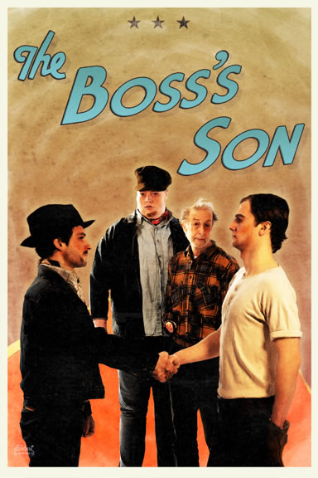
Learning Objective: To study chapter 2 of the novel
Steinbeck’s methods of characterisation:
Dialogue - including sentence length, use of slang, repetition, questioning and accent.
Physical images.
Association: who or what does he associate with that might tell us about the type of person he is?
Reactions: how do he relate to others?
Other characters’ opinions: what do others say about him?
Actions: what he does.

Slide 13
Learning Objective: To study Chapter 2 of the novel
Steinbeck’s methods of characterisation:
Dialogue - including sentence length, use of slang, repetition, questioning and accent.
Physical images.
Association: who or what does he associate with that might tell us about the type of person he is?
Reactions: how do he relate to others?
Other characters’ opinions: what do others say about him?
Actions: what he does.
Cut out these quotations and then glue them under the relevant headings.

Slide 14
Q
W
E
R
T
Y
Have a go at writing a QWERTY paragraph, using your notes so far.
What impression does Steinbeck create of Curley in this section of the novel?
[Note: we’ll come back to look at Curley’s wife later on.]

Slide 15
One of the ways Steinbeck... Another way... Curley is also shown to be... The writer suggests... When Curley is first described...
Q
}
W
E
This is shown when it says, “___”... An example of this is when Steinbeck writes, “___”... For example, “___”
R
This makes the reader think... This suggests to the reader... The reader will think... This implies... This suggests...
T
The use of the closed question... The writer’s word choice... The stage direction “___”... The repetition of... This word has strong connotations of...
Y
This suggests... This implies... This links to...

Slide 16
Self-Assess
Band 6
Insightful/exploratory response to themes/ideas
Close analysis of detail to support interpretation
Evaluation of writer’s uses of language and/or form and/or structure and effects on readers
Band 5
Exploratory response to themes/ideas
Analytical use of details to support interpretation
Analysis of writer’s uses of language and/or form and/or structure and effects on readers
How well have you:
Responded to the ideas/themes in the extract
Used relevant quotes?
Analysed the effect of language?
Band 4
Thoughtful consideration response to themes/ideas
Details linked to interpretation
Appreciation/consideration of writer’s uses of language and/or form and/or structure and effects on readers

Slide 17
Learning Objective: To study chapter 2 of the novel
What does this section of the novel suggest that life is like for farmworkers?
What was life like? – jot down some points that you could make
Sparse – very few possessions
Lonely – George and Lenny are seen as different to everyone else
Disposable – people would just move on
Lonely – no one to share life with
At the mercy of the boss / his family
Anything else?

Slide 18
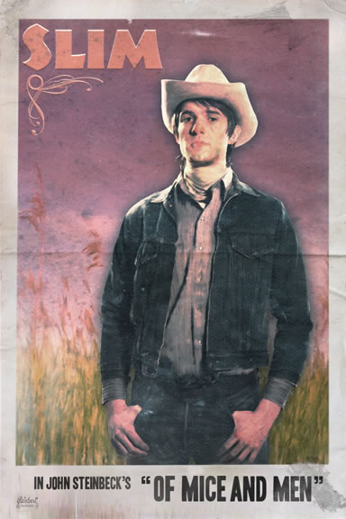
Learning Objective: To study Chapter 2 of the novel
Another important character introduced to us in this chapter is Slim, the jerkline skinner (lead mule-team driver).
You have been given the section of the novel that introduces Slim. This is taken from a past exam paper.
The question asked for section (a) was:
In this passage, how does Steinbeck present Slim?
I have highlighted some key words and phrases from the section. On your copy of the text, highlight these word/phrases, then annotate them with ideas re: their effect on the reader. What do they suggest about Slim?

Slide 19
A tall man stood in the doorway. He held a crushed Stetson hat under his arm while
he combed his long, black, damp hair straight back. Like the others he wore blue
jeans and a short denim jacket. When he had finished combing his hair he moved
into the room, and he moved with a majesty only achieved by royalty and master
craftsmen. He was a jerkline skinner, the prince of the ranch, capable of driving ten,
sixteen, even twenty mules with a single line to the leaders. He was capable of killing
a fly on the wheeler’s butt with a bull whip without touching the mule. There was a gravity in his manner and a quiet so profound that all talk stopped when he spoke. His authority was so great that his word was taken on any subject, be it politics or love. This was Slim, the jerkline skinner. His hatchet face was ageless. He might
have been thirty-five or fifty. His ear heard more than was said to him, and his slow
speech had overtones not of thought, but of understanding beyond thought. His
hands, large and lean, were as delicate in their action as those of a temple dancer. He smoothed out his crushed hat, creased it in the middle and put it on. He looked
kindly at the two in the bunk house. ‘It’s brighter’n a bitch outside,’ he said gently.
‘Can’t hardly see nothing in here. You the new guys?’
‘Just come,’ said George.
‘Gonna buck barley?’
‘That’s what the boss says.’
Slim sat down on a box across the table from George. He studied the solitaire hand
that was upside down to him. ‘Hope you get on my team,’ he said. His voice was
very gentle. ‘I gotta pair of punks on my team that don’t know a barley bag from a
blue ball. You guys ever bucked any barley?’

Slide 20
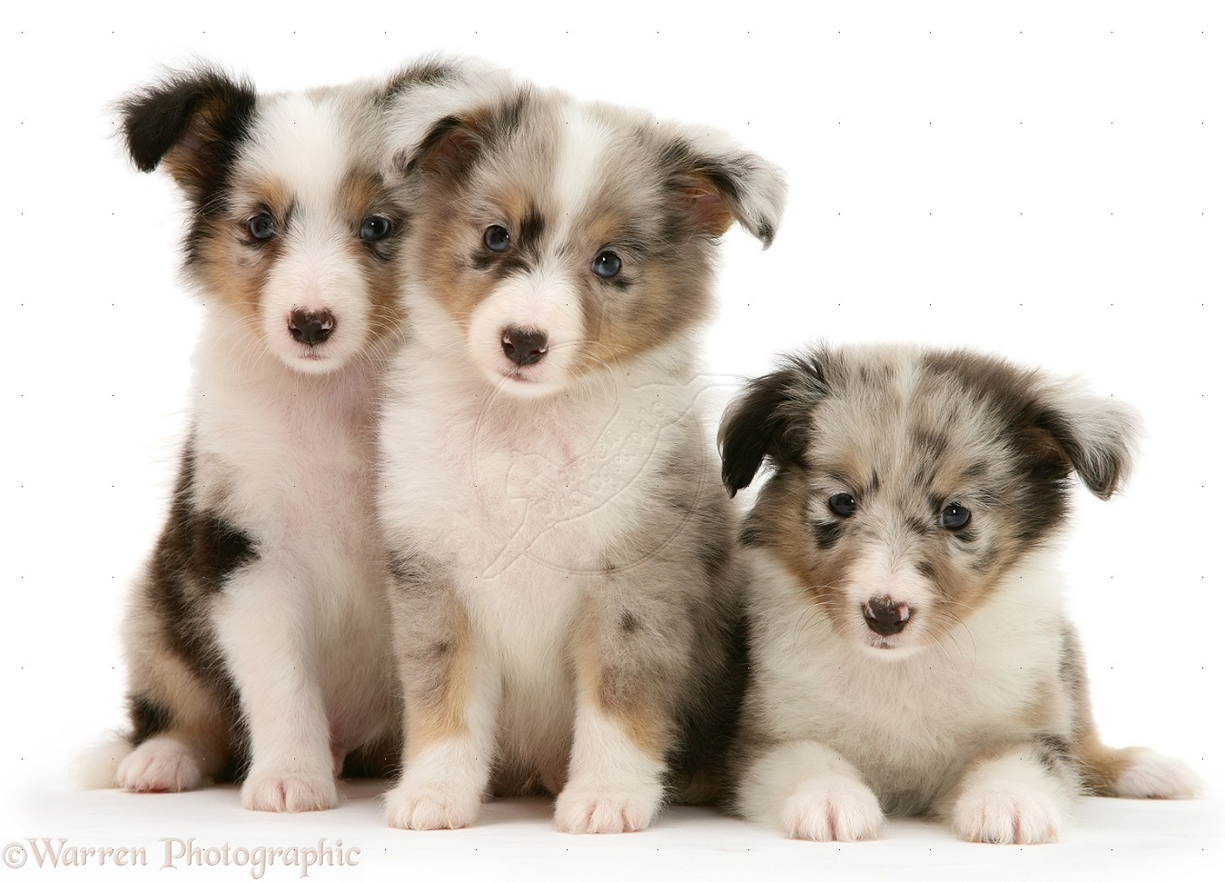
Learning Objective: To study Chapter 2 of the novel
“Nine of ‘em. I drowned four of ‘em right off. She couldn’t feed that many.”
“Yeah, five. I kept the biggest.”
“Whyn’t you get Candy to shoot his old dog and give him one of the pups to raise up?”
Imagine that the Dogs are a symbol for people in society. What do these quotes suggest?

