Slide 1
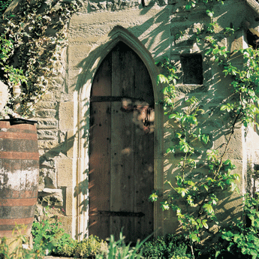
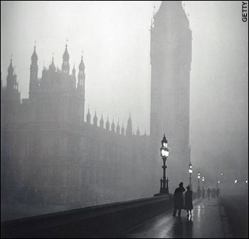
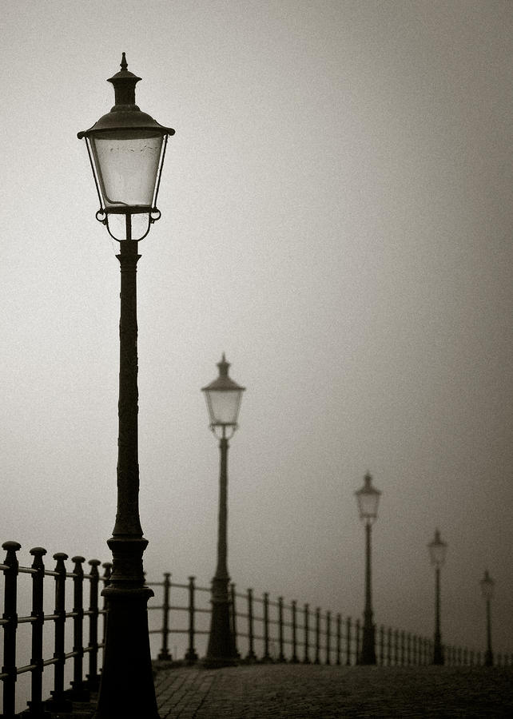
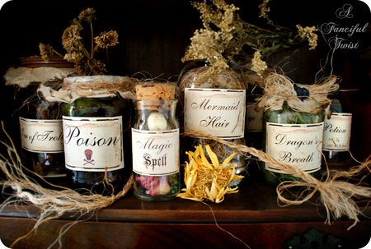
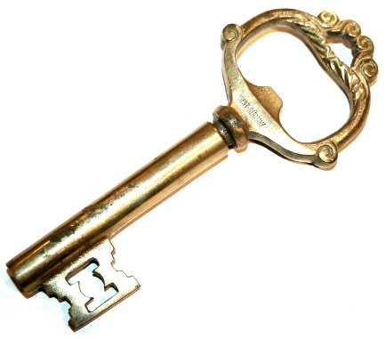
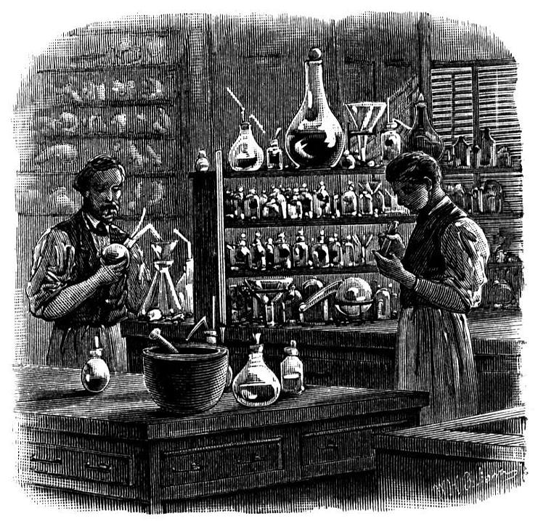
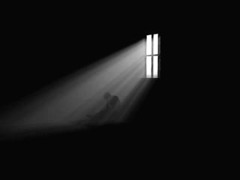
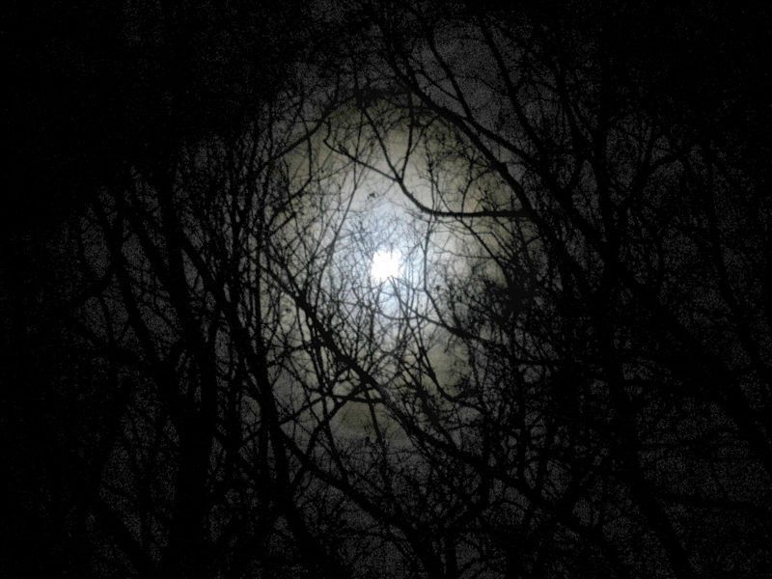
Exploring Key Themes
The novella as a whole
Look at the pictures. Can you make a list of themes that we find in the novella based on the images?

Slide 2
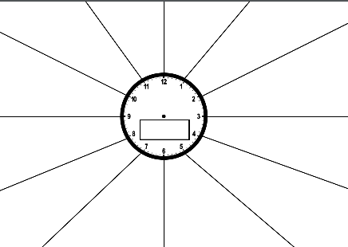
Key Themes: use your sheet to make notes
Good vs evil
The duality of human nature
Secrecy and silence
The Gothic
Religion and science
Light versus dark
…?

Slide 3
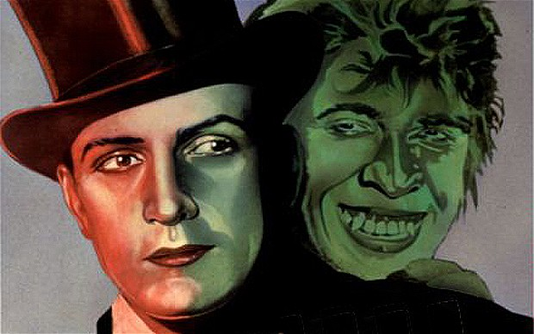
Good vs Evil
How was Jekyll expected to behave as an upstanding and privileged member of society?
What was considered taboo in Victorian society?
Can you think of any moments in the novel when Stevenson alludes to ‘shocking’ behaviours?
What did the Victorians really value?
Why might Victorians have a ‘fear of Science’?
How does Jekyll describe himself at the start of his statement?
What is it about Hyde’s ‘otherness’ that links to fears in Victorian society?
How would Victorian society expect him to live his life?

Slide 4
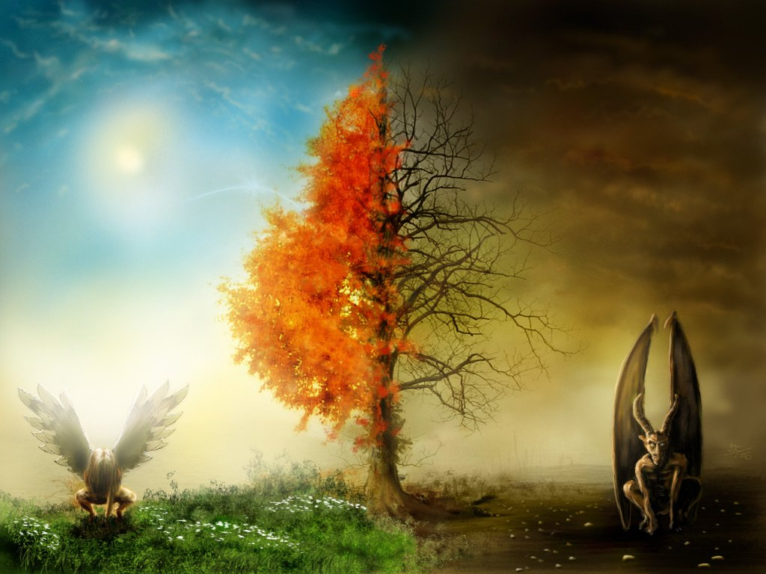
The Duality of Human Nature
Darwinism was a movement that overshadowed the Victorian Era. What do you know about it and how might it be relevant to Hyde (remember he is described as “ape like”)?
How might a gentleman in Victorian society be considered hypocritical? What kind of behaviour do they look down on and then do secretly anyway? What is Stevenson criticising?
There was a branch of religion in Victorian society called Evangelism. They believed that mankind was inevitably sinful (which individuals from the creation story does this remind you of?) What is Stevenson telling his reader with this in mind?
Notes:
1. Darwin argued that humans shared a ommon ancestor with apes. Some upper class Victorians accepted this theory of evolution, but interpreted it in a different way – they felt it would eventually lead to the creation of the perfect creature and therefore saw themselves as higher and better than others in society.
From another perspective, some found the theory suggested that they would eventually regress and become more like their ancestors.
2. Stevenson suggests that not only is there a dark side to all of us, but that it can actually be stronger.

Slide 5
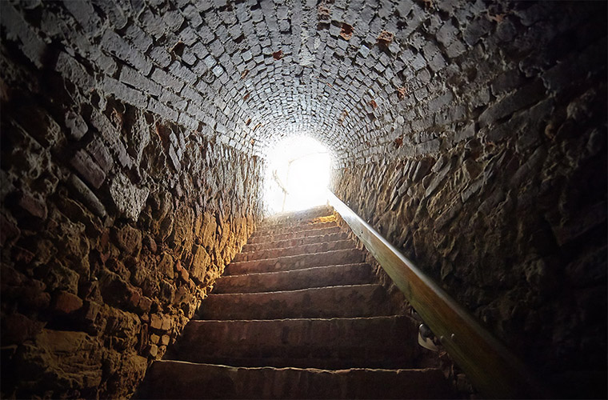
Silence and Secrecy
Utterson has done many ‘ill things’ in his life. Why do we not find out what these are?
Enfield never explains why he was out at 3 in the morning – what could he have been doing?
Many things are left unsaid. Can you think of an event that the gentlemen choose not to speak of? What does this say about society?
There are many locked doors mentioned in the novella. They are symbols: can you list them?
What could they represent?
Notes:
3. Back door has neither ‘bell nor knocker’
Window is slammed shut by Jekyll
Hyde locks himself in the cabinet
Letters and ingredients are kept in locked drawers and safes

Slide 6
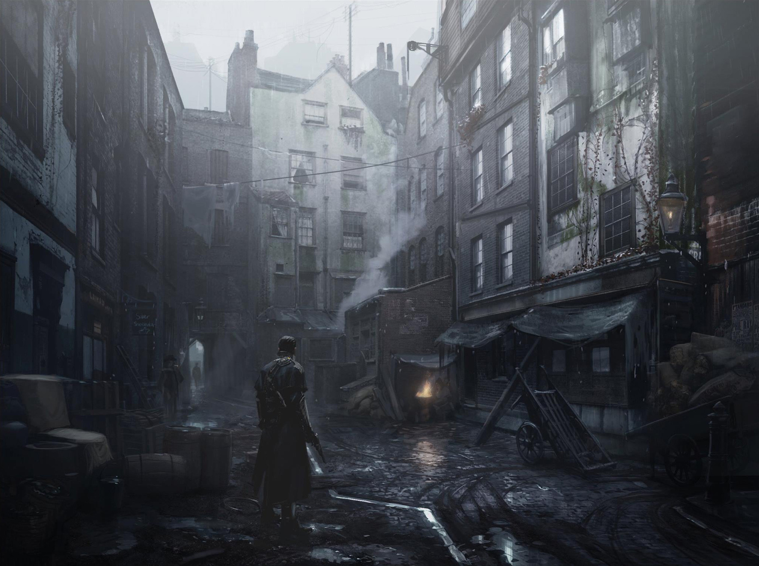
The Gothic
The Supernatural
What key features of the Gothic can you think of?
Darkness, secrets and night time
What examples from the novella can you think of?
Breaking of moral and social codes
Notes:
Make notes under each heading

Slide 7
Stevenson’s Messages in the Novella
We all have a dark side that is capable of any evil!
Victorian society became about playing a part that was false
Suppressing desires only leads to them becoming more powerful and distorted
Can you think of any others?

