Slide 1
Learning Objective To study Chapter 3 of the novel

Slide 2
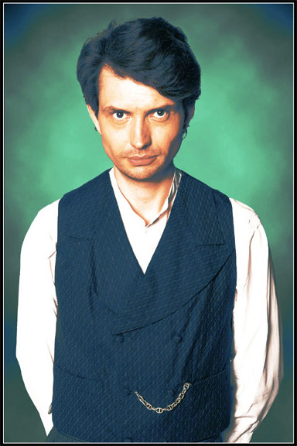
Learning Objective: To study Chapter 3 of the novel
Dr Jekyll… at last!
Stevenson delays introducing the character of Dr Jekyll until Chapter 3. This is the first time we, the reader, find out what he looks like, how he speaks, and how he behaves.
What do we already know about him?
What do we expect him to be like?
What do we find out in this chapter?
Write some notes for questions 1 and 2 now; we will return to 3 once we’ve read the chapter.

Slide 3
Learning Objective: To study Chapter 3 of the novel

Slide 4
Learning Objective: To study Chapter 3 of the novel
Dr Jekyll… at last!
Stevenson delays introducing the character of Dr Jekyll until Chapter 3. This is the first time we, the reader, find out what he looks like, how he speaks, and how he behaves.
What do we already know about him?
What do we expect him to be like?
What do we find out in this chapter?
4. Was he what we expected? What effect did delaying his introduction have on the story?

Slide 5
Learning Objective: To study Chapter 3 of the novel
‘To this rule, Dr. Jekyll was no exception; and as he now sat on the opposite
side of the fire- a large, well-made, smooth-faced man of fifty, with something of a stylish cast perhaps, but every mark of capacity and kindness- you could see by his looks that he cherished for Mr. Utterson a sincere and warm affection.’
Annotate your copy of this quote to identify any words which create a favourable impression of Jekyll.

Slide 6
Learning Objective: To study Chapter 3 of the novel
Mr. Hyde was pale and dwarfish, he gave an impression of deformity without any nameable malformation, he had a displeasing smile, he had borne himself to the lawyer with a sort of murderous mixture of timidity and boldness, and he spoke with a husky, whispering and somewhat broken voice; all these were points against him, but not all of these together could explain the hitherto unknown disgust, loathing and fear with which Mr. Utterson regarded him. ‘There must be something else,’ said the perplexed gentleman.
Now look at the description of Mr Hyde from Chapter 2 and write a summary of the physical differences between Dr Jekyll and Mr Hyde.
Whereas… However….
In contrast… Unlike Dr Jekyll, Mr Hyde is…

Slide 7
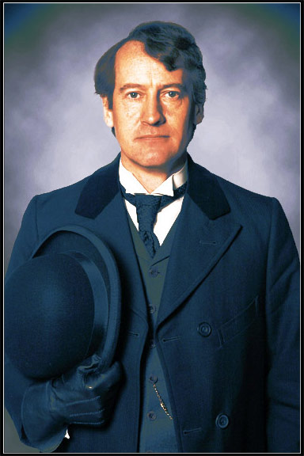
Learning Objective: To study Chapter 3 of the novel
Much of this chapter is dialogue between Jekyll and Utterson. In threes (Utterson/ Jekyll/ Narrator) read the chapter aloud.
Who says the most?
What impression does this create?

Slide 8
Learning Objective: To study Chapter 3 of the novel
Look at the following statements. Based on the conversation between Jekyll and Utterson in Chapter 3, decide whether they are true or false.
Can you find a quotation to back up your answer?

Slide 9
Learning Objective: To study Chapter 3 of the novel
Jekyll is glad to speak privately to his old friend Utterson.
True
‘To this rule, Dr Jekyll was no exception…’

Slide 10
Learning Objective: To study Chapter 3 of the novel
Jekyll is happy to discuss his will again.
False
‘A close observer might have gathered that the topic was distasteful…’

Slide 11
Learning Objective: To study Chapter 3 of the novel
Jekyll wants to stay friends with Lanyon but finds his old-fashioned ways frustrating.
True
‘I always mean to see more of him… I was never more disappointed in any man than in Lanyon.’

Slide 12
Learning Objective: To study Chapter 3 of the novel
Utterson is determined not to let Jekyll change the subject.
True
‘…pursued Utterson, ruthlessly disregarding the change in topic’

Slide 13
Learning Objective: To study Chapter 3 of the novel
There is no sign that Jekyll minds talking about Hyde.
False
‘Dr Jekyll grew pale to the very lips, and there came a blackness about his eyes…’

Slide 14
Learning Objective: To study Chapter 3 of the novel
Utterson sincerely wants to help Jekyll if he can.
True
‘Make a clean breast of this in confidence and I make no doubt I can get you out of it’

Slide 15
Learning Objective: To study Chapter 3 of the novel
Jekyll does not trust Utterson.
False
‘I would trust you before any man alive’

Slide 16
Learning Objective: To study Chapter 3 of the novel
Utterson is reluctant to help Mr Hyde.
True
‘I can’t pretend that I shall ever like him’

