Slide 1
Learning Objective To study Chapter 1 of the novel

Slide 2
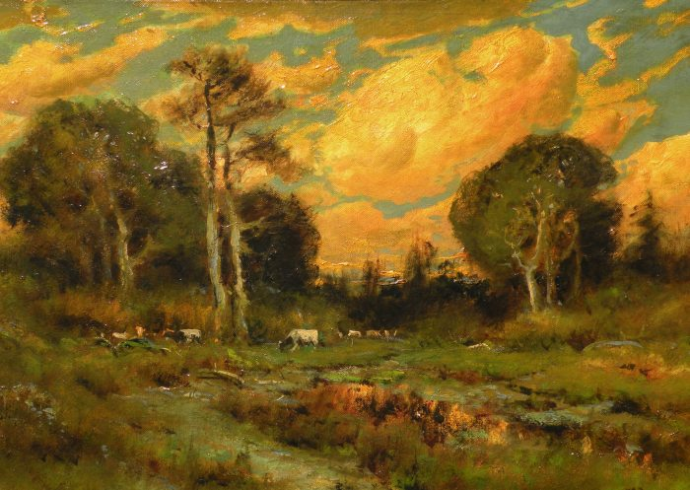
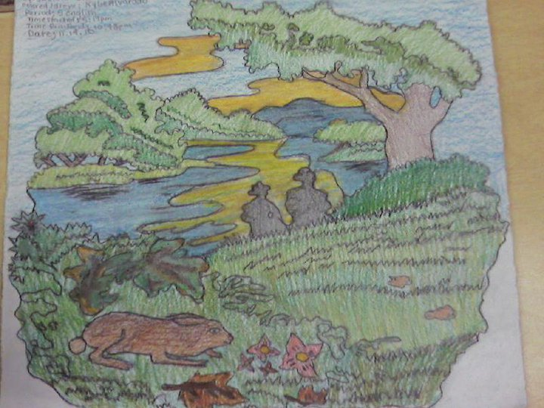
Learning Objective: To study Chapter 1 of the novel
“A few miles south of Soledad, the Salinas River drops in close to the hillside bank and runs deep and green. The water is warm too, for it has slipped twinkling over the yellow sands in the sunlight before reaching the narrow pool. On one side of the river the golden foothill slopes curve up to the strong and rocky Gabilan mountains, but on the valley side the water is lined with trees—willows fresh and green with every spring, carrying in their lower leaf junctures the debris of the winter’s flooding; and sycamores with mottled, white, recumbent limbs and branches that arch over the pool. On the sandy bank under the trees the leaves lie deep and so crisp that a lizard makes a great skittering if he runs among them. Rabbits come out of the brush to sit on the sand in the evening, and the damp flats are covered with the night tracks of ’coons, and with the spread pads of dogs from the ranches, and with the split-wedge tracks of deer that come to drink in the dark.
There is a path through the willows and among the sycamores, a path beaten hard by boys coming down from the ranches to swim in the deep pool, and beaten hard by tramps who come wearily down from the highway in the evening to jungle up near water. In front of the low horizontal limb of a giant sycamore there is an ash pile made by many fires; the limb is worn smooth by men who have sat on it.
Evening of a hot day started the little wind to moving among the leaves. The shade climbed up the hills toward the top. On the sand banks the rabbits sat as quietly as little gray, sculptured stones. And then from the direction of the state highway came the sound of footsteps on crisp sycamore leaves. The rabbits hurried noiselessly for cover. A stilted heron labored up into the air and pounded down river. For a moment the place was lifeless, and then two men emerged from the path and came into the opening by the green pool.”
Reread the opening of the novel and sketch the scene that Steinbeck describes. Pay particular attention to the detail of colour and nature. Label your drawing with lines from the novel.

Slide 3
Learning Objective: To study Chapter 1 of the novel
“A few miles south of Soledad, the Salinas River drops in close to the hillside bank and runs deep and green. The water is warm too, for it has slipped twinkling over the yellow sands in the sunlight before reaching the narrow pool. On one side of the river the golden foothill slopes curve up to the strong and rocky Gabilan mountains, but on the valley side the water is lined with trees—willows fresh and green with every spring, carrying in their lower leaf junctures the debris of the winter’s flooding; and sycamores with mottled, white, recumbent limbs and branches that arch over the pool. On the sandy bank under the trees the leaves lie deep and so crisp that a lizard makes a great skittering if he runs among them. Rabbits come out of the brush to sit on the sand in the evening, and the damp flats are covered with the night tracks of ’coons, and with the spread pads of dogs from the ranches, and with the split-wedge tracks of deer that come to drink in the dark.
There is a path through the willows and among the sycamores, a path beaten hard by boys coming down from the ranches to swim in the deep pool, and beaten hard by tramps who come wearily down from the highway in the evening to jungle up near water. In front of the low horizontal limb of a giant sycamore there is an ash pile made by many fires; the limb is worn smooth by men who have sat on it.
Evening of a hot day started the little wind to moving among the leaves. The shade climbed up the hills toward the top. On the sand banks the rabbits sat as quietly as little gray, sculptured stones. And then from the direction of the state highway came the sound of footsteps on crisp sycamore leaves. The rabbits hurried noiselessly for cover. A stilted heron labored up into the air and pounded down river. For a moment the place was lifeless, and then two men emerged from the path and came into the opening by the green pool.”
Which adjectives did you pick out as the most effective at creating a picture in your mind? Make a note of these on your drawing/ in your book.

Slide 4
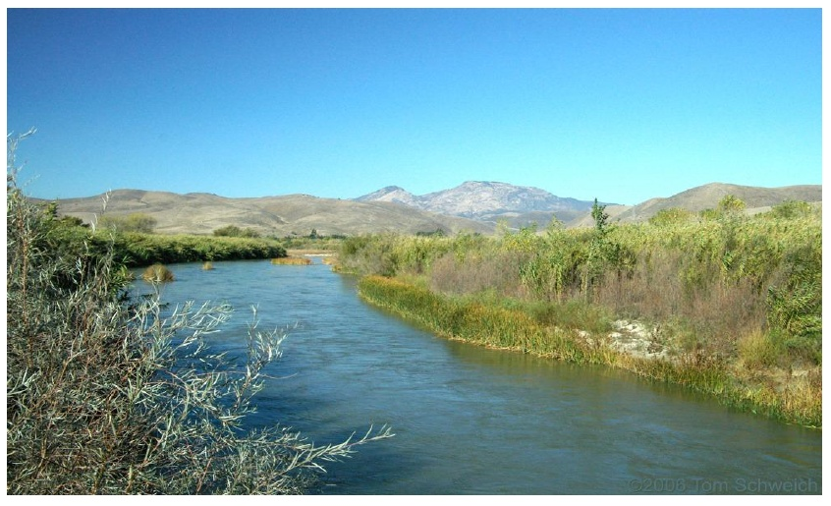
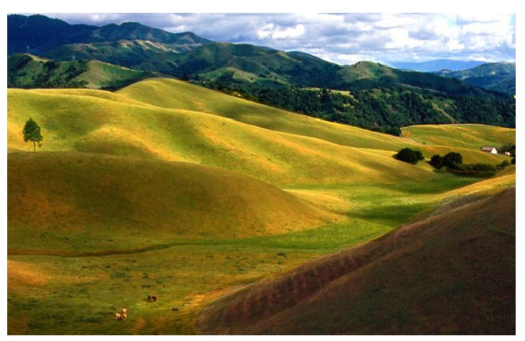
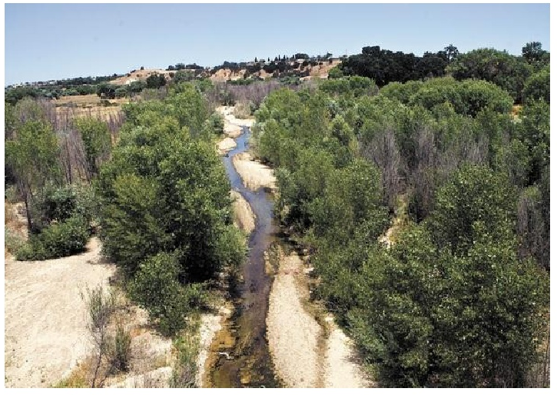
The real Salinas Valley and Gabilan Mountains. Did Steinbeck describe them accurately?

Slide 5
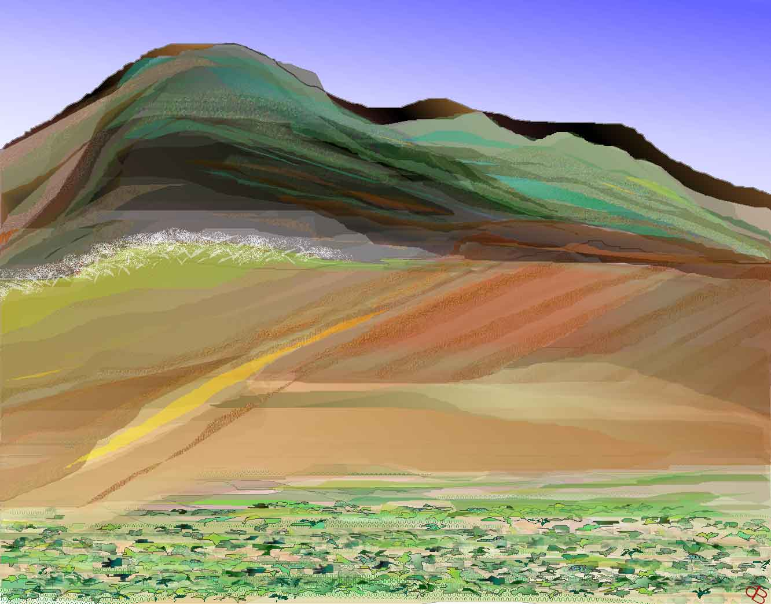
Learning Objective: To study Chapter 1 of the novel
How does this description link with what we know about California in the 1930s? Remember – you have to refer to context in the exam!
Why has Steinbeck created such an ‘Eden’? What part will this location play later on in the novel?

Slide 6
Learning Objective: To study Chapter 1 of the novel
We are introduced to the characters of George and Lennie: Re-read the extract below. Steinbeck first describes the features that they have in common and then their individual characteristics. They are presented in this way to emphasis their close relationship, despite their clear differences.
“They had walked in single file down the path, and even in the open one stayed behind the other. Both were dressed in denim trousers and in denim coats with brass buttons. Both wore black, shapeless hats and both carried tight blanket rolls slung over their shoulders. The first man was small and quick, dark of face, with restless eyes and sharp, strong features. Every part of him was defined: small, strong hands, slender arms, a thin and bony nose. Behind him walked his opposite, a huge man, shapeless of face, with large, pale eyes, and wide, sloping shoulders; and he walked heavily, dragging his feet a little, the way a bear drags his paws. His arms did not swing at his sides, but hung loosely.”
Complete the venn diagram on your sheet. Each circle represents the characters of George and Lennie. Write the features that they share in the area where the circles overlap, and write their individual characteristics in the remaining areas of the circles.

Slide 7
Learning Objective: To study Chapter 1 of the novel
“The first man stopped short in the clearing, and the follower nearly ran over him. He took off his hat and wiped the sweat-band with his forefinger and snapped the moisture off. His hugecompanion dropped his blankets and flung himself down and drank from the surface of the green pool; drank with long gulps, snorting into the water like a horse. The small man stepped nervously beside him. "Lennie!" he said sharply. "Lennie, for God' sakes don't drink so much." Lennie continued to snort into the pool. The small man leaned over and shook him by the shoulder. "Lennie. You gonna be sick like you was last night." Lennie dipped his whole head under, hat and all, and then he sat up on the bank and his hat dripped down on his blue coat and ran down his back. "Tha's good," he said. "You drink some, George. You take a good big drink." He smiled happily. George unslung his bindle and dropped it gently on the bank. "I ain't sure it's good water," he said. "Looks kinda scummy." Lennie dabbled his big paw in the water and wiggled his fingers so the water arose in little splashes; rings widened across the pool to the other side and came back again. Lennie watched them go. "Look, George. Look what I done." George knelt beside the pool and drank from his hand with quick scoops. "Tastes all right," he admitted. "Don't really seem to be running, though. You never oughta drink water when it ain't running, Lennie," he said hopelessly. "You'd drink out of a gutter if you was thirsty." He threw a scoop of water into his face and rubbed it about with his hand, under his chin and around the back of his neck. Then he replaced his hat, pushed himself back from the river, drew up his knees and embraced them. Lennie, who had been watching, imitated George exactly. He pushed himself back, drew up his knees, embraced them, looked over to George to see whether he had it just right. He pulled his hat down a little more over his eyes, the way George's hat was.”
Find this extract in your book

Slide 8
Learning Objective: To study Chapter 1 of the novel
One of the ways that we begin to see the contrast between George and Lennie is through the way that Steinbeck describes their movement. Movement is shown through the author’s choice of verbs and adverbs.
Remember:
Verbs are words which tell of the action taking place e.g. run, walk, climb
Adverbs are words which describe how an action is being carried on e.g. run quickly, walk lazily, climb clumsily.
List the verbs and adverbs used to describe George and Lennie’s actions. Next to each, comment on what this suggests to the reader (i.e. effect).

Slide 9
Skim read this section of the novel and find as many examples as you can of a situation where George does something and Lennie immediately copies.
Write the page numbers on your mini whiteboard and be prepared to share them with the class. The most examples wins!

Slide 10
What does the fact that Lennie copies George suggest about their relationship?
What does it suggest about Lennie?

Slide 11
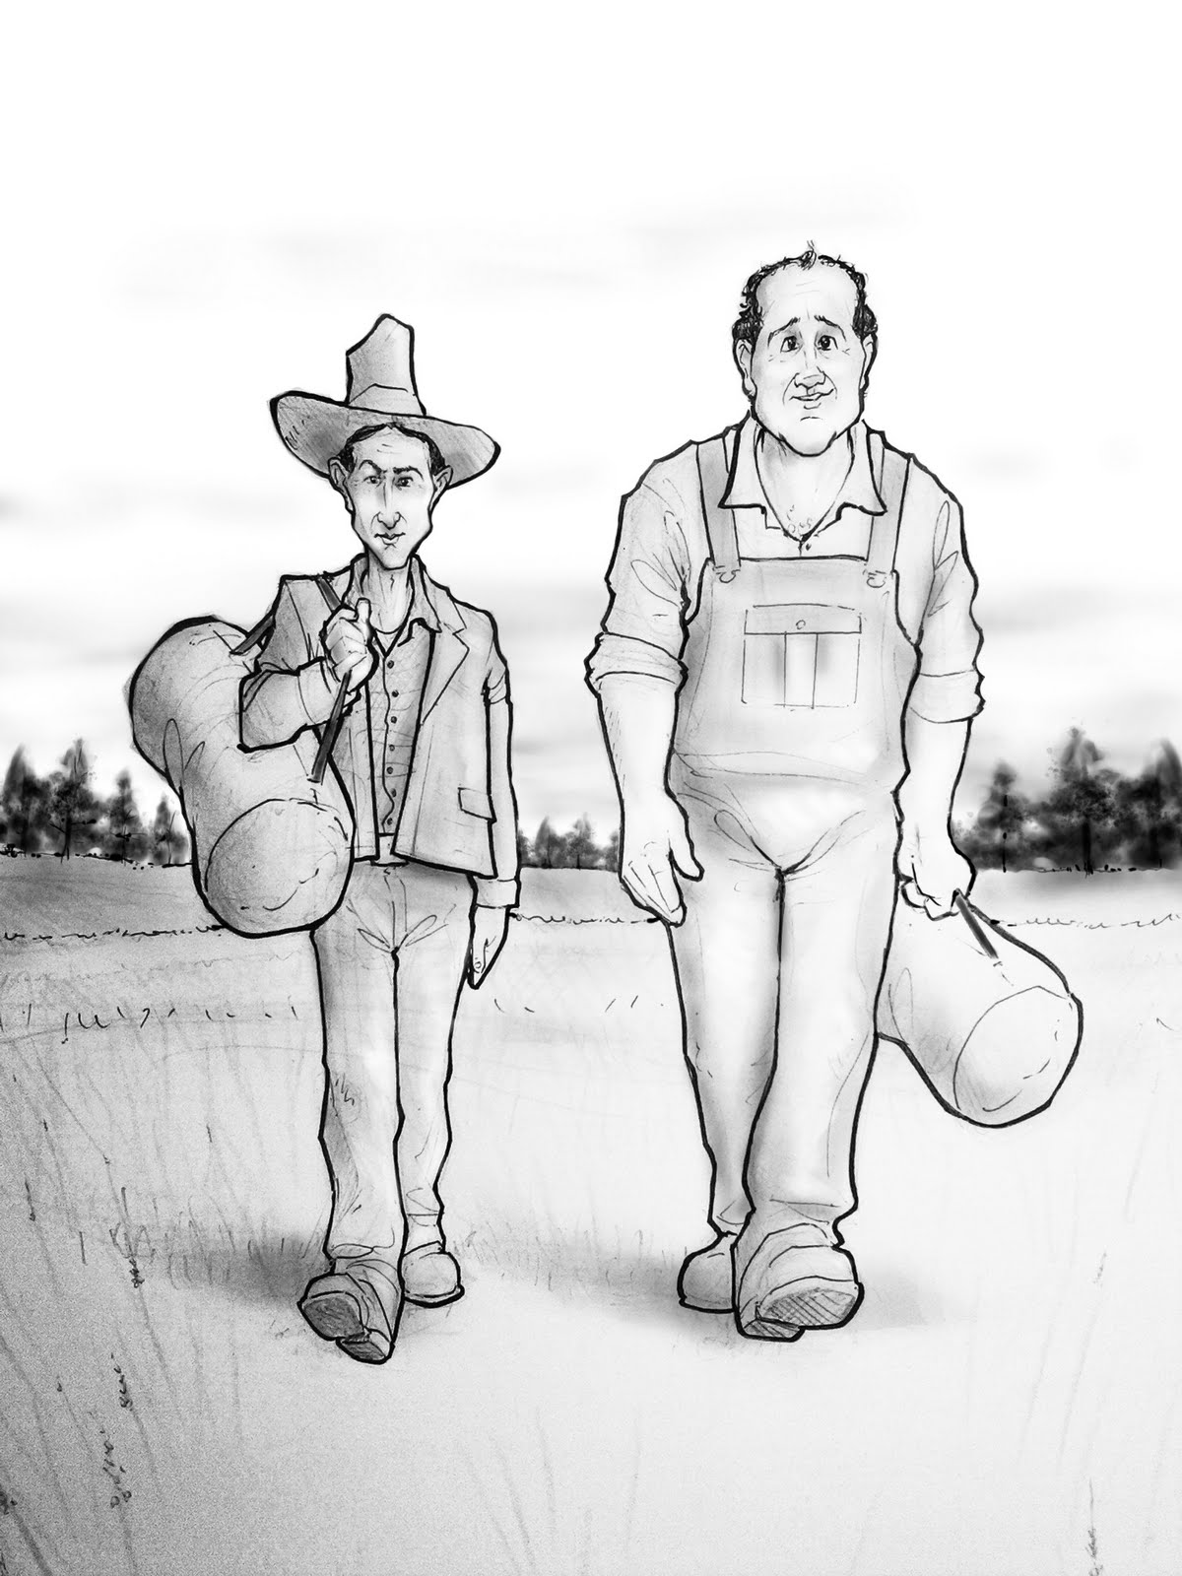
Learning Objective: To study Chapter 1 of the novel
Act out the conversation on your sheet, considering the questions underneath.
Make notes on your ideas and be prepared to share them with the class.

Slide 12
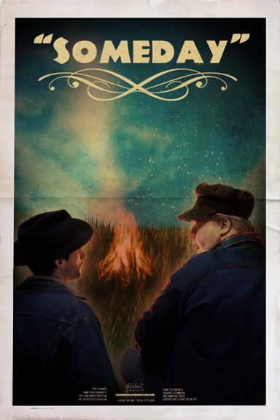
Learning Objective: To study Chapter 1 of the novel
"Come on, George. Tell me. Please, George. Like you done before."
How do we know that George has told the story “many times before”?
Highlight any clues you can find in the extract on your sheet.
Why is this important?

Slide 13
Q
W
E
R
T
Y
How does Steinbeck present the relationship between George and Lennie in this extract?
Work in pairs:
Highlight the words that seem important and work out how they are effective.
Try to find any language devices and think about why Steinbeck has used them.
The exam wants you to focus on very close language analysis.

Slide 14
Lennie spoke craftily, "Tell me- like you done before."
"Tell you what?"
"About the rabbits."
George snapped, "You ain't gonna put nothing over on me."
Lennie pleaded, "Come on, George. Tell me. Please, George. Like you done before."
"You get a kick outa that, don't you? Awright, I'll tell you, and
then we'll eat our supper...."
George's voice became deeper. He repeated his words rhythmically as though he had said them many times before.
"Guys like us, that work on ranches, are the loneliest guys in the world. They got no family. They don't belong no place. They come to a ranch an' work up a stake and then they go into town and blow their stake, and the first thing
you know they're poundin' their tail on some other ranch. They ain't got nothing to look ahead to."
Lennie was delighted. "That's it- that's it. Now tell how it is with us."
George went on. "With us it ain't like that. We got a future. We got somebody to talk to that gives a damn about us. We don't have to sit in no bar room blowin' in our jack jus' because we got no place else to go. If them other guys gets in jail they can rot for all anybody gives a damn. But not us."
Lennie broke in. "But not us! An' why? Because... because I got you to look after me, and you got me to look after you, and that's why." He laughed delightedly. "Go on now, George!"

Slide 15
George went on. "With us it ain't like that. We got a future. We got somebody to talk to that gives a damn about us. We don't have to sit in no bar room blowin' in our jack jus' because we got no place else to go. If them other guys gets in jail they can rot for all anybody gives a damn. But not us."
George snapped, "You ain't gonna put nothing over on me."
Lennie pleaded, "Come on, George. Tell me. Please, George. Like you done before."
"You get a kick outa that, don't you? Awright, I'll tell you

Slide 16
Q
W
E
R
T
Y
How does Steinbeck present the relationship between George and Lennie in this extract?
Work in pairs:
Highlight the words that seem important and work out how they are effective.
Try to find any language devices and think about why Steinbeck has used them.
The exam wants you to focus on very close language analysis.

Slide 17
One of the ways Steinbeck... Another way... George is also shown to be... The writer suggests... When Lennie is first described...
Q
}
W
E
This is shown when it says, “___”... An example of this is when Steinbeck writes, “___”... For example, “___”
R
This makes the reader think... This suggests to the reader... The reader will think... This implies... This suggests...
T
The use of the closed question... The writer’s word choice... The stage direction “___”... The repetition of... This word has strong connotations of...
Y
This suggests... This implies... This links to...

Slide 18
Peer-Assess
Band 6
Insightful/exploratory response to themes/ideas
Close analysis of detail to support interpretation
Evaluation of writer’s uses of language and/or form and/or structure and effects on readers
Band 5
Exploratory response to themes/ideas
Analytical use of details to support interpretation
Analysis of writer’s uses of language and/or form and/or structure and effects on readers
How well has (s)he:
Responded to the ideas/themes in the extract
Used relevant quotes?
Analysed the effect of language?
Band 4
Thoughtful consideration response to themes/ideas
Details linked to interpretation
Appreciation/consideration of writer’s uses of language and/or form and/or structure and effects on readers

Slide 19
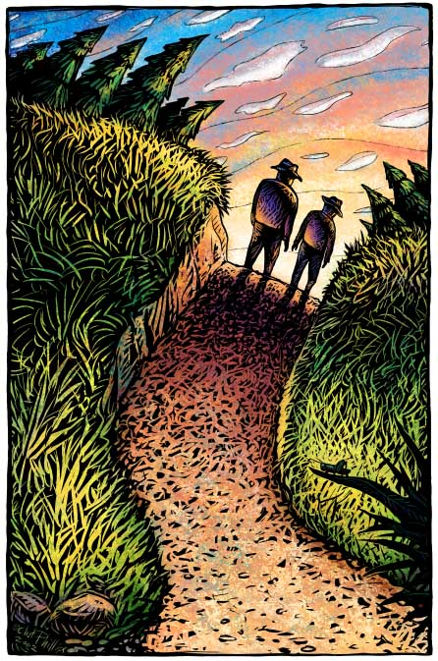
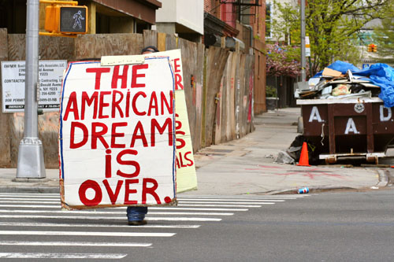
Section (b): How does the opening chapter of the novel reflect the life of migrant workers in America in the 1930s?
Think about:
The American Dream
The events of 20s/30s America
Work in pairs to make notes on this question. You don’t need to write it up (yet!) but remember that these are revision notes!

