Slide 2
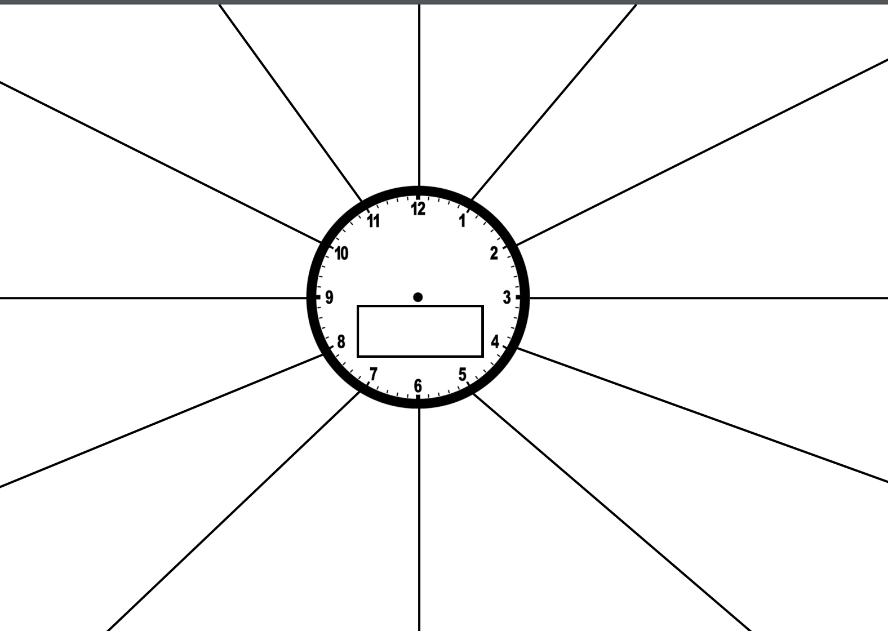

Slide 3
Bayonet Charge
&
Exposure
12-1

Slide 4
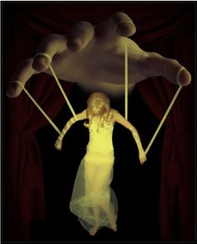
Women in Conflict
1-2

Slide 5
Poems with a tight structure
2-3

Slide 6
My Last Duchess
&
Kamikaze
3-4

Slide 7
#war
4-5

Slide 8
#power
5-6

Slide 9
Water
6-7

Slide 10
The Charge of the Light Brigade & Ozymandias
7-8

Slide 11
Modern Poetry
8-9

Slide 12
9-10

Slide 13
Female Poets
10-11

Slide 14
Happy endings
Vs
Sad endings
11-12

