Slide 1
Learning Objective To study Chapter 1 of the novel

Slide 2
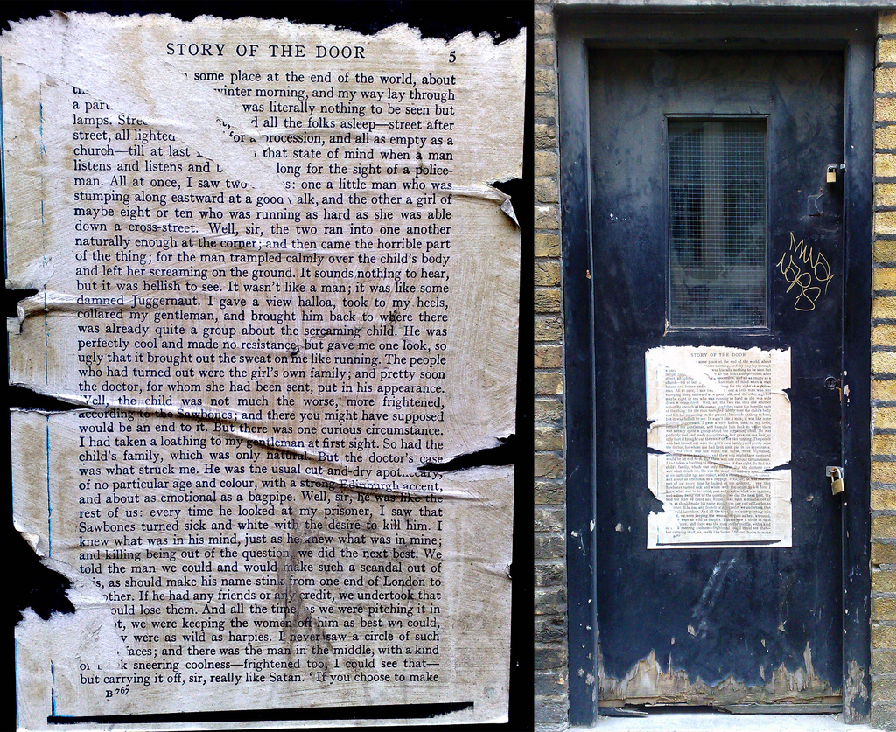
Learning Objective: To study Chapter 1 of the novel
1. The Story of the Door

Slide 3
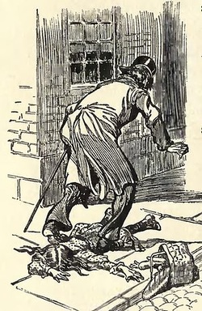
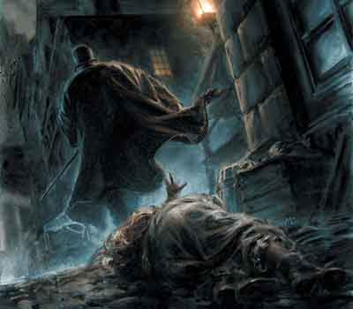
Learning Objective: To study Chapter 1 of the novel
‘Well, it was this way,’ returned Mr. Enfield: ‘I was coming home from some place at the end of the world, about three o’clock of a black winter morning, and my way lay through a part of town where there was literally nothing to be seen but lamps. Street after street and all the folks asleep-street after street, all lighted up as if for a procession and all as empty as a church-till at last I got into that state of mind when a man listens and listens and begins to long for the sight of a
policeman. All at once, I saw two figures: one a little man who was stumping along eastward at a good walk, and the other a girl of maybe eight or ten who was running as hard as she was able down a cross street. Well, sir, the two ran into one another naturally enough at the corner; and then came the horrible part of the thing; for the man trampled calmly over the child’s body and left her screaming on the ground. It sounds nothing to hear, but it was hellish to see. It wasn’t like a man; it was like some damned Juggernaut…’
Read up to ‘The cheque was genuine’.
Mr Enfield is a lawyer. He is Utterson’s friend and ‘distant kinsman, the well-known man about town’. Re-read Mr Enfield’s account of what happened when he first saw Mr Hyde.
Note down any key references or quotations that tell you about:
Where the event takes place
Mr Enfield’s thoughts and feelings
Mr Hyde’s actions
Paying compensation

Slide 4
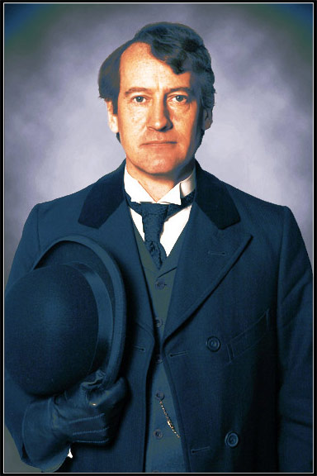
Learning Objective: To study Chapter 1 of the novel
Key Character: Mr Utterson
Utterson the lawyer was a man of a rugged countenance that was never lighted by a smile; cold, scanty and embarrassed in discourse; backward in sentiment; lean, long, dusty, dreary and yet somehow lovable. At friendly meetings, and when the wine was to his taste, something eminently human beaconed from his eye; something indeed which never found its way into his talk, but which spoke not only in these silent symbols of the after-dinner face, but more often and loudly in the acts of his life. He was austere with himself; drank gin when he was alone, to mortify a taste for vintages; and though he enjoyed the theatre, had not crossed the doors of one for twenty years. But he had an approved tolerance for others; sometimes wondering, almost with envy, at the high pressure of spirits involved in their misdeeds; and in any extremity inclined to help rather than to reprove. ‘I incline to Cain’s heresy,’ he used to say quaintly: ‘I let my brother go to the devil in his own way.’ In this character, it was frequently his fortune to be the last reputable acquaintance and the last good influence in the lives of downgoing men. And to such as these, so long as they came about his chambers, he never marked a shade of change in his demeanour.
Annotate your extract with the connotations of the bolded words. What do they suggest about Utterson?

Slide 5
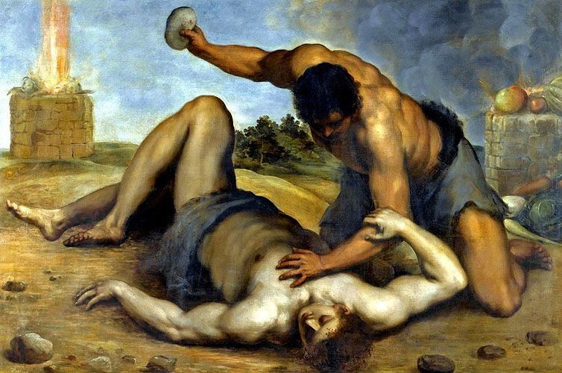
Learning Objective: To study Chapter 1 of the novel
Heresy:
belief or opinion contrary to orthodox religious (especially Christian) doctrine
AO3: Context
‘I incline to Cain’s heresy,’ he used to say quaintly: ‘I let my brother go to the devil in his own way.’
In the Bible, Cain killed his brother Abel. When God asked Cain where Abel was, Cain replied, “Am I my brother’s keeper?” Utterson calls this heresy because it goes against the Christian teaching of love for others.
Utterson means that his ‘sin’ is that he doesn't get involved in the personal affairs of others.
In the late c19th, the law was a wealthy profession and lawyers held high status in society. They were valued for their role in the important business of property ownership, inheritance and legal disputes. They had to be trustworthy and discreet in the way they dealt with people who might be on the right or wrong side of the law. Would ‘Cain’s heresy’ be an appealing quality in such a lawyer?

Slide 6
Learning Objective: To study Chapter 1 of the novel
Match the quotes below with the statements in the table.
“It was reported by those who encountered them in their Sunday walks, that they said nothing…”
“Let us make a bargain never to refer to this again.”
“The fact is, if I do not ask you the name of the other party, it is because I know it already.”
“You start a question and it’s like starting a stone… the more it looks like Queer Street, the less I ask.”
Queer Street: financial ruin

Slide 7
Learning Objective: To study Chapter 1 of the novel
Match the quotes below with the statements in the table.
“It was reported by those who encountered them in their Sunday walks, that they said nothing…”
“Let us make a bargain never to refer to this again.”
“The fact is, if I do not ask you the name of the other party, it is because I know it already.”
“You start a question and it’s like starting a stone… the more it looks like Queer Street, the less I ask.”
Queer Street: financial ruin

Slide 8
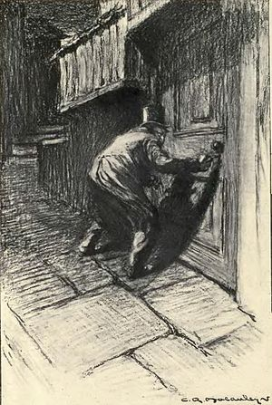
Learning Objective: To study Chapter 1 of the novel
The setting and description of the door is important to our understanding of the character who passes through it.
"It seems scarcely a house. There is no other door, and nobody goes in or out of that one but, once in a great while, the gentleman of my adventure. There are three windows looking on the court on the first floor; none below; the windows are always shut but they're clean. And then there is a chimney which is generally smoking; so somebody must live there. And yet it's not so sure; for the buildings are so packed together about the court, that it's hard to say where one ends and another begins.”

Slide 9
Learning Objective: To study Chapter 1 of the novel
It chanced on one of these rambles that their way led them down a by-street in a busy quarter of London. The street was small and what is called quiet, but it drove a thriving trade on the weekdays. The inhabitants were all doing well, it seemed and all emulously hoping to do better still, and laying out the surplus of their grains in coquetry; so that the shop fronts stood along that thoroughfare with an air of invitation, like rows of smiling saleswomen. Even on Sunday, when it veiled its more florid charms and lay comparatively empty of passage, the street shone out in contrast to its dingy neighbourhood, like a fire in a forest; and with its freshly painted shutters, well-polished brasses, and general cleanliness and gaiety of note, instantly caught and pleased the eye of the passenger.
Two doors from one corner, on the left hand going east the line was broken by the entry of a court; and just at that point a certain sinister block of building thrust forward its gable on the street. It was two storeys high; showed no window, nothing but a door on the lower storey and a blind forehead of discoloured wall on the upper; and bore in every feature, the marks of prolonged and sordid negligence. The door, which was equipped with neither bell nor knocker, was blistered and distained. Tramps slouched into the recess and struck matches on the panels; children kept shop upon the steps; the schoolboy had tried his knife on the mouldings; and for close on a generation, no one had appeared to drive away these random visitors or to repair their ravages.
Complete the three tasks on the worksheet: 1) WWW/EBI an analysis of extract 1; 2) Draw and label the door; 3) Write your own analysis of extract 2.

Slide 10
Learning Objective: To study Chapter 1 of the novel
Peer Assess: WWW/EBI annotation

Slide 11
Learning Objective: To study Chapter 1 of the novel
Key Theme: Duality
Duality: the state or quality of being two or in two parts; dichotomy
How does Stevenson introduce this idea in Chapter 1?

Slide 12
Learning Objective: To study Chapter 1 of the novel
Stick in and complete the table to identify how Stevenson presents the theme of duality through the characters and settings in Chapter 1.
Include your own comments and short quotations to fill in the gaps and add to the ideas already there.

Slide 13
Q
W
E
R
T
Y
How does Stevenson engage the reader’s interest in Chapter 1?
How does Stevenson present Mr Utterson in Chapter 1?
Choose one question to answer.
You have fifteen minutes to write your answer.

Slide 14
One of the ways Stevenson... Another way... Utterson is also shown to be... The writer suggests... When the door is first described...
Q
}
W
E
This is shown when it says, “___”... An example of this is when Stevenson writes, “___”... For example, “___”
R
This makes the reader think... This suggests to the reader... The reader will think... This implies... This suggests...
T
The word order of this sentence suggests... The writer’s word choice... The simile “___”... The repetition of... This word has strong connotations of...
Y
This suggests... This implies... This links to...

Slide 15
Peer-Assess: WWW/ EBI
Band 6
Critical/exploratory response to task
Precise references used to support interpretation
Analysis of writer’s methods and their effects on the reader, with subject terminology used accurately
Exploration of contextual factors
How well has (s)he:
Responded to the question?
Used relevant quotes?
Analysed the effect of the writer’s methods?
Explored the effect on the reader?
Included contextual references?
Band 5
Thoughtful/developed response to task
Apt references integrated into interpretations
Examination of writer’s methods and their effects on the reader, with subject terminology used effectively
Thoughtful consideration of contextual factor
Band 4
Clear/explained response to task
Effective use of references to support explanation
Clear explanation of writer’s methods and their effects on the reader, with relevant subject terminology
Clear understanding of contextual factors

Slide 16
Peer-Assess: WWW/ EBI
Band 6
Critical/exploratory response to task
Precise references used to support interpretation
Analysis of writer’s methods and their effects on the reader, with subject terminology used accurately
Exploration of contextual factors
Add to, change or extend one idea in your partner’s work.
Band 5
Thoughtful/developed response to task
Apt references integrated into interpretations
Examination of writer’s methods and their effects on the reader, with subject terminology used effectively
Thoughtful consideration of contextual factor
Band 4
Clear/explained response to task
Effective use of references to support explanation
Clear explanation of writer’s methods and their effects on the reader, with relevant subject terminology
Clear understanding of contextual factors

