Slide 1
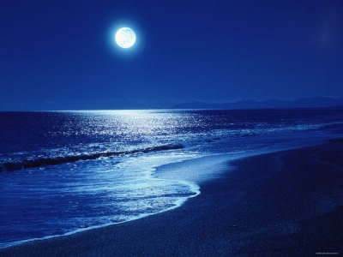
Moon on the Tides: Poetry Anthology – Linking Poems and Exam Preparation
35% of your Literature mark
Unit 2: Poetry across time

Slide 2
Which poem is featured?

Slide 3
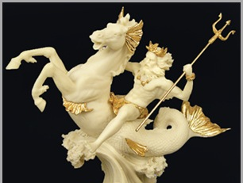
Together down, sir. Notice Neptune, though,
Taming a sea-horse, thought a rarity,

Slide 4
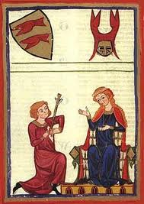
... We played at courtly love:
The troubadour, the damsel and the peach.

Slide 5
like a basket of washing that got up
and walked…

Slide 6
Of soaked Carrara-covered earth
For Londoners to fill..

Slide 7
Dem tell me bout de man who discover de balloon
and de cow who jump over de moon

Slide 8
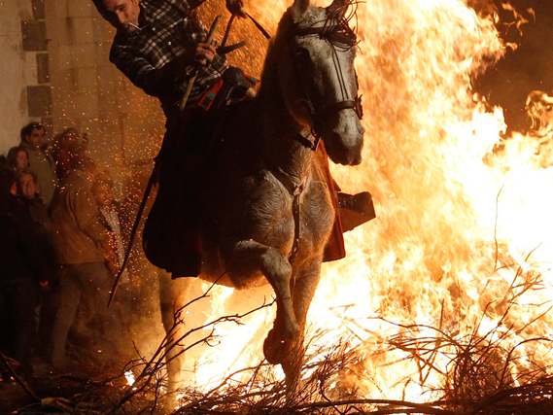
a new fear to fight the fear of fire,
so I could lead the horses…

Slide 9
Poor clever girl! I know,
For all my damaged brain, something she doesn’t:

Slide 10
He had six brothers and I had one, my Brendon Gallacher.

Slide 11
But I can drown the fools

Slide 12
vee share in chapatti
vee share in di chutney

Slide 13
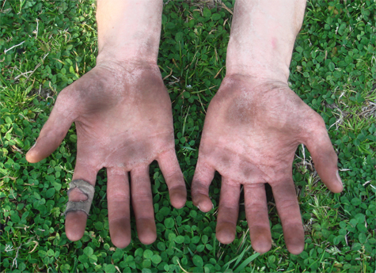
- ‘Your hands were like paws then, your face blue and bleak

Slide 14
And wrinkled lip and sneer of cold command

Slide 15
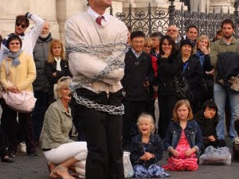
For gold – escape from locks and chains.

Slide 16
And Mister they called Hey mister

Slide 17
Look at me now.

Slide 18
Exam Reminders

Slide 19
This unit will be externally examined.
In Section A, you have to answer one question.
You will have to write an essay in which you compare a named
poem with a poem of your choice.
This section will be marked out of thirty-six using AO1, AO2 and
AO3.
You will have 45 minutes to complete your essay comparing the
poems. (Don’t forget, this is just one section of the paper. In
Section B, there will be a question on an unseen poem.)

Slide 20
AO1: Respond to texts critically and imaginatively; select and evaluate relevant textual detail to illustrate and support interpretations [15%]
AO2: Explain how language, structure and form contribute to writers’ presentation of ideas, themes and settings [10%]
AO3: Make comparisons and explain links between texts, evaluating writers’ different ways of expressing meaning and achieving effects [10%]
Note: Section B is a question on an unseen poem. More on that later.

Slide 21
Section A Mark Scheme

Slide 22
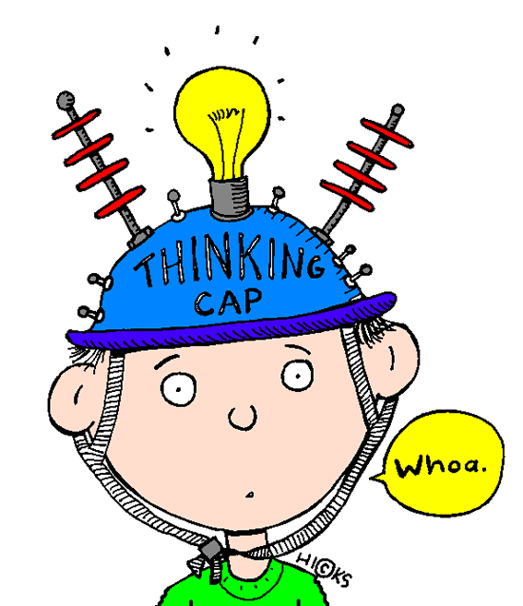
Things to think about...
Character: someone specific or a representation of something more general?
Voice: whose it is? Who is it speaking to? How is it created?
Perspective: whose point of view is being explored? Is it the poet’s?
Ideas and attitudes: why has the poet written this poem? What ideas does it express?
Techniques: how does the poet use language, structure and form to communicate or create effects?

Slide 23
Poetry VITALS…
Voice: Who is speaking in the poem?
Imagery: What imagery is being created? How is it effective?
Theme: What are the main themes featured in the poem?
Address: Who is the poem addressed to? Why?
Language (Features): What type of language/ devices are used?
What is their effect?
Structure: How is the poem laid out? What is the effect of this?
Notes:
This is the acronym that we will use on each poem to look at all the different aspects

Slide 24
To summarise, you need to be able to: ☑ Identify links between poems ☑ Identify similarities and differences between poems, exploring themes and referring closely to the text ☑ Explore similarities and contrasts between poems, making precise references to the writers’ use of linguistic and structural choices to convey their messages

Slide 25
Linking Poems

Slide 26
For each of the poems and focuses, identify another poem which could be linked to it...
Give
Outsiders

Slide 27
For each of the poems and focuses, identify another poem which could be linked to it...
Medusa
Jealousy

Slide 28
For each of the poems and focuses, identify another poem which could be linked to it...
Singh Song!
Dialogue

Slide 29
For each of the poems and focuses, identify another poem which could be linked to it...
Brendon Gallacher
Imagination

Slide 30
For each of the poems and focuses, identify another poem which could be linked to it...
On a Portrait of a Deaf Man
1st Person Perspective

Slide 31
For each of the poems and focuses, identify another poem which could be linked to it...
River God
Superstition

Slide 32
For each of the poems and focuses, identify another poem which could be linked to it...
Casehistory: Alison (head injury)
Powerful Ending

Slide 33
For each of the poems and focuses, identify another poem which could be linked to it...
The Ruined Maid
Women

Slide 34
For each of the poems and focuses, identify another poem which could be linked to it...
Ozymandias
Power

Slide 35
Planning an Answer

Slide 36
Tip #1: Know which ideas/themes are linked to each poem and how the poet presents these through language and structure.
Tip #2: Compare all the way through.
Tip #3: Plan before you start.
Tip #4: Make sure you answer the question in your introduction and conclusion.

Slide 37
Tip #5: Focus on the writer and the effect of what (s)he is doing.
Tip #6: Don’t write about everything. Pick key moments to analyse in depth and link these to the theme and ideas of the poem.
Tip #7: Don’t just ‘feature spot’. Be specific about the effect of the techniques you mention, linking to theme and ideas.

Slide 38
How do I structure a response for Section A of the exam?
Select question.
Planning
Highlight key words in the question.
Mind map ideas and plan your response.
Write your opening paragraph explaining what the two poems are about and making links between them. Start your 1st sentence with ‘both’.
Introduction
Explore key point 1 in both poems using QWERTY: write about themes, subject or tone of speaker’s voice.
Main body
Explore key point 2 in both poems using QWERTY: write about the effect of language techniques.
Explore key point 3 in both poems using QWERTY: write about effect of structure/form.
Possible key point 4 in both poems using QWERTY: write about shift/change in poem (look at the end).
Concluding paragraph – refer back to the question and summarise the similarities and differences between the two poems, making sure you answer the overall question. Add in your own opinion of the poems.
Conclusion

Slide 39
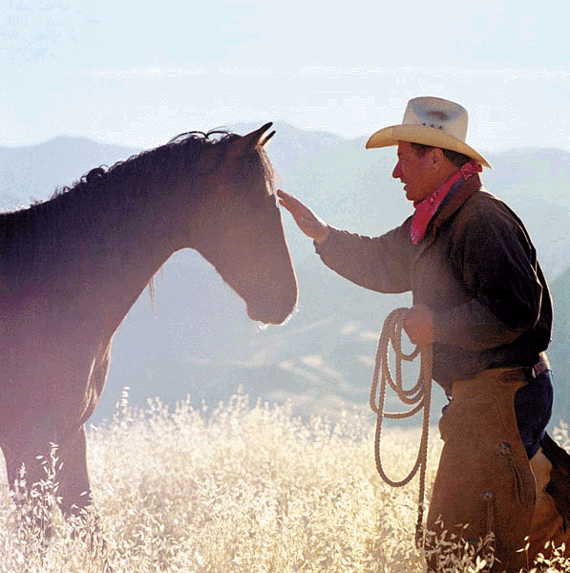
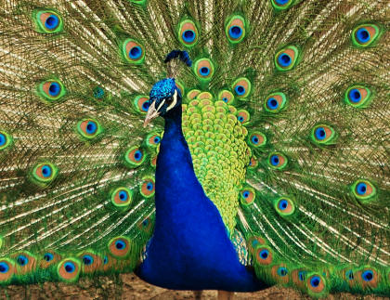
Question: 36 marks; 45 mins
AQA Moon on the Tides poetry: ‘Character and Voice’
How is control presented in The Horse Whisperer and one other poem you have studied?

Slide 40
How is control presented in The Horse Whisperer and one other poem you have studied? (Poem for comparison: Les Grands Seigneurs)
Introduction: what the two poems are about; make links between them. Start 1st sentence with ‘both’.
Key Point 1: Both characters have control at the beginning of the poems (they are telling a story about their past) [Themes; subject; tone of voice]
Key Point 2: Both past lives are portrayed through the use of vivid, powerful imagery [Effect of language techniques]
Key Point 3: A significant event marks a turning point in these characters’ past lives [Effect of structure/form]
Key Point 4: There is a shift in control – the speakers are now ‘controlled’ in some way themselves [Shift/change in poem – look at end]
Conclusion: summarise similarities/differences; answer question; give opinion

Slide 41
Introduction: what the two poems are about; make links between them. Start 1st sentence with ‘both’.
Both ‘Horse Whisperer’ by Andrew Forster and ‘Les Grands Seigneurs’ by Dorothy Molloy are about individuals whose lives undergo a significant change. In ‘Horse Whisperer’, readers hear from a poetic voice who used to be respected and valued in his role as a horse whisperer only for the Industrial Revolution to make his job outdated, meaning he is shunned by his community. In ‘Les Grands Seigneurs’ the narrator reveals that she was an independent single woman who had lots of attention from men, and enjoyed their company and the power it gave her. Central to both of these poems is the idea of control. Both speakers, in their past lives, had a great deal of control, but because of a life-changing event they have lost this power and, it may be argued, have become controlled themselves.

Slide 42
Key Point 1: Themes; subject; tone of voice
A similarity between both the speakers in these poems is that they are both narrating a story from a similar position – one where they are reflecting on a happier past in which they had control over their lives. In ‘Horse Whisperer’, the first two stanzas describe the protagonist’s role as an important member of his community, and readers are given the impression of a man who is highly valued by the society of which he is a part. The repetition of ‘They shouted for me…’ reveals that farmers were highly dependant on the horse whisperer to tame these important animals, even to the point where they took him for granted. The sibilance in ‘My secret was a spongy tissue…’ evokes the sound of whispering, and the detailed description of the charms used to ‘draw the tender giants to [his] hands’ suggests a highly skilled and knowledgeable person. ‘Restless’ horses are transformed by the speaker’s power, as conveyed by the simile ‘like helpless children’. Similarly, the speaker in ‘Les Grands Seigneurs’ is reflecting on a past in which she enjoyed many and varied relationships with men. The phrase ‘The best and worst of times were men’ highlights that male company was everything for this woman. Moreover, we are given hints that these men, as well being beneficial to the speaker (‘Men were my buttresses’ – meaning support), are to an extent controlled by this woman. Men are described using metaphors, ‘Men were my dolphins, my performing seals’, which suggests that they were at the beck-and-call of the speaker, implying that she had a lot of control over them.

Slide 43
Key Point 2: Effect of language techniques
Both of the speakers in these poems depict their past life using vivid imagery, and often figurative language, to portray the things they had control over. The speaker in ‘Horse Whisperer’ describes the horses he used to tame in an admiring way which reflects the detailed understanding and bond he had with them. Descriptions of the horses’ ‘shimmering muscles’ and ‘stately heads’ convey this admiration, and tell readers that the horse whisperer’s understanding of these creatures was absolute. In the final stanza of the poem, the narrator again reminisces about the creatures he knew so well and had such control over, with lyrical descriptions of their ‘searing breath’ and ‘glistening veins’, but above all their ‘pride’ - a characteristic which is repeated for emphasis at the end of the poem, and which perhaps refers to the speaker’s own pride, which has been taken away along with the control he had. In ‘Les Grands Seigneurs’, the speaker’s relationships with men are described using a series of metaphors, some of which portray the men as almost ridiculous and hint to the reader that the female speaker treated them as playthings. Images of men as ‘strutting pink flamingos’ and ‘hurdy-gurdy monkey-men’ suggest that men were eager to impress and entertain the speaker, and that she (‘their queen’) was happy to receive this adoration.

Slide 44
Key Point 3: Effect of structure/form
The most striking similarity between these two poems is that both speakers undergo a huge change in their lives, and that this change is signalled by a definite turning point. In ‘The Horse Whisperer’, this change occurs in the third stanza of the poem, when ‘the tractor came over the fields like a warning’, representing the onset of the Industrial Revolution, meaning that the horse whisperer is ‘the life-blood no longer’ – implying a sudden and devastating diminishing of his status. In ‘Les Grands Seigneurs’, this change occurs ‘overnight’ when the woman is ‘wedded, bedded’. This internal rhyme emphasises the fact that as soon as the speaker is married, and begins to have a sexual relationship, all of her previous independence, power and control is taken away. The structure of the poem reflects this; the speaker’s ‘new’ life is presented to us plainly in the fourth and final stanza, completely separate from what has come before. Similarly, in ‘The Horse Whisperer’, structure reflects the dying out of the speaker’s trade and status, as stanzas lessen in length by a line as the poem goes on.

Slide 45
Key Point 4: focus on the end
The final sections of each of these poems reveal how, in their new lives, each speaker has lost the control they once had, and, it could be argued, are now controlled themselves. The horse whisperer is treated as a ‘demon and witch’ and is forced to flee his community, having to join a ‘stampede’ of others who have also now become redundant and mistrusted. He exerts one final act of of power and control, seeking vengeance on the villagers who have wronged him by using ‘tools of revenge’, meaning that he uses the same mystical powers he once employed to calm the horses to now curse the creatures he leaves behind. Similarly, the speaker in ‘Les Grands Seigneurs’ becomes controlled by her husband. In contrast to the elaborate metaphors which she used to depict the men in her life, she describes herself using a list of words and phrases which show how diminished she has become: ‘a toy, a plaything, little woman, wife, a bit of fluff’. This kind of language, and the poet’s use of caesura, convey the idea that the woman is now solely defined by her sexuality and status as a wife; it is interesting that the lively metaphors at the beginning of the poem have been replaced with stale, clichéd imagery to do with the status of being somebody’s wife. Sentences become short and choppy at this point in the poem, meaning the tone of the final stanza reflects the bitterness and lifelessness which the speaker now feels.

Slide 46
Conclusion: summarise similarities/differences; answer question; give opinion
Many similarities can be drawn between these poems when they are considered as texts about control. Both speakers had a great deal of control, self-worth and independence in their past lives – one because of his profession and status within a community, and the other because of her relationships with men. Moreover, both speakers lose control after a significant event or turning point in each of their lives, meaning the control they once had disappears altogether.

Slide 47
Section A Mark Scheme

Slide 48
Example answer:
With a partner, decide what mark you would give this answer.

Slide 49
Section A Mark Scheme

Slide 50
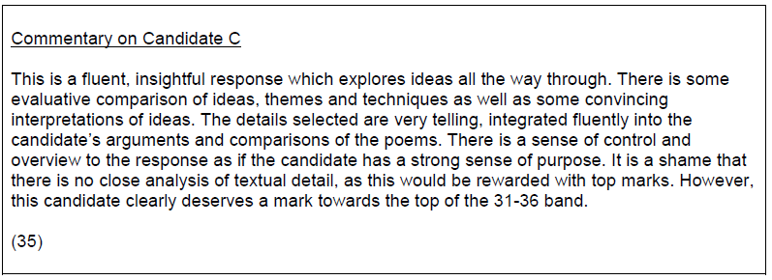
Read what the examiner said about this answer:
How could the answer be improved?

Slide 51
Compare the ways poets present strong emotions in Medusa and The River God
What emotions are there?
How do the poets present these emotions?
or
Compare the ways poets present powerful characters in My Last Duchess and either The River God or Medusa
Plan and write up your answer. You have 45 minutes.
Which characters are powerful?
How is their power presented?

Slide 52
Step 1 – read the questions – pick the one you want to answer - and underline key words

Slide 53
Step 2 – pick out 3 points you could make about the theme in that poem
Identity in the Clown Punk
Identity changes
Identity is to do with personal appearance
Identity can cause misery

Slide 54
Step 3 – pick your other poem to compare
Identity =
checking out me history
case history alison
portrait of a deaf man
the hunchback in the park
medusa

Slide 55
Step 4 – pick out 3 points you could make about the theme in the second poem
Identity in the Clown Punk
Case History: Alison
Identity changes
Identity is to do with personal appearance
Identity can cause misery
Her past to present
She became fat
She is trapped in the present

Slide 56
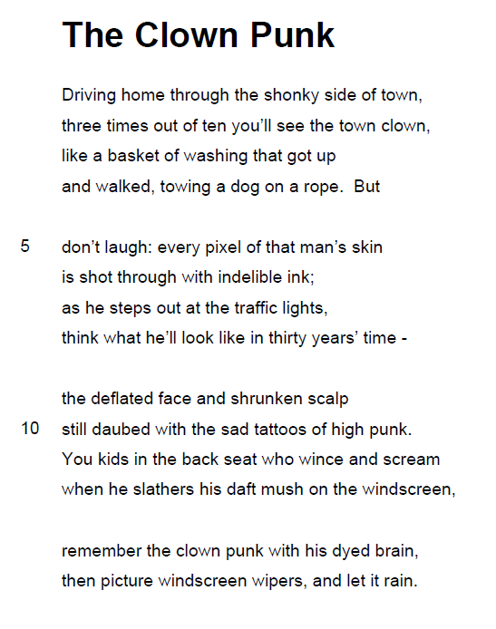
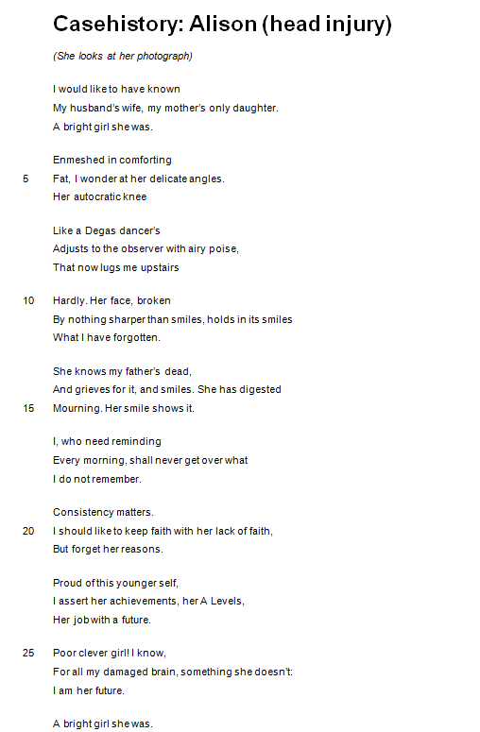
Step 5 – pick out quotations for each of your paragraphs
3. Identity causes misery
enjambment
1. Identity changes
enjambment
2. Identity to do with personal appearance

Slide 57
Step 6 – write your answer

Slide 58
One of the ways the poet... Another way... Medusa is also shown to be... The poet suggests... When he is first described...
Q
}
W
E
This is shown when it says, “___”... An example of this is when Smith writes, “___”... For example, “___”
R
This makes the reader think... This suggests to the reader... The reader will think... This implies... This suggests...
T
The use of the simile... The poet’s word choice... The repetition of the word “___”... The alliteration of... This word has strong connotations of...
Y
This suggests... This implies... This links to...

Slide 59
Compare the ways poets present…
isolated characters
romantic love
change
memory
loss
power
powerful characters
strong emotions
male characters
Hunchback in the Park
Singh Song!
Les Grands Seigneurs
Casestudy: Alison
Brendon Gallacher
Ozymandias
My Last Duchess
Medusa
The River God
in…
… and one other poem of your choice.

