Slide 1
Learning Objective To explore the structure of the novel

Slide 2
Learning Objective: To explore the structure of the novel
Chapter 1
The opening is set in a beautiful clearing by a stream.
What type of structure is used in Of Mice and Men?
The structure of the text is cyclical, it is a circular novella. This means that the first and last chapters come full circle.
Thinking about Lennie and George’s situation, why do you think Steinbeck chose to structure the novella in a circle? Think about what a circle represents or what terms like ‘vicious circle’ mean?
Chapters 2 -5
The meat of the story is set on the ranch, inside, in either the bunkhouse, in Crooks' room or in the barn. At the beginning of each chapter, there is a description of the setting. Then, the sections largely focus on dialogue from the characters. There is no official viewpoint; therefore, Steinbeck wants the reader to draw his / her own conclusions. There is rising and falling action in each section, which leads to foreshadowing.
Chapter 6
The closing is set in a beautiful clearing by a stream.

Slide 3
Learning Objective: To explore the structure of the novel
The book starts and ends in the wilderness - this is clear framing. If you compare the descriptions, you find lots of the same details including the water snake and the heron. At the end of the novel George and Lennie have got precisely nowhere. There is a vicious cycle in that they get a job, Lennie gets into some kind of trouble, and they run away. This clearly happens time after time. Weed was just the last time - the only way out of this cycle is for them to get their own place - or for Lennie to die. In addition, there is a cycle of hope and disappointment. George and Lennie escape from Weed and get a job (hopes raised) then they meet Curley (hopes dashed). Lennie gets a puppy (hopes raised) then he kills it (hopes dashed). Candy has money to buy the ranch (hopes really raised) but Lennie kills Curley's wife (hopes severely dashed).

Slide 4
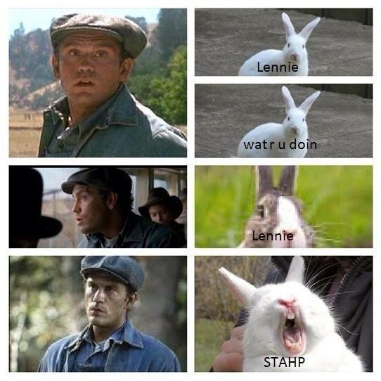
Learning Objective: To explore the structure of the novel
Foreshadowing
We’ve already picked out a lot of this. The watersnake in the wilderness is "trouble in paradise" - Curley's wife. Note that the water snake gets eaten at the end of the book. The death of Candy's dog foreshadows the death of Lennie etc. There's also a build up of deaths and damage caused by Lennie. Mouse (tiny); puppy (bit bigger); Curley's hand (bigger still but Slim helps them out); Crooks' close shave (could have been serious) and finally Curley's wife. You're really glad he never got his hands on the rabbits!

Slide 5
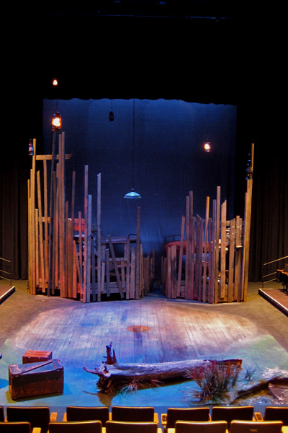
Learning Objective: To explore the structure of the novel
Final point – Steinbeck said he was trying out a new form in Of Mice and Men which he called a play-novelette. In other words it is a play written in novel form. That is why the characters reveal themselves through dialogue and it is also why each 'chapter' starts with description that reads almost like stage directions. The story is told by an omniscient narrator.
Look at the way characters are all introduced by Candy before they "walk on stage". We are given an opinion on most characters before we see them which shorthands character description for us in a short book.
Complete your structure handout.

