Slide 1
Learning Objective To explore some of the themes and symbols of the novel

Slide 2
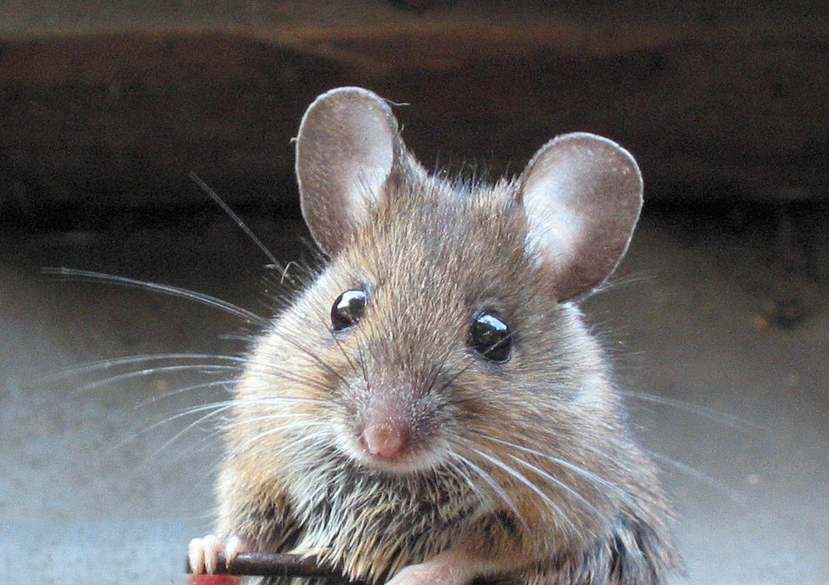
Robert Burns – To a mouse
http://www.youtube.com/watch?v=cy8lehO7nqg
But Mousie, thou are no thy-lane, In proving foresight may be vain: The best laid schemes o' Mice an' Men, Gang aft agley, (Often go wrong) An' lea'e us nought but grief an' pain, For promis'd joy!
Oh mouse, you are not alone in proving planning is a waste of time. The best laid plans (of mice and men) often go wrong, leaving us pain where they promised us joy.
What connotations do mice have?
Why do you think Burns has chosen to link ‘mice and men’ in the poem?
How does the poem’s message link up to what you know about the American Dream?
Why do you think Steinbeck has chosen this title for his novella?
How might the title be foreshadowing something?

Slide 3
Learning Objective: To explore some of the themes and symbols of the novel
Steinbeck originally titled his book Something That Happened. However, he changed the title after reading Burns' poem.
The title/poem means that the best made plans often go wrong (agley). This fits in the novel with the dream of George and Lennie to own their own farm ending in tragedy. It seems as if regardless of their efforts, fate or destiny will determine their success or failure – raising the question: were they always doomed?
One of the ways that writers achieve the sense of inevitability or destiny is to drop hints throughout the text. This is called foreshadowing.
What clues are there that hint towards the ending of the novel where George kills Lennie?

Slide 4
Learning Objective: To explore some of the themes and symbols of the novel
Disability as foreshadowing
Four of Steinbeck's characters are disabled: Candy is missing a hand, Crooks has a crooked spine, Lennie is mentally slow, and Curley acquires a mangled hand in the course of the novel.
They are physical manifestations of one of the novel's major themes: the schemes of men go awry. Here, to re-iterate the point, Steinbeck has the actual bodies of his characters go awry. It is as if nature herself is often doomed to errors in her scheme. And whether they be caused at birth, or by a horse, or by another man, the physical deformities occur regardless of the person's will or desire to be otherwise, just as George and Lennie's dream goes wrong despite how much they want it to be fulfilled.

Slide 5
???
Prejudice
Dreams
???
Plans going wrong
Loneliness and companionship

Slide 6
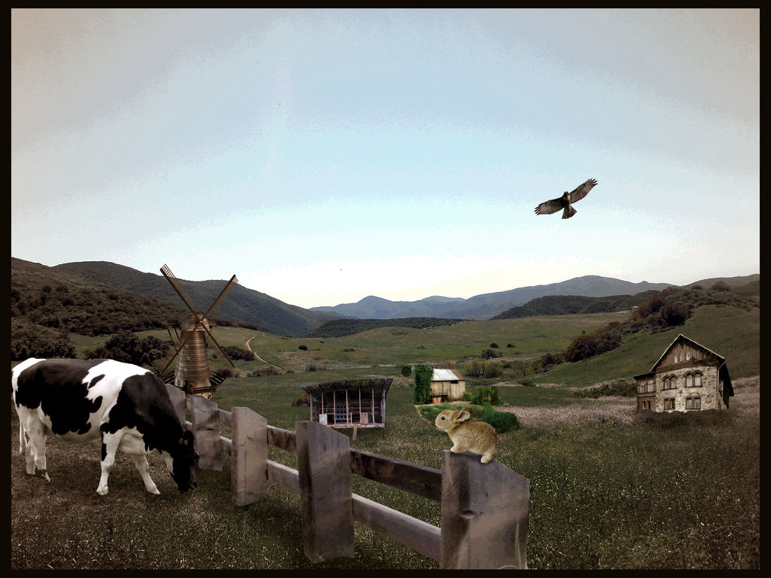
Theme #1 - Dreams

Slide 7
Learning Objective: To explore some of the themes and symbols of the novel
It seems that all of the characters in Of Mice and Men are holding onto dreams, hopes, and plans. Whose dreams are whose? Write down the dream of each character in your book, as below:
LENNIE: _________________________________________________ ____
GEORGE: _________________________________________________ ____
CURLEY: _________________________________________________ ____
C’s WIFE: _________________________________________________ ____
CROOKS: _________________________________________________ ____
CANDY: _________________________________________________ ____
 Put a tick on the list above if the dream or hope of the character comes true, and an ‘L’ if the dream is likely to come true.

Slide 8
Learning Objective: To explore some of the themes and symbols of the novel
What is George and Lennie’s dream?
George and Lennie have a dream, even before they arrive at their new job on the ranch, to make enough money to live "off the fatta the lan" and be their own bosses. Lennie will then be able to tend the rabbits.
George also has a dream of finding a girl and having an easy life but he knows it is impossible

Slide 9
Learning Objective: To explore some of the themes and symbols of the novel
What is Curley’s dream?
To be a boxer
To prove to himself/and others that he is a ‘big’ man and that he should be respected

Slide 10
Learning Objective: To explore some of the themes and symbols of the novel
What is Curley’s wife’s dream?
She wanted to be an actress in Hollywood. She imagines how great it would be to stay in nice hotels, own lots of beautiful clothes, and have people want to take her photograph.
She is lonely and craves attention
She would love to be loved, instead of being treated as a possession/trophy wife
She would like to have friends, to get off the ranch and enjoy herself

Slide 11
Learning Objective: To explore some of the themes and symbols of the novel
What is Crooks’ dream?
He wants to be part of George and Lennie’s dream and own a farm
The ideal world presented by Crooks also reflects childhood. His father had a chicken ranch full of chickens, a berry patch, and alfalfa. He and his brothers would sit and watch the chickens. It was a much happier time.
Friendship and plentiful food are both parts of Crooks' dream.
To be treated equally and not be discriminated against because of his race
To be able to mix/join in with the other men in the bunkhouse

Slide 12
Learning Objective: To explore some of the themes and symbols of the novel
What is Candy’s dream?
He wants to join George and Lennie in their dream and even has some money to help
He might also wish to be treated with respect as the other ranch hands see him as being old, foolish and useless.
He doesn’t want to be alone

Slide 13
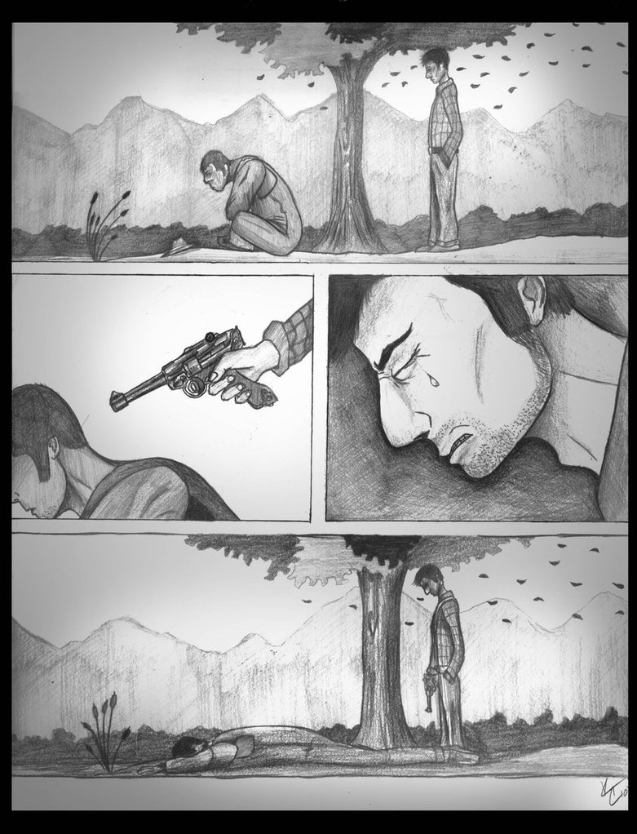
How have the characters’ dreams changed at the end of the novella? Why?
What does the shooting of Lennie symbolise?

Slide 14
George knows how much the dream means to Lennie and it is poignant that he retells the dream, the last thing Lennie thinks of, before he dies.
When George tells Lennie to look across the river and imagine their farm, he lets Lennie die with the hope that they will attain their dream, and attain it soon.
George, who must kill Lennie, is not allowed such comfort. He must go on living knowing the failure of their dream, as well as dealing with the guilt of having killed his best friend.

Slide 15
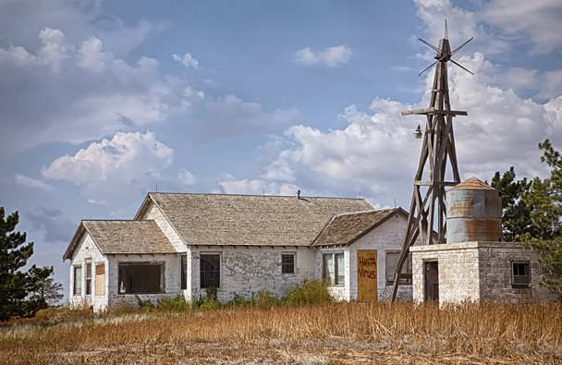
Learning Objective: To explore some of the themes and symbols of the novel
Link to Context
Read and answer the questions on your sheet about ‘The American Dream’.

Slide 16
Learning Objective: To explore some of the themes and symbols of the novel
Do you think that the dream farm means the same thing to Lennie as it does to George? What does it mean to each of them?
Re-read the following line that comes just after Candy reveals he has the money to buy the ranch: "This thing they had never really believed in was coming true." Do you really think George and Candy believe they will get the ranch?
Why might dreaming and planning be a positive thing, even if those plans ‘gang aft alay’ / often go wrong?
For these characters, dreams and hope what makes life worth living, but they are also dangerous. Why?
Pessimism or Optimism?
Whilst the ending of the novel is an unhappy one, is that the underlying tone of the book? What about the rare relationship between George and Lennie? The majority of the book is about hopefulness and it is this hopefulness that keeps them motivated, regardless of whether their hopes and dreams come true.
 What do you think? Write a brief argument saying whether you think the novel is pessimistic or optimistic.

Slide 17
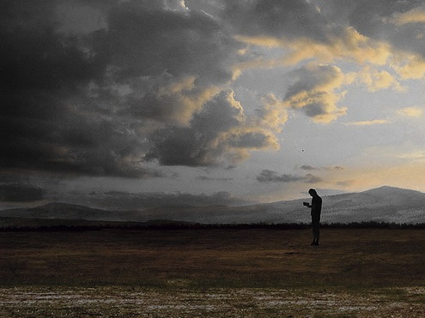
Theme #2 – Loneliness and companionship

Slide 18
Learning Objective: To explore some of the themes and symbols of the novel
Many of the characters in Of Mice and Men are lonely: Curley’s wife, Candy (disregarded through his age) and Crooks (isolated because of his race). George is so afraid of this loneliness that he tells Slim that it is one of the main reasons he looks after Lennie.
Identify the characters and the cause of their loneliness. Organise your ideas in a spider diagram, with ‘loneliness’ in the middle and the characters’ names off the main branches.
When you’ve done that, fill in the table on your worksheet, to explain what the quotations reveal about the characters’ feelings about loneliness, isolation and / or friendship.

Slide 19
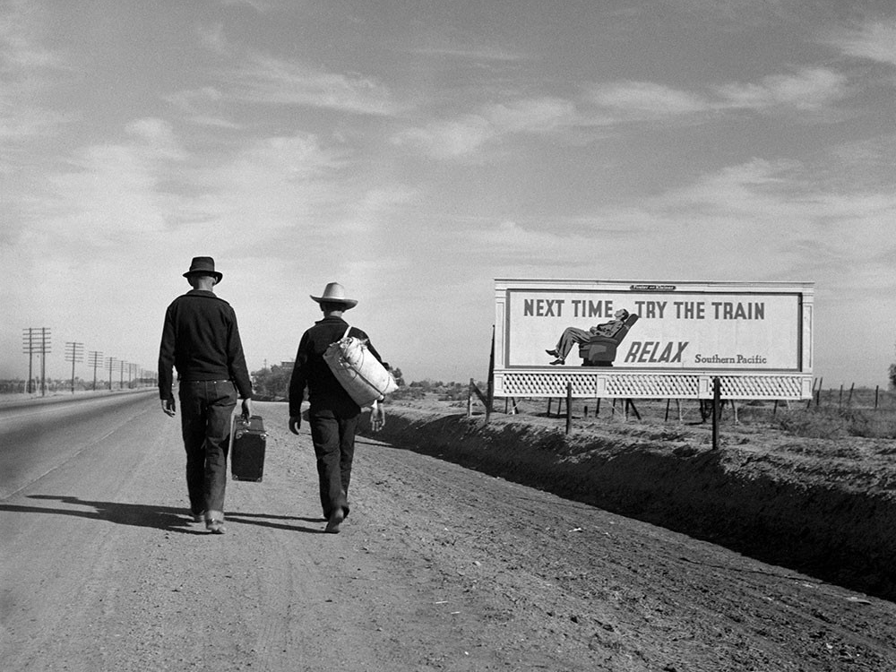
What is an itinerant worker?
How might the lifestyle of an itinerant worker make them feel lonely and isolated?
What would George be like without Lennie?
What would Lennie be like without George?
What was the status of black people and how might this add to Crooks’ isolation?
What was the status of women and how might this add to Curley’s wife’s isolation?
Link to Context

Slide 20
Learning Objective: To explore some of the themes and symbols of the novel
Over to you...
Use the question sheet to help you produce a handout on your theme.
You should include:
Key events and quotes
Links to characters and relationships
Links to context
Friendship
Innocence
Freedom and confinement
Justice
Visions of America
Violence
Prejudice
Weakness
Man and the natural world

Slide 21
Learning Objective: To explore some of the themes and symbols of the novel
‘Of Mice and Men’ is full of symbols. The characters, setting and even objects can be linked to the novel’s context and the ideas that Steinbeck is trying to communicate to his readers.
For example – the ranch represents America in the 1930's.
It has a decent leader (the Boss) who looks out for his men and provides decent accommodation. He questions George closely about his relationship to Lennie and it is clear that he will not tolerate George taking Lennie's pay off him. "What stake you got in this guy?" The bunkhouse is basic but clean and he employs a swamper to make sure it stays that way. He has compensated Candy for the loss of his hand and he gives the ranch workers whiskey at Christmas.
However, the Boss will retire soon and hand the ranch over to his son. He is a different type of man altogether. He is selfish and egotistical and a bully. He will sack Candy and not have so much respect for the men. Life in any country (or ranch) depends on its leader. Hard times are tolerable if the person in charge is doing their best and is fair and caring. In the 1930's America was recovering from the Wall Street Crash. Having a President who was fully committed to the welfare of the people was essential.

Slide 22
Learning Objective: To explore some of the themes and symbols of the novel
The men on the ranch represent
the development of an itinerant worker
Whit is young and still has hope and enthusiasm - he still enjoys things - like going into town to Old Suzy's and finding a letter from a 'friend' in a magazine. Eventually he will become hardened like Carlson.
Carlson isn't mean - he doesn't want to "fight all the time" but he protects himself: physically with the luger, and mentally by not engaging with the feelings of others. There's a reason why Steinbeck gives him the last line of the book. Carlson sees George has had to kill his best friend, and he doesn't understand what the big deal is. He has the same attitude to Lennie as Curley's wife does to the dead puppy - the whole country's "full of mutts" and you can just get another one.
Steinbeck is commenting on a society where everyone is so consumed with making ends meet that feelings are forgotten. Eventually the men end up like old Candy - alone and facing poverty in old age. Whit becomes Carlson and Carlson becomes Candy.

Slide 23
Learning Objective: To explore some of the themes and symbols of the novel
The dreams of the characters represent
the American Dream
Crooks comments that every ranch worker dreams of owning a piece of land. But by the 1930's the land is all claimed. Small holders (like Crooks father and the old couple George knows) are losing their land because they can't afford to keep it. George and Lennie's dream is not just their dream - it's a common dream. Somewhere to belong.
Curley's wife also dreams, but for her it is Hollywood that calls to her. She is very young and very naive and believes what she sees at the cinema. She does not realise that Hollywood is all about image and that the reality is very different. She covers her face in make up to look like a screen star and marries Curly to spite the mother who she thinks has put paid to her acting career. To use her own word this is of course baloney. The man she met who said she was a 'natural' was spinning her a line. Hollywood at the time was booming - America needed escapism from the reality of life and Curly's wife is no different.

Slide 24
Learning Objective: To explore some of the themes and symbols of the novel
Curley’s wife represents
the position of women in the 1930s
Attitudes to women in America at the time were complex. In the movies, women were glamorous and attractive. They were cheerful in the face of adversity and sang their way through their troubles. If they were wives and mothers then they were perfect in every way. Women were the moral guardians of America. However, the men on the ranch distrust Curley's wife. She makes the mistake of stepping out of her domestic box and behaving in a way which they see as flirtatious. Their fear is not without foundation - men who get involved with other men's wives (like Andy Cushman) can end up in a lot of trouble. There's a reason why George says "You give me a good whore house every time...A guy can go in an' get drunk and get ever'thing outa his system all at once, an' no messes."
The prostitutes that Whit talks about to George represent another reality of America at the time. For many women, "respectable" jobs are few and far between. For poorly educated girls, prostitution represented a way of earning fairly decent money. There are, and were brothels in every town and they were frequented by all sorts of men. Even respectable men indulge in gambling and "tarts".

Slide 25
Learning Objective: To explore some of the themes and symbols of the novel
Crooks represents
attitudes towards race in the 1930s
The Jim Crow laws at the time meant that segregation for blacks and whites was commonplace and not questioned. In fact, Crooks being a "nigger" explains everything as far as Candy is concerned. Crooks' room is private, but it is actually the harness room attached to the barn. His bed is a wooden box filled with straw (bought for the horses). He sits on kegs (barrels) which nails are stored in. Even his light is second class "a meagre yellow light". Crooks has few rights as a black man which is why he hangs on tight to the ones he has "even if he don't like 'em". If black people appeared in films they were jolly and smiling and a little bit dim - they sang and danced or they were prortrayed as domestic servants. Steinbeck's portrayal of Crooks as the physically and psychologically damaged victim of Curley's wife's cruelty is very far from this stereotype.

Slide 26
Learning Objective: To explore some of the themes and symbols of the novel
Can you think of any other symbols in the novel?
You could consider:
Chapter 1: "A water snake slipped along on the pool, its head held up like a little periscope.“
Chapter 4: "...a mauled copy of the California civil code for 1905.“
Chapter 5: "...over the pile hung the four-taloned Jackson fork suspended from its pulley"
The snake = the serpent in the garden of Eden. The wilderness is represented as a perfect place, so the presence of the snake is perhaps to remind us that things can and will go wrong. Remember, it gets eaten by a heron at the end!
California civil code = set out that a) all men are equal; b) that black people can vote; c) that mixed-race marriage is illegal. It represents Crooks’ status: supposedly equal but not really. To vote, black people had to prove that they could read. The book is therefore also a symbol of Crooks’ intelligence and determination to claim his rights.
The fork = a large and potentially dangerous piece of equipment, hanging over the pile of hay where Curley’s wife will eventually be killed. If you compare it to the sword of Damocles, the message becomes clear – it’s only a matter of time before disaster strikes.

