Slide 1
Learning Objective To study Chapter 6 of the novel

Slide 2
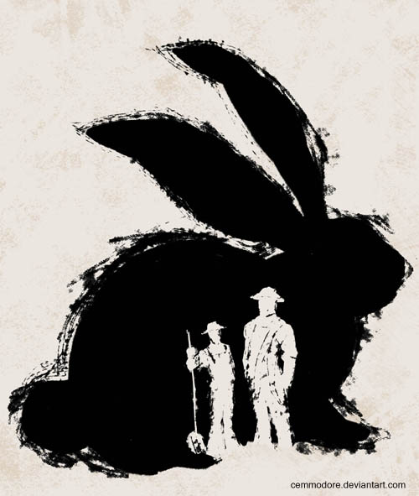
Learning Objective: To study Chapter 6 of the novel
The Ending
Where does this chapter take place? When were we last here?
How is Lennie’s vision of Aunt Clara and the giant rabbit fitting with his childlike simplicity?

Slide 3
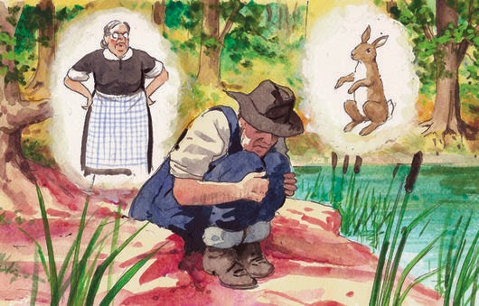
Learning Objective: To study Chapter 6 of the novel
What do you think they represent?

Slide 4
Learning Objective: To study Chapter 6 of the novel
Giant Rabbit - represents the fear that George will harm him or abandon him. At first, the rabbits were a soft animal that he loved, now they haunt him.
Aunt Clara - is a domineering mother figure that disapproved of how much trouble he has caused. This further strengthens his fears. Both together reinforce Lennie's fears that he is a burden to George and is better off living alone and in isolation.
Why do you think Steinbeck included this scene? It is our first and only time ‘inside’ Lennie’s head. Why now?

Slide 5
Learning Objective: To study Chapter 6 of the novel
Read from: 'George came quietly out of the brush …’ to the end of the novel.
The pool by the river is the place where Lennie and George’s story begins and ends. It is a safe sanctuary and a place free from the prejudices of the rest of the world, where Lennie and George can be themselves. This is where the story was born, and also where the dream farm and Lennie meet their end.
Although the first chapter and the last chapter share the same setting, there are some obvious differences between the two chapters.
Fill out your Venn Diagram to illustrate these differences and similarities.
What is the significance of these?

Slide 6
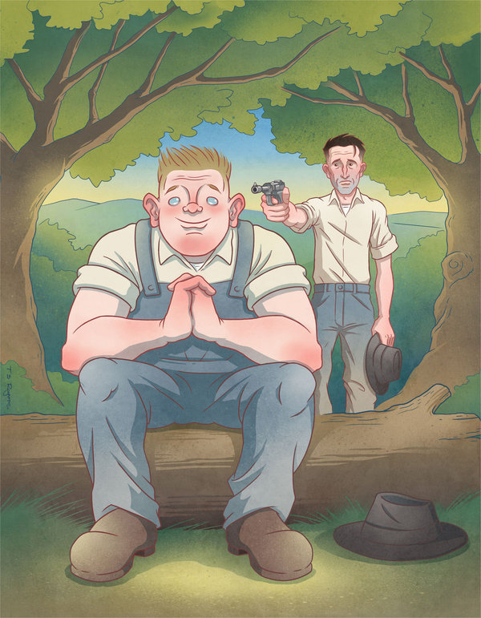
Learning Objective: To study Chapter 6 of the novel
1. Why does Steinbeck begin and end the novella in the same place?
2. In Chapter 1, Steinbeck mentions a heron, rabbits and other animals. What might these images symbolise?
3. In Chapter 6, Steinbeck then describes how a heron kills a water snake. What is the significance of this image? What does it represent? What does it foreshadow?
4. “Ain’t you gonna give me hell?” Why do you think Lennie wants George to do this at this point in the novel? How does Steinbeck present George here?
5. ‘The wind waves flowed up the green pool’. Comment on Steinbeck’s choice of image here, as the men get nearer to George and Lennie.
6. Why do you think George talks about the farm as he shoots Lennie? How does this conclude the theme of ‘dreams’?
7. Comment on Slim’s reaction to what George has done. How is this consistent with his character throughout? Link this to the shooting of Candy’s dog.
Answer the questions you have been given in your book. Be prepared to discuss your answers.

Slide 7
Learning Objective: To study Chapter 6 of the novel
Slim said, “You hadda, George. I swear you hadda. Come on with me.” He led George into the entrance of the trail and up toward the highway.
Curley and Carlson looked after them. And Carlson said, “Now what the hell ya suppose is eatin’ them two guys?”
The last lines of the novel are famous. Think of as many reasons as you can for why Steinbeck chooses to end the novel in this way, and why the ending might fit in so well.
Other key quotes – why?
‘I done another bad thing.’
‘It don’t make no difference,’ George said.
‘He said woodenly, ‘If I was alone I could live so easy.’ His voice was monotonous.’
‘An’ I got you. We got each other, that’s what, that gives a hoot in hell about us.’
‘No, Lennie. I ain’t mad. I never been mad, an’ I ain’t now. That’s a thing I want ya to know.’

Slide 8
Learning Objective: To study Chapter 6 of the novel
How do you feel about George’s decision to shoot Lennie? Was it the right thing to do?

