Slide 1
Learning Objective To study Chapter 10 of the novel

Slide 2
Learning Objective: To study Chapter 10 of the novel

Slide 3
Learning Objective: To study Chapter 10 of the novel
With the plot of the story at an end and the explanation of Jekyll’s dual identity revealed, it may be tempting to overlook this chapter as a mere summary – it isn’t! The chapter explores the novel’s key themes and it is impossible to fully appreciate Stevenson’s structure without matching the details occurring here with those seen earlier.
This is a complex chapter and a challenge – to help us get to grips with it, we’re going to break it up into chunks.

Slide 4
Learning Objective: To study Chapter 10 of the novel
You have been given a number 1-6. You will gather with the other people with your number to work on an extract, before reporting back to your ‘home’ table and sharing your findings with them.
1. Read your extract in your study group and work together to understand what Jekyll is saying and to complete the second task on the sheet.
2. Make notes on your copy of the text, remembering that you will be sharing your ideas with your home table later on.
3. Return home and be prepared to explain what you found out!

Slide 5
Learning Objective: To study Chapter 10 of the novel
Group 1: Find words and phrases meaning ‘two’ or ‘doubles’. What ideas do they express about duality in human nature?

Slide 6
Learning Objective: To study Chapter 10 of the novel
Group 2: Look at language describing the first mixture and transformation. How does it show Jekyll’s pleasure in evil?

Slide 7
Learning Objective: To study Chapter 10 of the novel
Group 3: Identify important aspects of Hyde’s appearance. What do they show about the balance between good and evil?

Slide 8
Learning Objective: To study Chapter 10 of the novel
Group 4: Identify metaphors and similes of concealment. How do they express Jekyll’s confidence in the role of Hyde?

Slide 9
Learning Objective: To study Chapter 10 of the novel
Group 5: Identify questions expressing confusion. What do they suggest about the danger of losing control?

Slide 10
Learning Objective: To study Chapter 10 of the novel
Group 6: How are metaphors and similes used to express ideas about temptation and willpower?

Slide 11
Learning Objective: To study Chapter 10 of the novel
Let’s read the rest together…

Slide 12
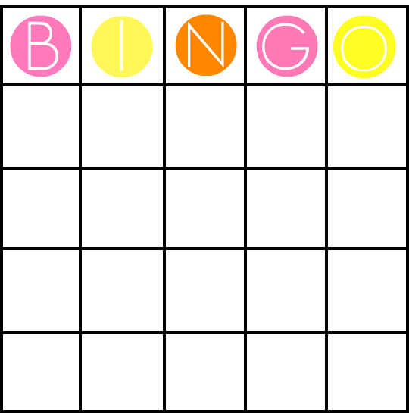
Learning Objective: To study Chapter 10 of the novel
Be the first to find the chapter where each of the following events mentioned in Jekyll’s statement is first mentioned. If you’re the first, you can cross it off. Get four in a row, and it’s BINGO!
= free space!

Slide 13
Learning Objective: To study Chapter 10 of the novel
Be the first to find the page number for each of the following events mentioned in Jekyll’s statement. If you’re the first, you can cross it off. Get four in a row, and it’s BINGO!
Jekyll acquired a mirror for his room.
(Chapter 8)
= free space!

Slide 14
Learning Objective: To study Chapter 10 of the novel
Be the first to find the page number for each of the following events mentioned in Jekyll’s statement. If you’re the first, you can cross it off. Get four in a row, and it’s BINGO!
He employed a suitable housekeeper for the house he rented in Hyde’s name.
(Chapter 4)
= free space!

Slide 15
Learning Objective: To study Chapter 10 of the novel
Be the first to find the page number for each of the following events mentioned in Jekyll’s statement. If you’re the first, you can cross it off. Get four in a row, and it’s BINGO!
Jekyll told his servants that Hyde was free to visit his house.
(Chapter 2)
= free space!

Slide 16
Learning Objective: To study Chapter 10 of the novel
Be the first to find the page number for each of the following events mentioned in Jekyll’s statement. If you’re the first, you can cross it off. Get four in a row, and it’s BINGO!
Jekyll opened a bank account in Hyde’s name.
(Chapter 4)
= free space!

Slide 17
Learning Objective: To study Chapter 10 of the novel
Be the first to find the page number for each of the following events mentioned in Jekyll’s statement. If you’re the first, you can cross it off. Get four in a row, and it’s BINGO!
Jekyll became smaller when he changed into Hyde.
(Chapters 2, 4 or 8)
= free space!

Slide 18
Learning Objective: To study Chapter 10 of the novel
Be the first to find the page number for each of the following events mentioned in Jekyll’s statement. If you’re the first, you can cross it off. Get four in a row, and it’s BINGO!
When in the role of Hyde, Jekyll noticed that other people found his presence disturbing.
(Any!)
= free space!

Slide 19
Learning Objective: To study Chapter 10 of the novel
Be the first to find the page number for each of the following events mentioned in Jekyll’s statement. If you’re the first, you can cross it off. Get four in a row, and it’s BINGO!
Jekyll murdered Carew.
(Chapter 4)
= free space!

Slide 20
Learning Objective: To study Chapter 10 of the novel
Be the first to find the page number for each of the following events mentioned in Jekyll’s statement. If you’re the first, you can cross it off. Get four in a row, and it’s BINGO!
Jekyll destroyed the key for the back door of his house which he used as Hyde by grinding it under his foot.
(Chapter 8)
= free space!

Slide 21
Learning Objective: To study Chapter 10 of the novel
Be the first to find the page number for each of the following events mentioned in Jekyll’s statement. If you’re the first, you can cross it off. Get four in a row, and it’s BINGO!
He stuck to his resolution to stay as Jekyll for two months.
(Chapter 6)
= free space!

Slide 22
Learning Objective: To study Chapter 10 of the novel
Be the first to find the page number for each of the following events mentioned in Jekyll’s statement. If you’re the first, you can cross it off. Get four in a row, and it’s BINGO!
Hyde wrote blasphemies in religious books.
(Chapter 6)
= free space!

Slide 23
Learning Objective: To study Chapter 10 of the novel
Be the first to find the page number for each of the following events mentioned in Jekyll’s statement. If you’re the first, you can cross it off. Get four in a row, and it’s BINGO!
Even when he was Hyde, his handwriting was still Jekyll’s own.
(Chapter 6)
= free space!

Slide 24
Learning Objective: To study Chapter 10 of the novel
Be the first to find the page number for each of the following events mentioned in Jekyll’s statement. If you’re the first, you can cross it off. Get four in a row, and it’s BINGO!
By the end, Jekyll was unable to get the drug he needed.
(Chapter 8)
= free space!

Slide 25
Learning Objective: To study Chapter 10 of the novel
Make sure that you have the right chapters on each box! This will be a valuable revision tool when you are revising structure.

Slide 26
Learning Objective: To study Chapter 10 of the novel
Key Theme: Concealment
By exploring the theme of concealment, Stevenson seems to be suggesting that respectable people keep aspects of their lives secret for fear of losing their reputation or place in society. How does this fit with what we know of Victorian England?
Copy the quotes below into your book. Identify any techniques being used. What connotations do they share?
‘in my impenetrable mantle, the safety was complete’
‘to assume, like a thick cloak, that of Edward Hyde’
‘to shake and pluck back that fleshy vestment’
Mantle: a cloak or shawl; an important role or responsibility
‘the veil of self-indulgence’
Vestment: a ceremonial or official robe

Slide 27
Learning Objective: To study Chapter 10 of the novel
Key Theme: Concealment
The novel suggests that identity is a complex idea. The ‘face’ that people present to the outside world may conceal the different aspects of their personality.
1. Jekyll explains why he wants to separate the two sides to his nature, saying: ‘If each […] could but be housed in separate identities, life would be relieved of all that was unbearable’. What do you think he means by this?
‘…so potently controlled and shook the very fortress of identity’
2. Jekyll describes the freedom he felt when he transformed into Hyde. Copy the following quotations into your book and explain how the metaphors in them create a sense of that freedom.
‘…shook the doors of the prison-house of my disposition’

Slide 28
Learning Objective: To study Chapter 10 of the novel
Key Theme: Concealment
Eventually, Jekyll lives in such fear and hatred of Hyde that he sees him as a separate person. The complexity of his identity as both Jekyll and Hyde is shown when he uses both a first-person and a third-person narrative.
‘I ran to the house in Soho, and […] destroyed my papers; thence I set out through the lamplit streets […] gloating on my crime […] still hearkening in my wake for the steps of the avenger. Hyde had a song upon his lips as he compounded the draught, and as he drank it, pledged the dead man.’
2. What do you think these grammatical shifts show about:
a) Jekyll’s state of mind
b) Ideas about identity?
1. Identify the different narrative voices in this extract.

Slide 29
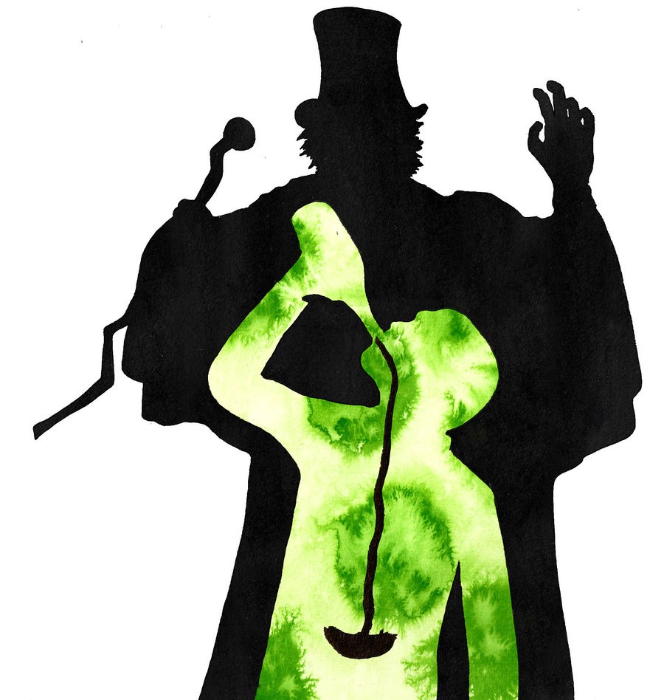
Learning Objective: To study Chapter 10 of the novel
Put together a presentation on the representation of good and evil in the novel. Use the planning sheet to help you prepare.

