Slide 1
Learning Objective To study Chapter 9 of the novel

Slide 2
Learning Objective: To study Chapter 9 of the novel

Slide 3
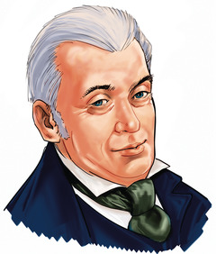
Learning Objective: To study Chapter 9 of the novel
Lanyon’s testimony
Dr Lanyon’s testimony eventually provides an explanation of the mystery, but Stevenson maintains suspense all the way through it. Match the events in your table with a quotation from the text. The first one is done for you.

Slide 4
Learning Objective: To study Chapter 9 of the novel
‘if you fail me tonight I am lost’
‘Upon the reading of this letter, I made sure my colleague was insane’
‘The butler was awaiting my arrival; he had received by the same post as mine a registered letter of instruction’
‘All this, though it whetted my curiosity, told me little that was definite’
‘If his messenger could go to one place, why could he not go to another?’
‘I loaded an old revolver, that I might be found in some posture of self-defence’
‘…searching backward glance into the darkness of the square. There was a policeman […] I thought my visitor started and made great haste’
‘I had never set eyes on him before’
‘there was something abnormal and misbegotten in the very essence of the creature that now faced me’

Slide 5
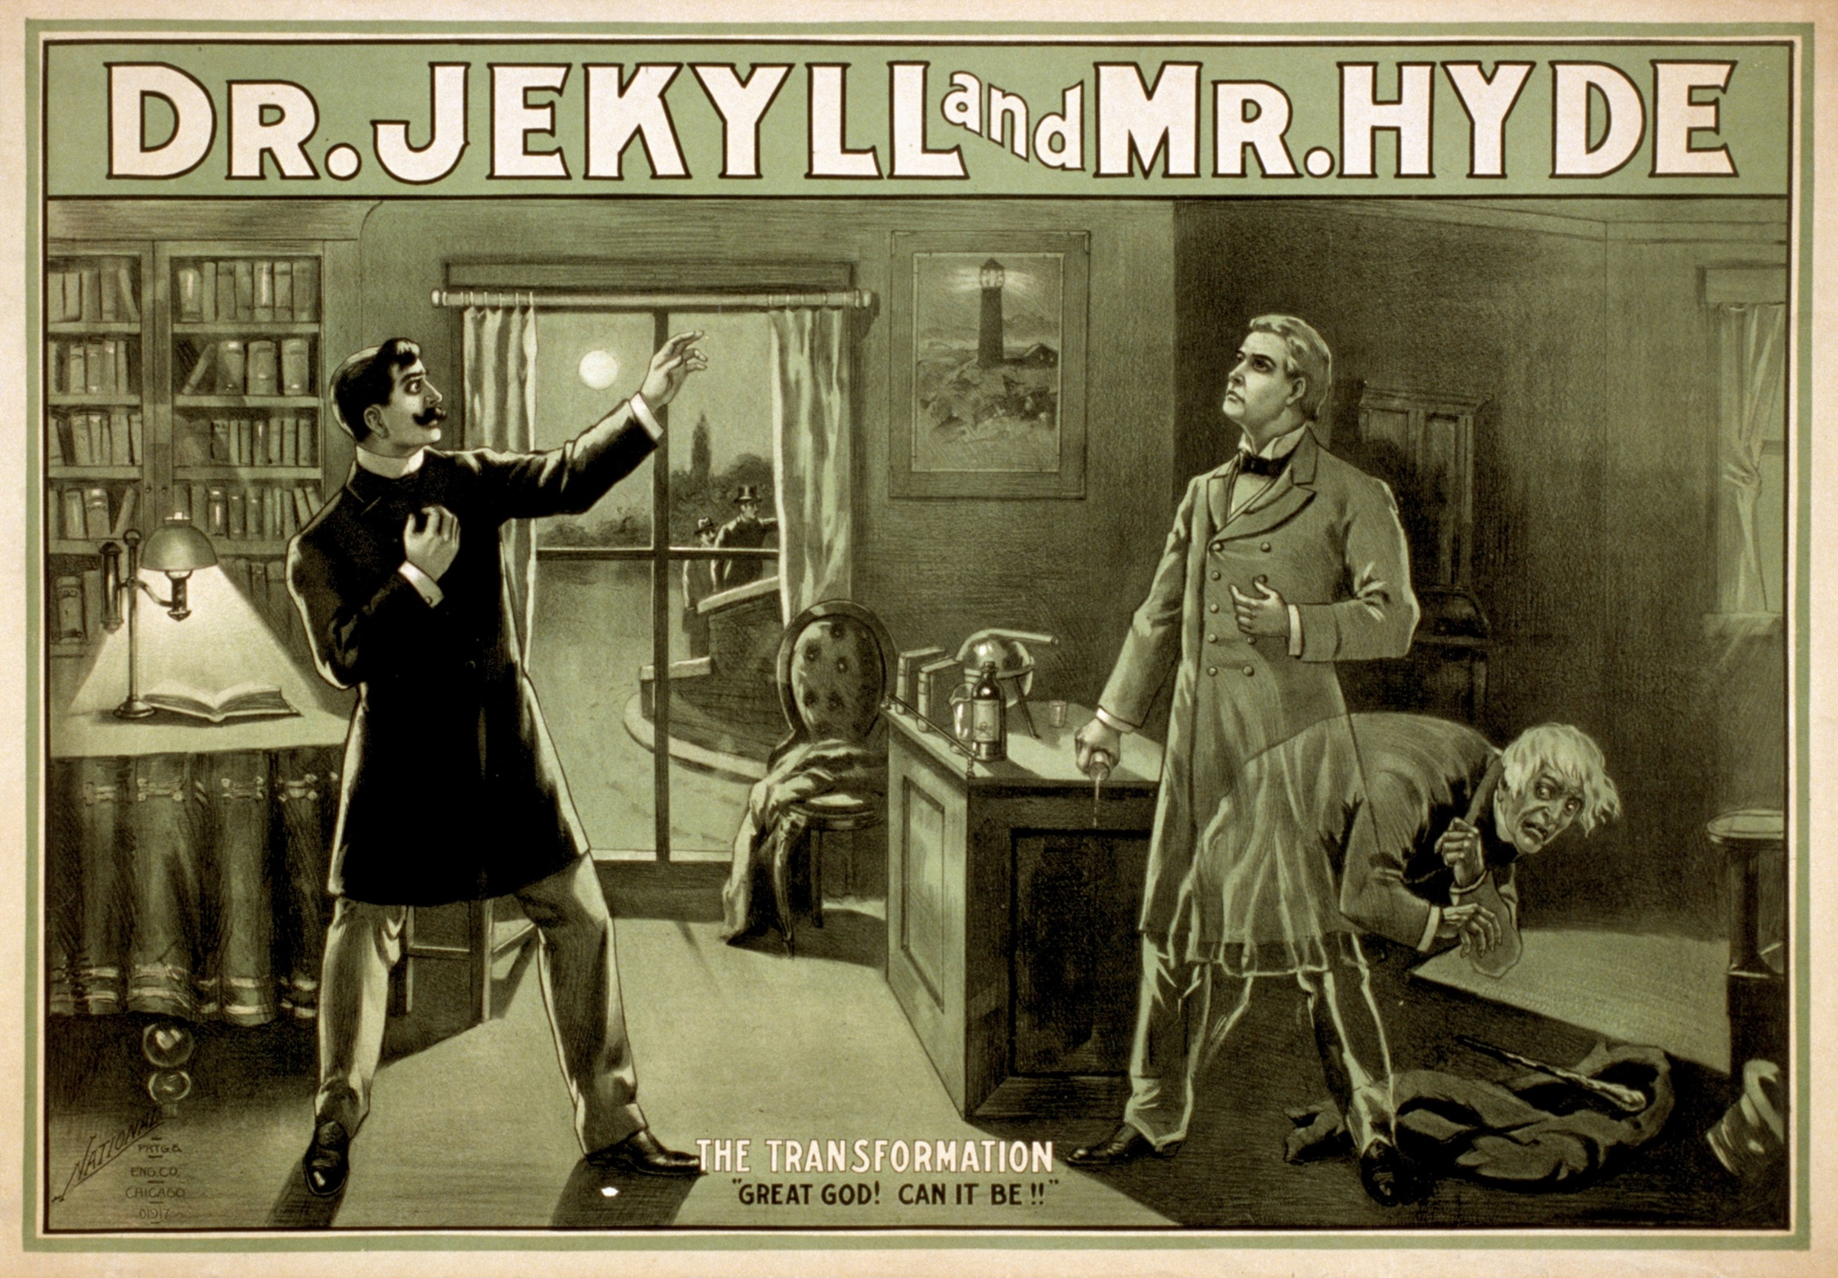
Learning Objective: To study Chapter 9 of the novel
How does Stevenson create a dramatic revelation in this passage?
Let’s prepare together.

Slide 6
Learning Objective: To study Chapter 9 of the novel
How does Stevenson create a dramatic revelation in this passage?
Lanyon shows both confusion and concern from the moment he receives Jekyll’s letter to the point where the visitor mixes the chemicals. Stevenson heightens the drama by making the stranger pause, put down the chemicals and ask Lanyon to choose whether or not to stay to see what happens:
‘Will you be wise? will you be guided? will you suffer me to take this glass in my hand and to go forth from your house without further parley? or has the greed of curiosity too much command of you? Think before you answer, for it shall be done as you decide. As you decide, you shall be left as you were before, and neither richer nor wiser, unless the sense of service rendered to a man in mortal distress may be counted as a kind of riches of the soul. Or, if you shall so prefer to choose, a new province of knowledge and new avenues to fame and power shall be laid open to you, here, in this room, upon the instant; and your sight shall be blasted by a prodigy to stagger the unbelief of Satan.’

Slide 7
Learning Objective: To study Chapter 9 of the novel
‘Will you be wise? will you be guided? will you suffer me to take this glass in my hand and to go forth from your house without further parley? or has the greed of curiosity too much command of you? Think before you answer, for it shall be done as you decide. As you decide, you shall be left as you were before, and neither richer nor wiser, unless the sense of service rendered to a man in mortal distress may be counted as a kind of riches of the soul. Or, if you shall so prefer to choose, a new province of knowledge and new avenues to fame and power shall be laid open to you, here, in this room, upon the instant; and your sight shall be blasted by a prodigy to stagger the unbelief of Satan.’
1. What do you notice about the sentences the visitor uses? How do they create suspense?
2. What do you think the visitor means by the ‘greed of curiosity’? [Hint: how might the bolded words appeal to Lanyon?]
3. Identify the following persuasive devices in the visitor’s speech:
Rhetorical questions
Direct address to the listener (‘you’)
Metaphor
Appeal to emotions
4. Why has Stevenson included this speech?

Slide 8
Learning Objective: To study Chapter 9 of the novel
How does Stevenson create a dramatic revelation in this passage?
Short descriptive phrases provide lots of information before the reader knows who is being described
Repetition for emphasis
Dashes create the impression of natural speech, as Lanyon breaks his sentence up with vivid detail
"O God!" I screamed, and "O God!" again and again; for there before my eyes--pale and shaken, and half fainting, and groping before him with his hands, like a man restored from death--there stood Henry Jekyll!’
A simile makes the transformation seem other-worldly
The writer delays the subject of the sentence until the end to heighten tension.

Slide 9
Learning Objective: To study Chapter 9 of the novel
How does Stevenson create a dramatic revelation in this passage?
?
?
?
And now, you who have so long been bound to the most narrow and material views, you who have denied the virtue of transcendental medicine, you who have derided your superiors--behold!"
?
?
Look for:
Repetition of you
Description of someone with status
Dash
Exclamation mark

Slide 10
Learning Objective: To study Chapter 9 of the novel
How does Stevenson create a dramatic revelation in this passage?
You have 35 minutes.

Slide 11
One of the ways Stevenson... Another way... The transformation is also shown to be... The writer suggests... When the visitor is first described...
Q
}
W
E
This is shown when it says, “___”... An example of this is when Stevenson writes, “___”... For example, “___”
R
This makes the reader think... This suggests to the reader... The reader will think... This implies... This suggests...
T
The word order of this sentence suggests... The writer’s word choice... The simile “___”... The repetition of... This word has strong connotations of...
Y
This suggests... This implies... This links to...

Slide 12
Peer-Assess: WWW/ EBI
Band 6
Critical/exploratory response to task
Precise references used to support interpretation
Analysis of writer’s methods and their effects on the reader, with subject terminology used accurately
Exploration of contextual factors
How well has (s)he:
Responded to the question?
Used relevant quotes?
Analysed the effect of the writer’s methods?
Explored the effect on the reader?
Included contextual references?
Band 5
Thoughtful/developed response to task
Apt references integrated into interpretations
Examination of writer’s methods and their effects on the reader, with subject terminology used effectively
Thoughtful consideration of contextual factor
Band 4
Clear/explained response to task
Effective use of references to support explanation
Clear explanation of writer’s methods and their effects on the reader, with relevant subject terminology
Clear understanding of contextual factors

Slide 13
Response to feedback:
Band 6
Critical/exploratory response to task
Precise references used to support interpretation
Analysis of writer’s methods and their effects on the reader, with subject terminology used accurately
Exploration of contextual factors
Add to, change or extend one idea in your work in response to your partner’s feedback.
Band 5
Thoughtful/developed response to task
Apt references integrated into interpretations
Examination of writer’s methods and their effects on the reader, with subject terminology used effectively
Thoughtful consideration of contextual factor
Band 4
Clear/explained response to task
Effective use of references to support explanation
Clear explanation of writer’s methods and their effects on the reader, with relevant subject terminology
Clear understanding of contextual factors

