Slide 1
Learning Objective To understand the context of the novel ‘Jekyll and Hyde’

Slide 2
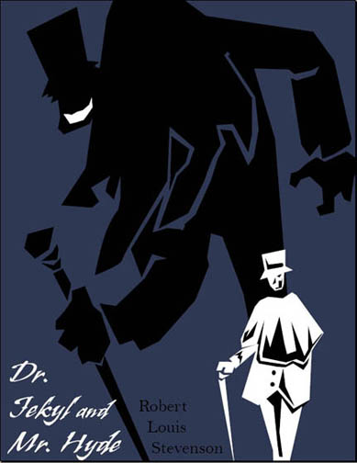
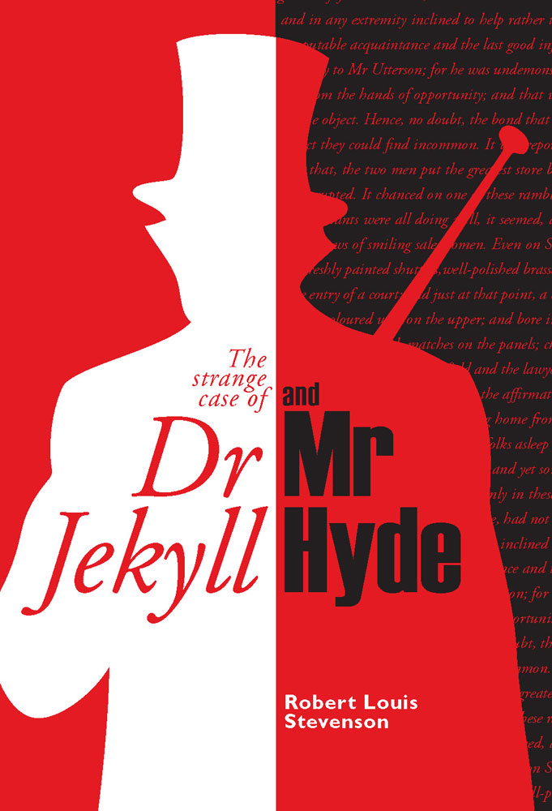
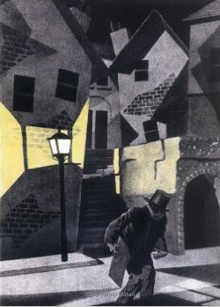
What inferences can you make about the novel, based on the three front covers above?

Slide 3
Learning Objective: To understand the context of the novel ‘Jekyll and Hyde’
Why is context important?
It is important to study the period, both in time and place, in which texts are written in order to fully understand and appreciate them.
In addition to the author’s personal views and beliefs, many events and attitudes from the period will have influenced the content, plot and themes of the novella. So, to fully understand The Strange Case of Dr Jekyll and Mr Hyde you will need to understand what happened in the run up to and time of the novel.

Slide 4
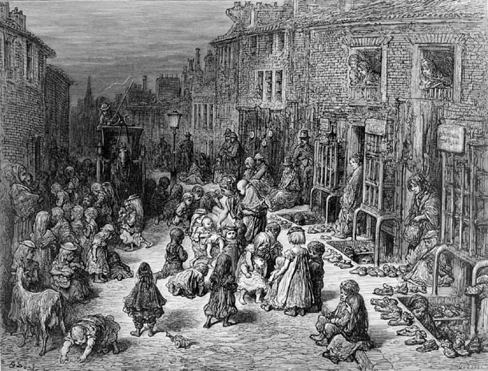
What do we know about Victorian London?

Slide 5
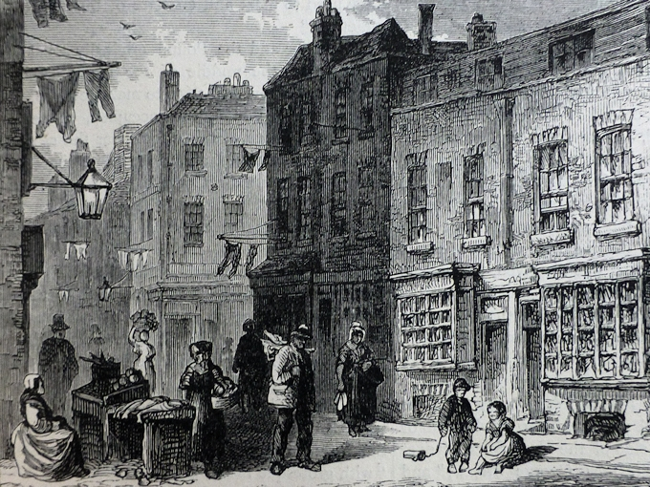
What do we know about Victorian London?

Slide 6
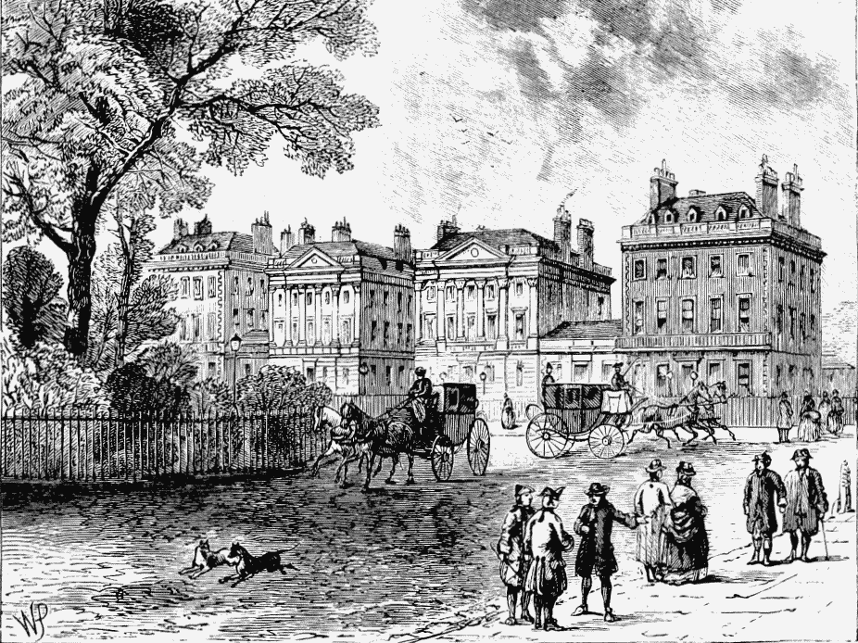
What do we know about Victorian London?

Slide 7
What do we know about Victorian London?
Use the packs of information on your tables to fill in your context sheets.
You will fill in any gaps for homework, so use your time wisely!

Slide 8
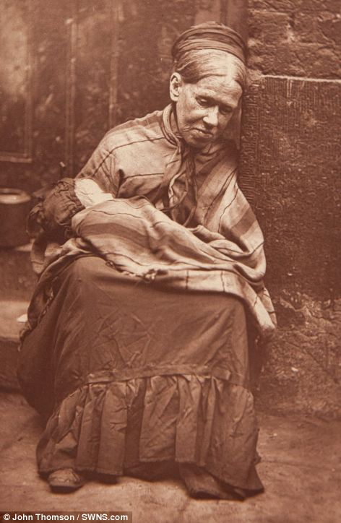
Old 'Scotty‘ had been the wife of a wealthy man who spent all his money before dying, leaving her peniless and one of London's 'crawlers' (beggars). She told John Thomson: 'I am becoming more accustomed to it now... What, however, I cannot endure, is the awful lazy, idle life I am forced to lead; it is a thousand times worse than the hardest labour, and I would much rather my hands were cut, blistered, and sore with toil, than, as you see them, swollen, and red, and smarting from the exposure to the sun, the rain, and the cold'

Slide 9
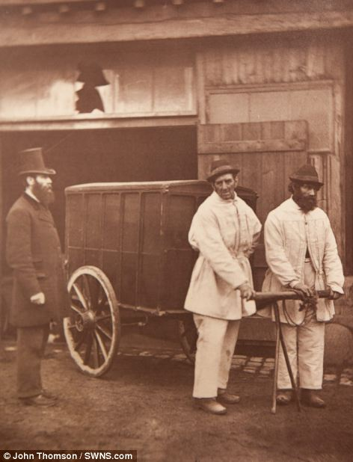
Public 'disinfectors' earned the princely sum of sixpence an hour for disinfecting houses and removing contaminated clothing and furniture - mites and lice were the usual culprits. The book's authors note that 'these are such busy times that [disinfectors] often work twelve hours a day'.

Slide 10
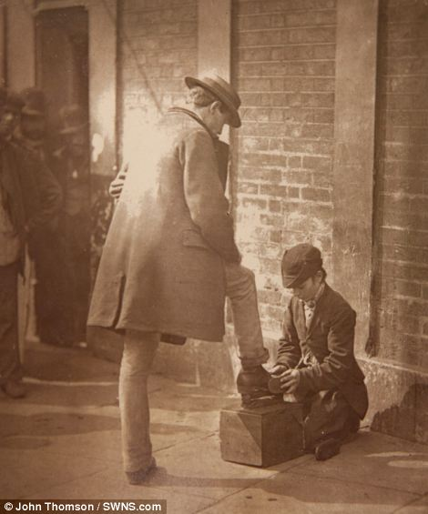
While the boy cleaning shoes in the photo looks barely a teenager, by the time this photo was taken he had served in two brigades, sailed the oceans as a sailor, and was now an 'independent shoe-black' to support his mother and invalid father with a few pence cleaning boots.

Slide 11
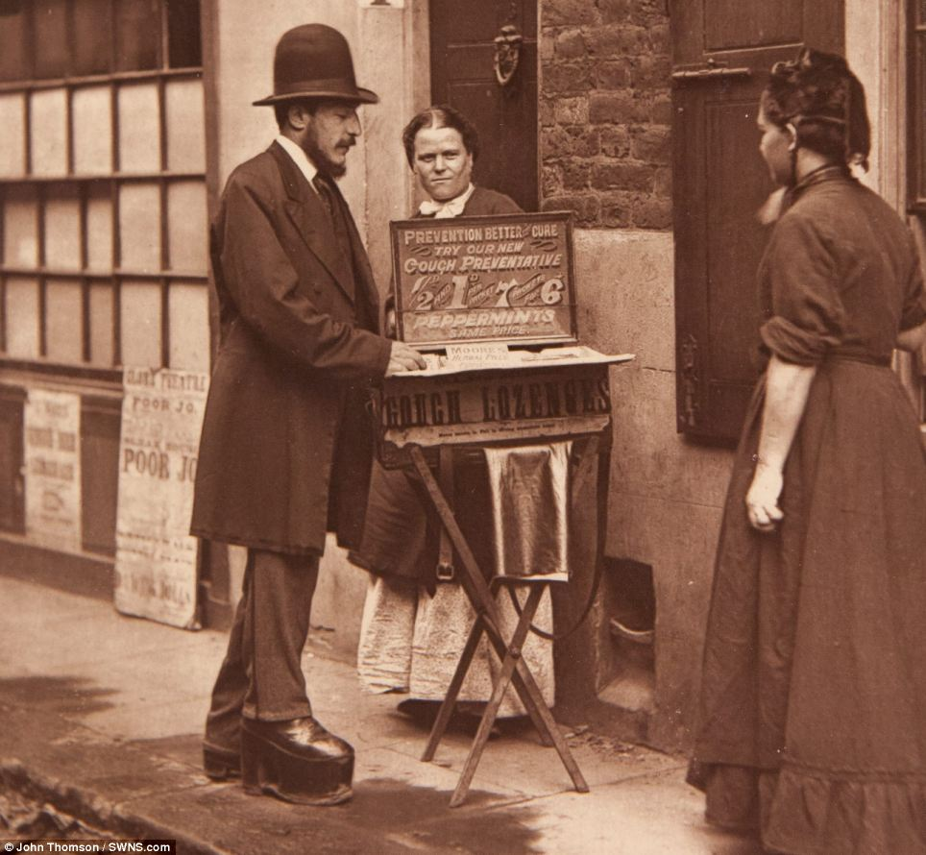
The 'street doctor' in this photo lost his job as a driver due to a degenerative eye disease. After spending months in hospitals, he met a man selling ointment that led to his eyesight gradually returning. The ointment seller set the man up in business. The man told Thomson and Smith: 'I had no money, but he gave me everything on trust. It was a good thing for both of us, because I was a sort of standing advertisement for him and for myself'

Slide 12
True or false?
Stevenson was born in London.

Slide 13
True or false?
The Victorian era gets its name from King Victor, who ruled over the time period.

Slide 14
True or false?
Gothic literature features dark and mysterious settings, overcast with fog.

Slide 15
True or false?
Darwin’s theory of evolution was published in 1859 and stated that humans evolved from other animals.

Slide 16
True or false?
Gentlemen in the Victorian era were obsessed with their reputations.

Slide 17
True or false?
Victorian gentlemen were encouraged to show their emotions openly.

Slide 18
True or false?
Victorian gentlemen would openly visit working class areas of London, such as Soho.

Slide 19
True or false?
Jack the Ripper killed five prostitutes before he was caught and convicted of the murders.

Slide 20
True or false?
Romanticism states that the imagination is useless.

Slide 21
True or false?
Stevenson died at the age of 72.

Slide 22
Learning Objective: To understand the context of the novel ‘Jekyll and Hyde’
How was Victorian Britain dissimilar to Britain today?

Slide 23
Learning Objective: To understand the context of the novel ‘Jekyll and Hyde’
The following paintings show disturbed states of mind.
Describe each one as fully as possible – what state of mind is it depicting?
What might each one be named?

Slide 24
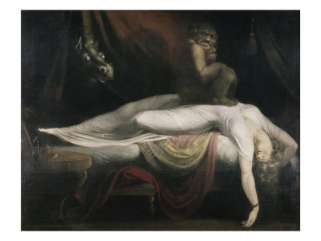
The Nightmare 1781 by Henry Fuseli

Slide 25
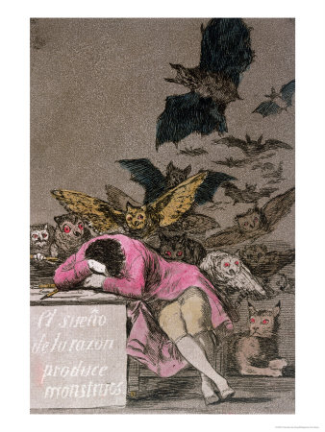
The Sleep of Reason Produces Monsters by Francisco Goya

Slide 26
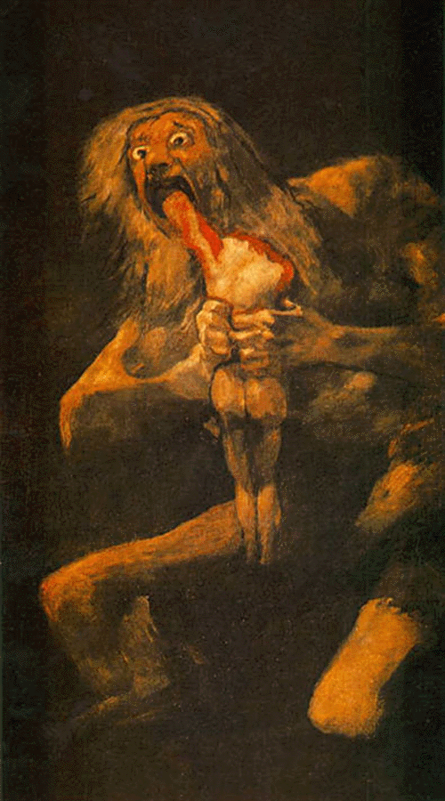
Saturn Devouring One of His Children 1819-1823 by Francisco Goya

Slide 27
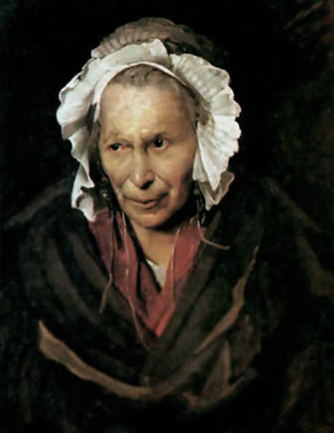
Insane Woman (Envy) 1822-1823 by Theodore Gericault

Slide 28
Victorian Painters
They were interested in all aspects of fantasy: imagination, dreams, nightmares, the infernal, and the macabre. They explored what happens when the human mind goes into the darker side of consciousness or when reason is asleep. For example, the Romantic artist, Theodore Gericault, was interested in the irrational states of the human mind and the idea that the mind affected the physical appearance of a person. He created many studies of the mentally ill and criminally insane.

Slide 29
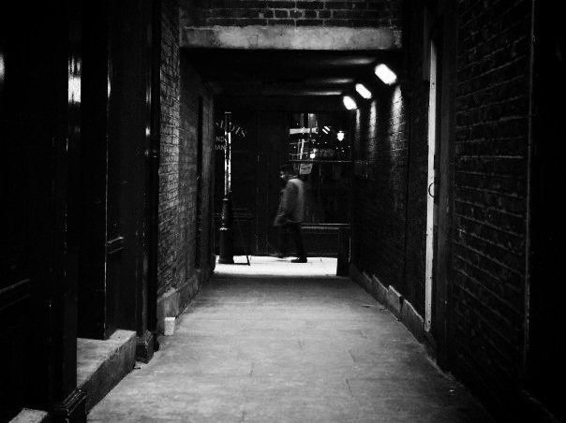
Read ‘An Autumn Evening in Whitechapel’ – a real Victorian newspaper article published in 1888.
Underline any language which suggests an ‘underworld’ or dark side to London.

Slide 30
Re-read from ‘Turn down…’

Slide 31
Turn down this side street out of the main Whitechapel Road. It may be well to tuck out of view any bit of jewellery that may be glittering about; the sight of means to do ill-deeds makes ill-deeds done. The street is oppressively dark, though at present the gloom is relieved somewhat by feebly lighted shopfronts. Men are lounging at the doors of the shops, smoking evil-smelling pipes. Women with bare heads and with arms under their aprons are sauntering about in twos and threes, or are seated gossiping on steps leading into passages dark as Erebus.
Now round the corner into another still gloomier passage, for there are no shops here to speak of. This is the notorious Wentworth Street. The police used to make a point of going through this only in couples, and possibly may do so still when they go there at all. Just now there are none met with. It is getting on into the night, but gutters, and doorways, and passages, and staircases appear to be teeming with children. See there in that doorway of a house without a glimmer of light about it. It looks to be a baby in long clothes laid on the floor of the passage, and seemingly exhausted with crying. Listen for a moment at this next house. There is a scuffle going on upon the staircase - all in the densest darkness - and before you have passed a dozen yards there is a rush down-stairs and an outsurging into the street with fighting and screaming, and an outpouring of such horrible blackguardism that it makes you shudder as you look at those curly-headed preternaturally sharp-witted children who leave their play to gather around the mêlée.
God help the little mortals! How can they become anything but savages, “pests of society,” the “dangerous classes,” and so on? How black and unutterably gloomy all the houses look! How infinitely all the moral and physical wretchedness of such localities as these is intensified by the darkness of the streets and the houses.

Slide 32
Choose a task:
1. How does the writer use language to suggest an ‘underworld’ or dark side to London?
OR
2. Write a descriptive account of a walk through Whitechapel.

Slide 33
Using the mark schemes, assess your partner’s work for vocabulary and sentence variety.
Peer Assess: WWW/EBI

Slide 34
AO2
Explain, comment on and analyse how writers use language and structure to achieve effects and influence readers, using relevant subjects terminology to support their views.
How does the writer use language to suggest an ‘underworld’ or dark side to London?
Level 4 Perceptive, Detailed 10-12 marks | Shows detailed and perceptive understanding of language • Analyses the effects of the writer’s choices of language • Selects a range of judicious examples • Uses sophisticated subject terminology accurately
Level 3 Clear, relevant 7-9 marks | Shows clear understanding of language • Clearly explains the effects of the writer’s choices of language • Selects a range of relevant examples • Uses subject terminology accurately
Level 2 Some, attempts 4-6 marks | Shows some understanding of language • Attempts to comment on the effect of language • Selects some relevant examples • Uses some subject terminology, not always appropriately
Level 1 Simple, limited 1-3 marks | Shows some understanding of language • Offers simple comment on effect of language • Simple references or examples • Simple mention of subject terminology
Peer Assess: WWW/EBI

Slide 35
‘The Finest Horror Story in our Language’ Learn the spellings and meanings of the following words for a test on Monday next week
Doppelganger - identical double
Juggernaut - Statue of the Hindu god Krishna that is pulled by a chariot and religious devotees throw themselves under it to be killed.
Abominable - adj. horrible
austere - adj. severe, stern
Conflagration - n. raging fire
Demeanour - n. manner/personality
eddy - n. whirlpool
Negligence - n. carelessness
odious - adj. horrid
perplexity - n. confusion
sedulously - adv. tirelessly
sullenness - n. gloominess
Troglodyte - cave-dwelling person

